Slide 1


From Open Textbook to Adaptive Learning
The Possibilities of Doing More with Open
February 2016

Slide 2


From Open Textbook to SmartBook…
Exploration &
Design
Initial
Training
Ongoing
Support
Project Management
A team of Georgia professors builds History in the Making, an OER e-book and print book used across the state
MHE and USG meet and develop a plan to build a low-cost interactive SmartBook
Fall 2015 - Sarah Mergel (lead SME) learns how to use MHE’s Annotate tool through a combination of in-person and virtual trainings
Sarah learns how to tag text, build probes and develop Learning Outcomes
Winter 2015 - Sarah and the MHE team begin the authoring process. The team employs a review process where Sarah provides proactive feedback as well as reviews the created LO’s and probes
Jan ‘16 - the SmartBook launches in four different classrooms at Dalton State
MHE, USG, and Dalton meet regularly to review initial data from the pilot
2
©2016 McGraw-Hill Education. Confidential and proprietary. Not for redistribution.
Notes:
Just under five years ago, I attended my first eCore faculty meeting. At that meeting Marie Lasseter of the USG Faculty Development Office spoke on Open Education Resources. Christy Talley Smith announced eCore would be working with the USG to create an OER for the US History Survey, and she was looking for volunteers. The next thing I knew, I was walking up to say I was interested (anyone who knows me well knows that I volunteer for everything and do not say no). I don’t know what I was thinking…I hadn’t even taught an eCore course yet and even with Marie’s insightful presentation, I didn’t really know what I was getting myself into.
A little over a year and half later, the team had produced a peer-reviewed open textbook, History in the Making. I loved working on the project because it made me a better instructor of the early American survey course and because I knew in the end students struggling with textbook costs would have one less book to worry about when I adopted the open textbook. For the most part, students have liked using the book.
This past fall, Marie Lasseter and Lauren Fancher put me in touch with the McGraw-Hill team to work on a pilot project to develop a SmartBook using History in the Making. The project had two main goals: (1) to learn about instructor and student reaction to the platform, gather feedback to bring back into the McGraw Hill process , and help Affordable Learning Georgia learn about the platform and possible options for the future; and (2) develop a low-cost interactive alternative to the US History I eBook.
From mid-September to mid-December, Matt Haldeman (my co-presenter), Nate Schorr, and I worked on authoring and reviewing the SmartBook content. For each chapter, I highlighted key information in each chapter, and then we worked on tagging text, writing learning objectives as weel as questions to test student understanding of the material, and finally, we tested the student experience. This spring we rolled out the SmartBook through the McGraw-Hill Connect Platform which can be integrated into an LMS. Right now, I am using the book in a face-to-face and hybrid class, and one of my DSC colleagues is using it in one of her hybrid classes—for a total of about 120 students in the pilot. By the end of the semester, we should have a good initial sense of how it works in different types of classes and some comparison between using the SmartBook and not using the SmartBook. Moreover, we will have an opportunity to update learning outcomes and probes based on instructor response, student performance reports, and student challenges

Slide 3
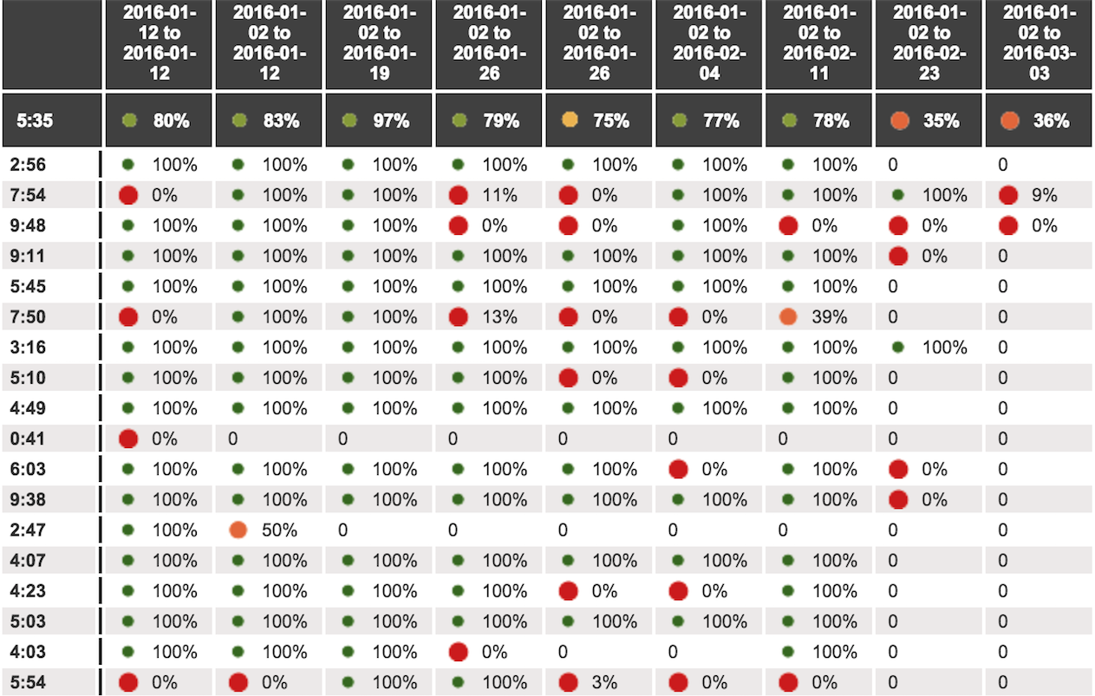
Implementing SmartBook in a U.S. survey course
3
©2016 McGraw-Hill Education. Confidential and proprietary. Not for redistribution.
Notes:
I’ve been using History in the Making in my face-to-face, online, and hybrid classes since 2013. When I adopted the book, I loaded the complete textbook into the Dalton State LMS for students to read online or download. I also placed individual chapters under the reading material for each unit; furthermore, I put links to those chapters on the unit checklists. At the end of the unit the students took an online quiz on the material to help check their understanding of the material. The downside was that I did not have a good sense of what they did not know until after the unit ended; moreover, when it came time to take exams students were simply memorizing information which they quickly forgot (if I judged by basic questions after exams designed to link new material to previous material).
When I adopted the SmartBook for History in the Making, I replaced those online quizzes with chapter review assignments. The assignments are due on the first day of a lesson (each unit of the course has two lessons). Students earn up to fifteen points for each chapter review they complete. The number of points is determined by how much of the review they complete and whether they submit by the deadline. Most of the students are meeting the deadline (though it took a couple of weeks to achieve that). Knowing before I go to class what students do not understand helps me to know what to emphasize in the lecture and discussions for the lesson. I can choose learning objectives and questions I want to bring out in class. When I look at the reports, I am looking for learning objectives that match the themes I emphasize in the lecture because those understanding those objectives will help students prepare for and take exams.
Recently, for material in Chapter Six students were struggling with a question on John Locke’s philosophy of government. I asked students to identify the natural rights Locke mentioned. Then, I brought the question up on the screen in class, and we talked about which answer was correct based on what they read in the book and we discussed in class. I chose to review that question because I know students will see something about Locke’s philosophy on their first exam in a few weeks. I’ve used the questions from the SmartBook as a basis of the exam (and the students know this). I just recently provided a study guide so that students can review and practice the material related to the concepts on the exam. For every chapter, students will see anywhere between thirty to forty questions given the number of learning objectives. The study guide will help narrow the focus a little for the testing environment. I’m anxiously awaiting to see how the students do on the exam.

Slide 4
Do you prefer SmartBook to your traditional textbook?
Student Responses
It…gives practice questions to see if you understand the material.
It’s more engaging and helps me learn better; it’s easy to use.
It allows me to see what material I need to know. I like [the] practice questions.
It’s different from other books.
It’s easier to read [than a print textbook].
I find it easier to use and lighter to carry around.
I feel it helps me engage more in my reading.
It’s more convenient for the modern technology of student’s today.
It is very cool and helpful.
It helps me focus on the material I have a hard time comprehending.
I really enjoy how it checks my learning process.
It asks questions to help you remember the material.
Notes:
About three weeks into the semester, we gave students the opportunity to provide some feedback on their experience using the SmartBook in Connect so far. The response was definitely more positive than negative. This screen provides you with some of the open-ended responses students provided when asked if they preferred the SmartBook to a traditional textbook. Overall, nearly 80 percent (of the 38 respondents who took the survey in the first week) preferred the SmartBook to a traditional print textbook. I’ve only seen one student in my two classes this semester carting around a print copy of the book. With this book, students who prefer a print copy of the book can still get one and use it. Once they’ve read the chapter in a format they are more comfortable with they can complete the online chapter reviews.
In terms of features, just under 44 percent of students liked the highlighting most in terms of studying for the course; just under 39 percent of students like the practice questions in terms of studying for the course. The remaining 18 percent split between the recharge (which retests students on the learning objectives they struggled most with in the review assignment) and the reports (which tells students what learning objectives and questions they found most difficult).
As, I look at these results I am encouraged by the students’ first impressions of the adaptive learning environment. It helps me to meet my students where they are at. They must engage in some active learning not passive absorption of the material. And clearly from the student comments they are getting out of the SmartBook what I hope they will because they are engaging with the course material (and the reports tell me what they do and do not understand.
A few weeks ago, in my face-to-face class I passed out some primary sources for a group discussion on colonial religion. One group, who was struggling with finding the most important content, asked why these readings couldn’t be highlighted like their textbook…They definitely liked that feature of the book.

Slide 5
Initial Finding #1: Learners took different, variables paths to get to overall success, but answered thoughtfully
Average Time to Completion
1:30
Chapter 3
Percent Aware
Awareness | Percent of Student
81% and Over | 25%
71%-80% | 43%
61%-70% | 19%
51%-60% | 11%
50% and Under | 2%
Average = 0:38
0:12
1:32
3:00
Chapter 1
Conclusion
An adaptive course provides flexibility to ensure learners can progress at their own pace. We saw a wide range in terms of time to completion for such a short course. Impressively, we saw very high rates of overall awareness
Average = 0:57
0:15
2:55

Slide 6
Initial Finding #2: There were certain sections of the course where most learners struggled (and others that most found relatively easy)
Most Challenging Learning Objectives
Least Challenging Learning Objectives
Refining & improving the learning resources attached to these LO’s will have the greatest impact in terms of learner knowledge
Building more sophisticated probes that test higher order thinking skills will help challenge learners and ensure they understand applicability of these concepts
Section | Accuracy
Understand the political structure of New Spain (Chapter 3) | 36%
Illustrate how the DWIC controlled trade in the Caribbean (Chapter 3) | 37%
Understand the importance of roads within Anasazi society (C 1) | 44%
Section | Accuracy
Explain the origin and path of tobacco (Chapter 3) | 99%
Recognize the terminology BCE (Chapter 1) | 93%
Describe the impact of horses on the Spanish conquest (Chapter 3) | 89%
How did we teach these concepts? They aren’t resonating with learners, or potentially the questions we are asking to test memory are confusing. How can we dig in and better examine why learners are challenged by these concepts?
Most learners understand these concepts the first time around. This is knowledge that they arriving with. How do we push to take these concepts that most learners already know and apply higher order critical thinking skills?

