Slide 1
Affordable Learning Georgia:
Raising Awareness About How Textbooks Affect Student Success
Information for Campus Stakeholders
2014

Slide 2
Agenda
Textbook Trends and Issues
Supplementary Materials
Affordable Learning Georgia Background
Affordability, Choice, Accessibility
Next Steps

Slide 3
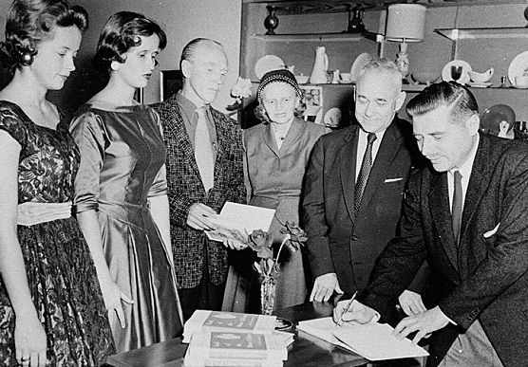
Textbooks
Photograph of signing of the first book published by a faculty member at Georgia College, Milledgeville, Baldwin County, Georgia, 1956. Vanishing Georgia, Georgia Division of Archives and History, Office of Secretary of State. Digital Library of Georgia.
Trends and Issues

Slide 4
Background: Textbooks and Student Success Barriers
According to a study of the U.S. Government Accountability Office, the annual average amount spent by college students on textbooks is 26% of the cost of tuition at a public, four-year university.*
Columbus State University undergraduate students spend a minimum over 4 years of $4500 on textbooks ** and graduate with an average debt of $25,687*** and an average annual student loan payment of $3,715****
SOURCES
* College Textbooks, GAO-05-806, July 2005. U.S. Government Accountability Office.
** Mark Flynn, CSU: Total list price for core courses textbooks = $2,300 - $2,500. For course texts in the major, depending on discipline = $2,300-$4,500 more. The total four years = $4,500-$7,000 depending on the discipline.
*** US News College Report. Columbus State University. ****College Measures. Columbus State University.

Slide 5
Background: Textbooks and Student Success Barriers
Students spend an average of $1200 a year on textbooks. *
65% of students surveyed reported that they had decided against buying a textbook because it was too expensive.***
94% of students surveyed who had decided not to purchase the textbook feared that doing so would hurt their grade. More than 50% of these students felt significant concern for their grade.***
Almost 50% of students surveyed reported that the cost of textbooks impacted how many/which classes they took each semester.***
According to “Turning the Page” a June 2013 report on the textbook market from the Lumina Foundation, “approximately 30 percent of college students do not purchase textbooks required for specific classes.”**
SOURCES:
* Trends in College Pricing. p. 11, 2013-14. The College Board.
** Turning the Page. June 2013. Lumina Foundation
*** Fixing the Broken Textbook Market. January 2014. U.S. PIRG Education Fund and the Student PIRGs

Slide 6
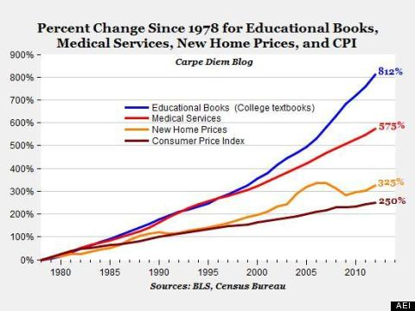
Textbook Price Trends
SOURCE: The college textbook bubble and how the “open educational resources” movement is going up against the textbook cartel. Carpe Diem, December 24, 2012. Mark J. Perry.

Slide 7
Textbook Price Trends
SOURCE: College Textbooks, GAO-13-368, June 2013. U.S. Government Accountability Office.

Slide 8
How Students Get Texts
SOURCE: College Textbooks, GAO-13-368, June 2013. U.S. Government Accountability Office.

Slide 9
How Students Get Texts
SOURCE: Chronicle of Higher Education, Technology, Graphic, January 27, 2013

Slide 10
How Students Get Texts
SOURCE: Chronicle of Higher Education, Technology, Graphic, January 27, 2013

Slide 11
Recent USG OER Adoptions: Student Savings and Impacts
Summer 2013: The first USG-developed electronic Open Textbook, US History I, was published. Partnership with University of North Georgia and faculty from UNG, FVSU, and GPC. Saves students nearly $100 while providing rich and fully sourced content.
SAVINGS:
Adopted for use in USG's eCore History I classes over the Summer and Fall 2013 semesters, saving students more than $44,000.
Summer and Fall 2013 student savings from the use of Open Textbooks in e-Core Calculus I, Intro to Statistics, and U.S. History 1 totaled over $84,000.
IMPACTS:
In Spring 2013, prior to open text implementation: 88% HIST 2111 retention rate. In Summer 2013, the first semester with the open textbook, retention increased to 94%. Retention = non-withdrawals (grades A,B,C,D,F)
Successful completion (grades A, B and C) rose from 56% in the spring to 84% in the summer with the open textbook.

Slide 12
Calculate Potential Savings from OER
SOURCE: OpenStax, Calculator, 2014

Slide 13
Higher Education Opportunity Act and OpenStax, an OER Leader
SOURCE:
OpenStax, Faculty, 2014
OpenStax, HEOA, 2014

Slide 14
Many faculty members may have used the same textbooks for some period of time and may not be aware of how much the prices have increased in just the past 5 or 6 years.
Now is a good time to take a look at what the current prices are, consider what is really essential for the course, and perhaps work with the bookstore and the library to identify alternative materials.
A single book may not seem like much $, but the aggregate financial impact for multiple courses can mean that a student might not acquire some books at all.

Slide 15
A Provocative Analogy?
“R. Preston McAfee, an economics professor at Cal Tech, [suggests] that both textbook publishers and drug makers benefit from the problem of ‘moral hazards’ — that is, the doctor who prescribes medication and the professor who requires a textbook don’t have to bear the cost and thus usually don’t think twice about it.”
SOURCE: Link by Link. Don’t Buy That Textbook, Download It Free.
Noam Cohen. September 15, 2008. New York Times.

Slide 16
Supplementary Materials
Handout,Videos, Readings

Slide 17
Great Handout
OER Basics
2014 OER handout put together by the Center for Open Educational Resources and Language Learning. Free to adapt under their Creative Commons "By" license.

Slide 18
Videos
Georgia College and State University
2014 Affordable Learning Georgia
Watch the Video
The Impact of A Free Book
2013 OpenStax College
Watch the Video

Slide 19
Readings
Baraniuk, R. G., & Burrus, C. (2008). Global Warming Toward Open Educational Resources. Communications Of The ACM, 51(9), 30-32.
Center for American Progress (2012) Dramatically Bringing Down the Cost of Education with OER.
EDUCAUSE Library (2013). Open Educational Resources (OER)
Lumina Foundation (2013) Turning the Page. An economic analysis of the market for textbooks: Current conditions, new developments and policy options
ITHAKA (2014) Opening the Textbook: New Opportunities for Libraries and Publishers
U.S. Government Accountability Office (2005). College Textbooks: Enhanced Offerings Appear to Drive Recent Price Increases
U.S. Government Accountability Office (2013). College Textbooks: Students Have Greater Access to Textbook Information

Slide 20
Affordable Learning Georgia
A Brief Overview

Slide 21
Affordability Accessibility Choice
USG Vision: Reduce the cost of instructional resources as a strategy for ensuring student success
New
Models
USG Strategic Imperative 1: Academic Excellence and Degree Completion
We will maximize our resources and strengthen educational partnerships to ensure that Georgians have a seamless educational system that is both affordable and of the highest quality.
Actions for Flexible Degree Options: Develop New, Flexible, and Affordable Degree Options
The USG is committed to the development of new and flexible general education and degree program pathways that promote affordable and high-quality course and degree completion options to Georgians. Next generation academic program structures and innovations in distance learning, prior learning assessment, and open courses and learning resources provide opportunities for great expansion of the academic enterprise

Slide 22
Background: Affordable Learning Georgia Project
A University System of Georgia (USG) initiative to promote student success by providing affordable textbook alternatives, part of the overall plan to expand affordable access to USG education through multiple pathways including both traditional residential, “traditional” online, and new online modalities such as MOOCs
A one-stop service to help USG faculty and staff identify lower-cost, electronic, free, and Open Educational Resources, building on the cost-effective subscription resources provided by GALILEO and the USG libraries
A California State University partnership

Slide 23
Affordability Accessibility Choice
California State University Partnership
---
USG Focus
June 2013-June 2014:
Established working relationship and acquired framework for launching USG Affordable Learning initiative, including MERLOT and website
Campus Champions and Library Coordinators
Stakeholder Focus Groups

Slide 24
ALG Website
$ First Generation Site based on structure provided by Affordable Learning Solutions, providing quick access to thousands of OER resources, including textbooks. Continues to evolve and change
$ Linkages to GALILEO, USG Libraries, USG Bookstores, AMAC (Alternative Media Access Center for accessibility support), USG Copyright, and more
$ LibGuides framework and implementation for course reading list support
$ Third-generation site now live, has enhanced content management, success story showcase, newsfeed, and more
www.affordable learninggeorgia. org
libguides.galileo.usg.edu

Slide 25
Affordability Accessibility Choice
MERLOT, OER, GALILEO, and Library alternatives to textbooks

Slide 26
Affordability Accessibility Choice
Beyond ADA— financial barriers to timely access to textbooks have negative impact on student success

Slide 27
Affordability Accessibility Choice
No Mandate….
Traditional
Faculty authored
E-textbooks
Rental programs
Library resources

Slide 28
Funding for FY15 and FY16
Affordable Learning Georgia / GALILEO
Support from Governor and General Assembly
Need to show significant current and anticipated savings by October 2014
Planning underway for specific strategies
Dialogue with stakeholders, including this presenttion

Slide 29
Next Steps
May 2014-June 2015

Slide 30
GOING FORWARD: ACTIVITIES AND STRATEGIES
Goals and Programs:
OER for eCore
OER for Top Fifty Courses
OER Textbook Transformation Grants: working with campuses
Bookstore program
Symposium on the Future of the Textbook

Slide 31
www.affordablelearninggeorgia.org
Subscribe to This Week in Affordable Learning Georgia email news

