Slide 1
2014 Recognition Awards for Innovation and Early Success in Textbook Transformation

Slide 2
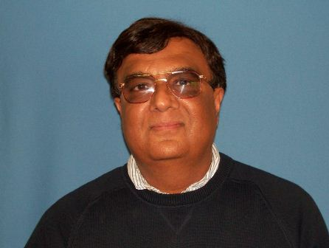
Dr. Sanjeev Arora
Professor, Physics
Fort Valley State University
Implementation of OpenStax College Physics textbook for 140 students annually
$14,000 in annual student savings
Reported by OpenStax

Slide 3
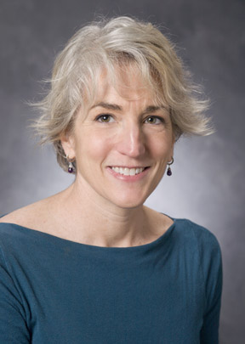
Dr. Peggy Brickman
Professor, Plant Biology
University of Georgia
UGA adaptation of OpenStax College Concepts of Biology textbook for 1,024 students annually through a USG Innovation Grant
$102,400 in annual student savings
Reported by OpenStax

Slide 4
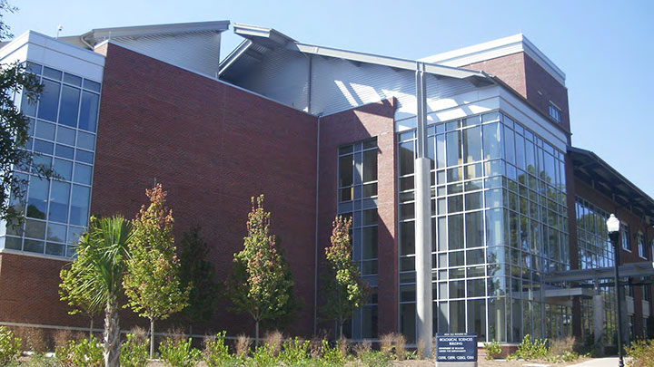
Dr. Katie Brkich
Assistant Professor,
Teaching & Learning
Georgia Southern University
“[Dr. Brkich] was one of the first professors on our campus to use only free articles from the library and GALILEO as her ‘textbook.’ She is a great proponent of using free resources, and is happy to help others learn how to do so effectively.”
-W. Bede Mitchell

Slide 5
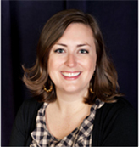
Dr. Susan Burran
Assistant Professor, Biology
Dalton State College
Dr. Burran worked with the Biology department to implement the OpenStax Biology textbook in all Dalton State BIOL 1107/1108 courses.
Dr. Burran is accepting the award on behalf of all project participants, including Annabelle McKie-Voerste, David DesRochers, Leah Howell, Matt Chenoweth, John Lugthart, Celeste Humphrey, Elizabeth Lucht, and April Kay.

Slide 6
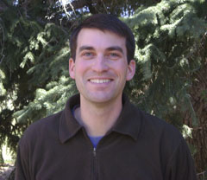
Dr. Andrew Edelman
Assistant Professor, Animal Ecology & Conservation
University of West Georgia
Implementation of OpenStax College Concepts of Biology textbook for 192 students annually
$19,200 in annual student savings
"Personally, I am very happy with the quality and format of the textbook. The students can access the book from any internet enabled device. They also have access to the book from day one of the class. I don't have to worry about them being unable or unwilling to spend money to purchase the textbook."
Reported by OpenStax

Slide 7
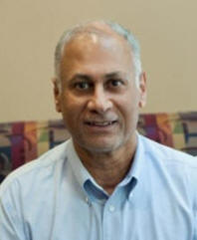
Dr. Hassan El-Najjar
Associate Professor, Sociology & Anthropology
Dalton State University
Implementation of OpenStax College Introduction to Sociology textbook for 192 students annually
$19,200 in annual student savings
Reported by OpenStax

Slide 8
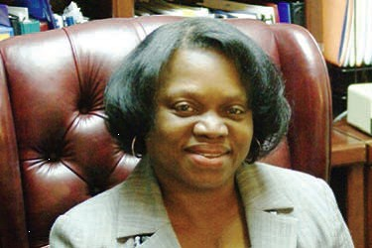
Mary Jo Fayoyin
Dean of Library Services Savannah State University
Trained Freshman Year Experience (FYE) faculty on OER, leading to an open textbook implementation for the college-wide required course.
“Our library director, Mary Jo, had a workshop where she talked to instructors about some of the open access resources. She gave me a list of books, and this one was one of her favorites. After I perused it, I loved it.”
-Teresa-Michelle Walker, FYE Coordinator

Slide 9
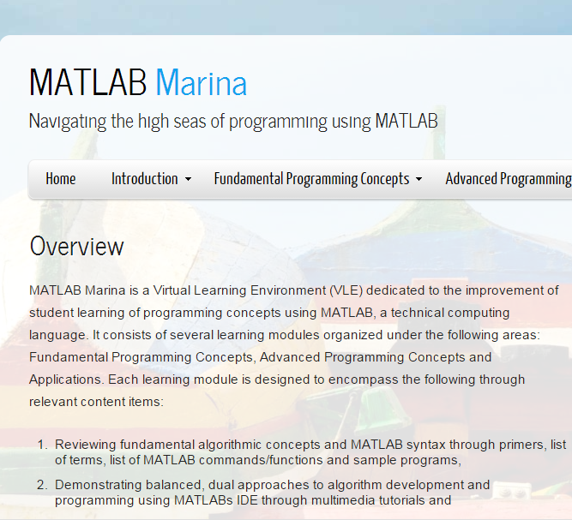
Dr. Priya Goeser
Associate Professor, Engineering Studies
Armstrong State University
Created MATLAB Marina, a Creative Commons-licensed programming Virtual Learning Environment (VLE) using the MATLAB language.
Dr. Goeser uses this VLE as the primary course material for Computing for Engineers, ENGR 1371, and as the supplement for Computational Modeling, ENGR 2010.

Slide 10
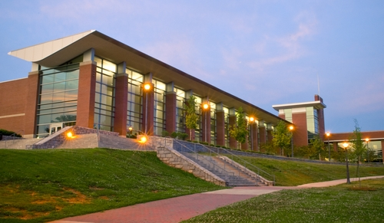
Dr. Greg Gowens
Adjunct Professor, Physics
University of West Georgia
Implementation of OpenStax College Physics textbook for 105 students annually
$10,500 in annual student savings
Reported by OpenStax

Slide 11
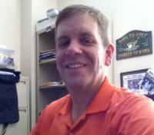
Dr. H. David Hunt
Assistant Professor, Sociology
Georgia Regents University
Implementation of OpenStax Sociology textbook in Summer 2012, continues to use the textbook in 2014, with estimated student savings of $11,200 annually.
“Students have responded with positive comments about the book. They especially like the cost (FREE!!!) and the ease of access.”

Slide 12
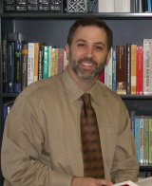
Dr. Steven Lewis
Associate Professor, Physics
University of Georgia
Implementation of OpenStax College Physics textbook for 21 students annually
$2,100 in annual student savings
Reported by OpenStax

Slide 13
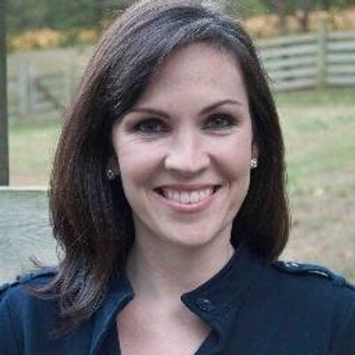
Dr. Anissa Lokey-Vega
Assistant Professor, Instructional Technology
Kennesaw State University
Lead faculty member and course designer for the first KSU MOOC, focused on K-12 educational excellence.
“Dr. Vega is committed to leveraging and creating affordable resources for teacher professional development. Her focus is on bringing technology resources and K-12 blending and online education to rural schools and educators who do not otherwise have access.”
-Dr. Elke M. Leeds

Slide 14
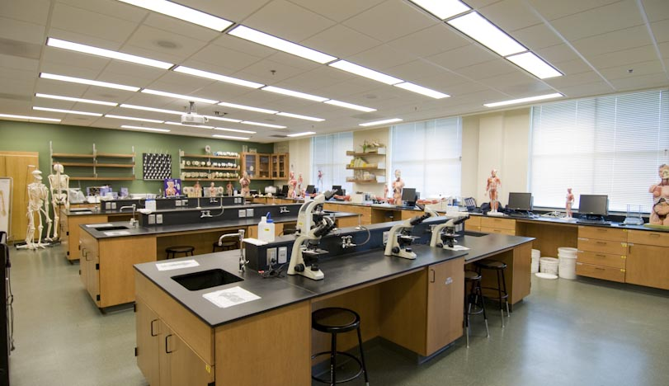
Dr. Jeffrey Mahr
Assistant Professor, Biology
Georgia Perimeter College
Implementation of OpenStax Biology textbook for 84 students annually
$8,400 in annual student savings
Reported by OpenStax

Slide 15
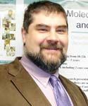
Dr. Robert Maxwell
Academic Profesional, Biology
Georgia State University
Implementation of OpenStax Biology textbook for 84 students annually
$8,400 in annual student savings
Reported by OpenStax

Slide 16
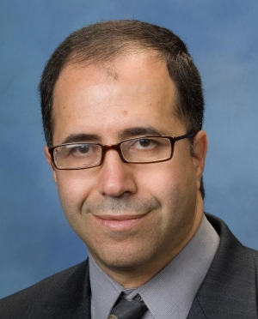
Dr. Taha Mzoughi
Associate Professor, Physics
Kennesaw State University
Founding editor of The Physics Source, a free digital library for introductory college level physics course materials.
Also creates free course activities for his Physics classes via the KSU website.

Slide 17
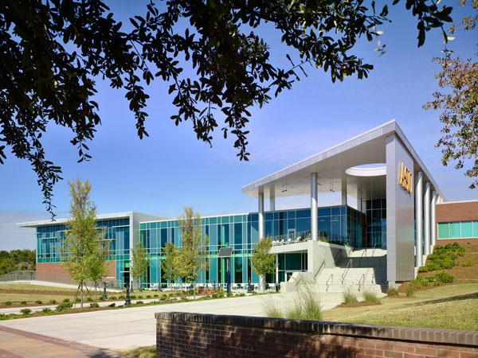
Dr. Arun Saha
Assistant Professor, Physics
Albany State University
Implementation of OpenStax College Physics textbook for 70 students annually
$7,000 in annual student savings
Reported by OpenStax

Slide 18
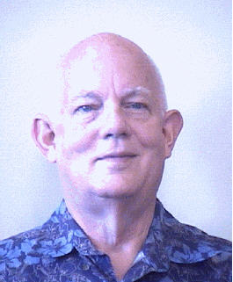
Dr. Julius E. Schneider
Assistant Professor, Biology
East Georgia State College
Implementation of OpenStax Biology textbook for 84 students annually
$8,400 in annual student savings
Reported by OpenStax

Slide 19
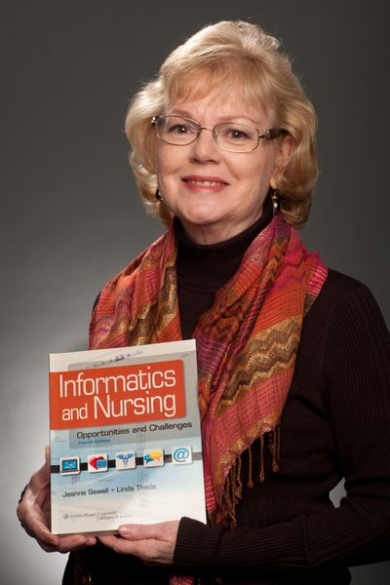
Jeanne Sewell
Assistant Professor, Nursing
Georgia College & State University
Creator of a Nursing Informatics open textbook with nearly 7,000 downloads to date.
Health Sciences Editor, MERLOT
Editorial Board, MERLOT JOLT
OER for Cancer India, Steering Committee

Slide 20
Dr. Theresa Stanley
Professor, Biology
Gordon State College
Implementation of Concepts of Biology OpenStax textbook for 96 students annually
$9,600 in annual student savings
Reported by OpenStax

Slide 21
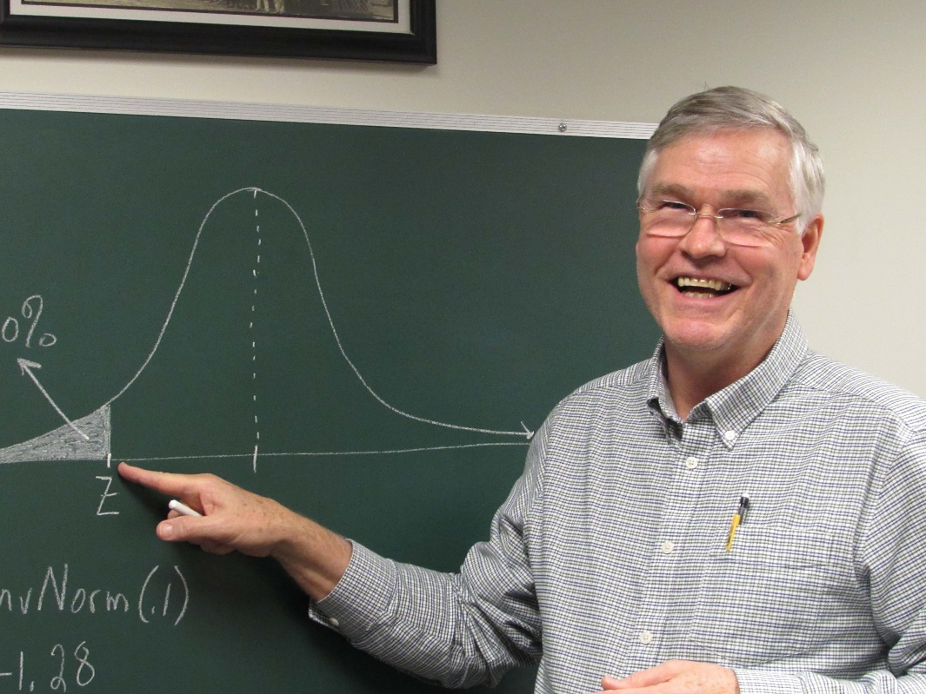
Dr. Richard Stephens
Professor, Mathematics
Columbus State University
Implemented open educational resources in eight mathematics courses since 2011, continues to accrue OER for courses to be taught in the future.
“Being able to locate available material allows for more time to edit and customize that material to one’s own course. Every time that I use a given OER, I find ways to better adapt the material to my own purposes.”

Slide 22
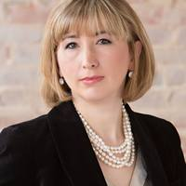
Dr. Diana Sturges
Associate Professor, Human Anatomy & Physiology
Georgia Southern University
Implementation of OpenStax Anatomy & Physiology for 980 students
$98,000 in annual student savings
Reported by OpenStax

Slide 23
Al Walters
Associate Professor, Physics
University of North Georgia
Implementation of OpenStax College Physics textbook for 84 students annually
$8,400 in annual student savings
Reported by OpenStax

Slide 24
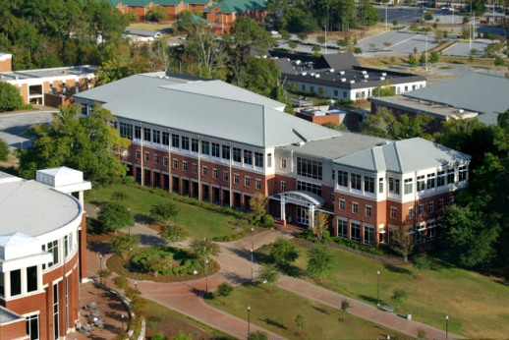
Dr. Matthew Williamson
Associate Professor, Human Anatomy & Physiology
Georgia Southern University
Implementation of OpenStax Anatomy & Physiology for 140 students annually
$14,000 in annual student savings
Reported by OpenStax

Slide 25
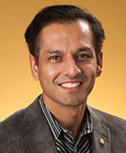
Dr. Humayun Zafar
Assistant Professor, Information Security & Assurance
Kennesaw State University
Lead faculty member and developer of the KSU Cyber Security MOOC, using open educational resources indexed in MERLOT.
“Dr. Zafar's Cyber Security MOOC has the potential to reach thousands of students all over Georgia and the world to provide affordable, high quality education in the critical area of cyber security.”
-Dr. Jim Cope

