Slide 1
Opensource.com
Flickr
Image: https://www.flickr.com/photos/opensourceway/6555466069/
Reusing, Adapting, Revising, Remixing, & Redistributing OER

Slide 2
Open Educational Resources
Open Educational Resources (OER) are teaching, learning, and research resources that reside in the public domain or have been released under an intellectual property license that permits their free use and re-purposing by others.
The William and Flora Hewlett Foundation: http://www.hewlett.org/programs/education-program/open-educational-resources
Notes:
Focus on Free

Slide 3
Types of OER
OER
Courses
Learning Objects
Videos
Test Banks
Modules
Textbooks
Images

Slide 4
Open Textbooks
Image: Province of British Columbia
CC BY-NC-ND 2.0
Flickr:http://www.flickr.com/photos/bcgovphotos/8095276477/in/photolist-dY7qxV-cmLfJ3-dkmpEn

Slide 5
Open Textbooks
Publicly available, freely accessible online
Always available
Available in multiple formats for reading on a variety of devices
Downloadable, printable
Adaptable, customizable to meet local instructional needs
Easily updated
Printed version available at low cost
Open vs other digital textbook options

Slide 6
Why Open Matters
Image – Mike Seyfeng – Flickr - CC BY 2.0
Notes:
Except, for the most part, we can’t
Copyright is a barrier to freely sharing and reusing educational materials and intellectual property

Slide 7
Reusing Copyrighted Educational Content
Copyright - the set of exclusive rights granted to the author or creator of an original work, including the right to copy, distribute and adapt the work
All Rights Reserved
Must ask permission to reuse

Slide 8
Permissions Granted
Notes:
Open licenses enable us to:
reuse the works of others
share our own works
build upon existing works to enhance the quality
adapt existing works to meet our own instructional goals and the needs of our students
Some Rights Reserved
Certain permissions granted
Authors/Creators:
keep copyright
decide terms of use
tag creative works with a set of permissions
Users easily know how they may use the works

Slide 9
Free Access + Free Permissions = Open
Free Access + Free Permissions - The 5 R’s
Open licenses provides at least 2 kinds of permissions:
Reuse – Permission to make and reuse exact copies
Redistribute – Permission to share copies with others
Open should also provide these additional permissions:
Revise – Permission to change, adapt, and alter the resource
Remix – Permission to combine the OER with other materials to produce a new work
Retain – Users have the right to make, archive, and “own” copies of the content
- David Wiley - http://opencontent.org/blog/

Slide 11
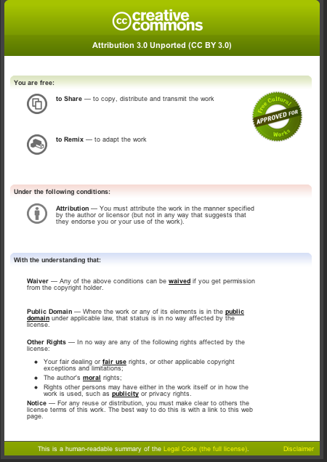
This license lets others distribute, remix, tweak, and build upon your work, even commercially, as long as they credit you for the original creation.
Use for maximum dissemination and use of licensed materials.

Slide 12
CC License Compatibility
Image: https://wiki.creativecommons.org/File:CC_License_Compatibility_Chart.png CC0 license
Notes:
https://wiki.creativecommons.org/File:CC_License_Compatibility_Chart.png

Slide 13
Public Domain in US
First Published before 1923 = PD
Unpublished: Life of the author plus 70 years and for works of corporate authorship to 120 years after creation or 95 years after publication, whichever endpoint is earlier
http://copyright.cornell.edu/resources/publicdomain.cfm
Still Complex
Works are sometimes released with PD when they are not

Slide 14
Creating, Adapting, Using OER
OER
Adapt
Create
Share
Use
Find
Remix
Notes:
What is it that you want to do? Create? Adapt? Remix?
If you are interested in adapting resources your approach will be somewhat different than if you are creating an original work where you are including other OER.
Adapting – some websites make it easy to adapt existing materials. Restructuring, adding content, omitting content.
Most open content is not in a format that is easy to edit.
Using – if you can’t find a single book that works for you, select several and assign what you need. The cost is free!
Create your own –We’ll talk mostly about creating your own works, but much of what we will discuss will apply to any aspect of working with OER.

Slide 15
USG Open Textbooks Projects
USG Open Textbook Project
developed open textbook as proof of concept for US History (first used in summer 2013)
model for developing open textbooks
Partnered with eCore, University Press of North Georgia
Current Downloads: 1456 from Podcast Server
eCore planning to implement open textbooks for all courses by 2016

Slide 16
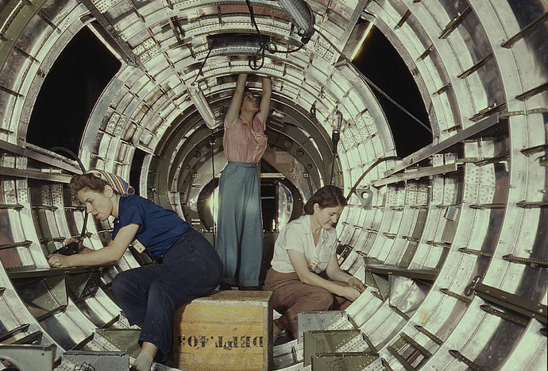
THE COLLABORATIVE MODEL
Instructional Designers
Faculty Authors
Project Managers
University Press
Image: The Library of Congress' photostream

Slide 17
Working with University Press
Editorial Review
Peer Review
Copyediting
Production & Design
Proofing
ISBN
Distribution
Marketing

Slide 18
Working with Instructional Designer
Design, develop, implement instructional strategies
Identify and provide guidelines for structuring instructional design features and components
Review and evaluate instructional design components
Assist with instructional tools and technologies
Find and evaluate existing materials
Assist with course redesign

Slide 19
Planning Considerations
Course design and revision process around implementing open textbook
Is it a new or remix existing ?
What license you will use?
What licenses are compatible?
Where you will store and distribute the work?
Who will be responsible for maintaining the master copy, manage updates, distributions, etc.?

Slide 20
Design & Development
Create processes/procedures and team roles
Select tools for design and development
Templates for writing and reviewing
Develop peer review process
Design templates for production
Create master list of existing resources used
Decide on formats for production and publication
Editable version, PDF, HTML, ePub, iBooks, Mobi, etc.
Modularization
Make it accessible
http://www.usg.edu/siteinfo/accessibility

Slide 21
Image: Mike Licht - Flickr CC BY 2.0
Notes:
Bonus hidden slide – just because it captures my attention ☺

Slide 22
Contact Information
Marie Lasseter
Director of Academic Technologies
Office of Faculty Development
Department of Faculty Affairs
University System of Georgia
marie.lasseter@usg.edu

