Slide 1
Opensource.com
Flickr
Image: https://www.flickr.com/photos/opensourceway/6555466069/
Introduction to Open Education
Marie Lasseter

Slide 2
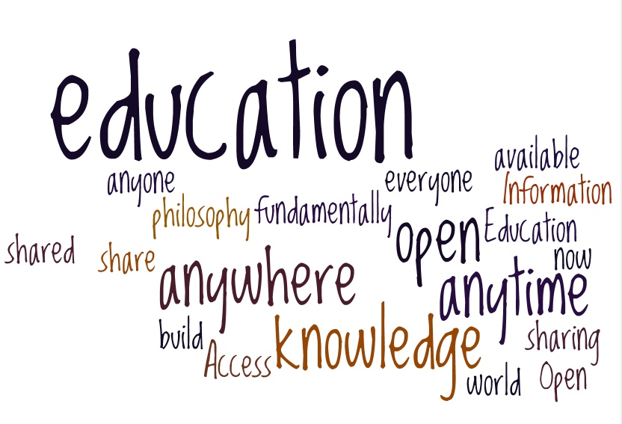
What is Open Education?
Notes:
Open Education is a philosophy about how people share and build upon knowledge
Practitioners and advocates of open education believe:
Access to education should be available to everyone, anywhere and at anytime
Education is fundamentally about sharing
Information and knowledge can now be shared with anyone, anytime, anywhere in the world
Practitioners and advocates work to eliminate barriers that prevent access
http://opensource.com/ http://en.wikipedia.org/wiki/Open_education

Slide 3
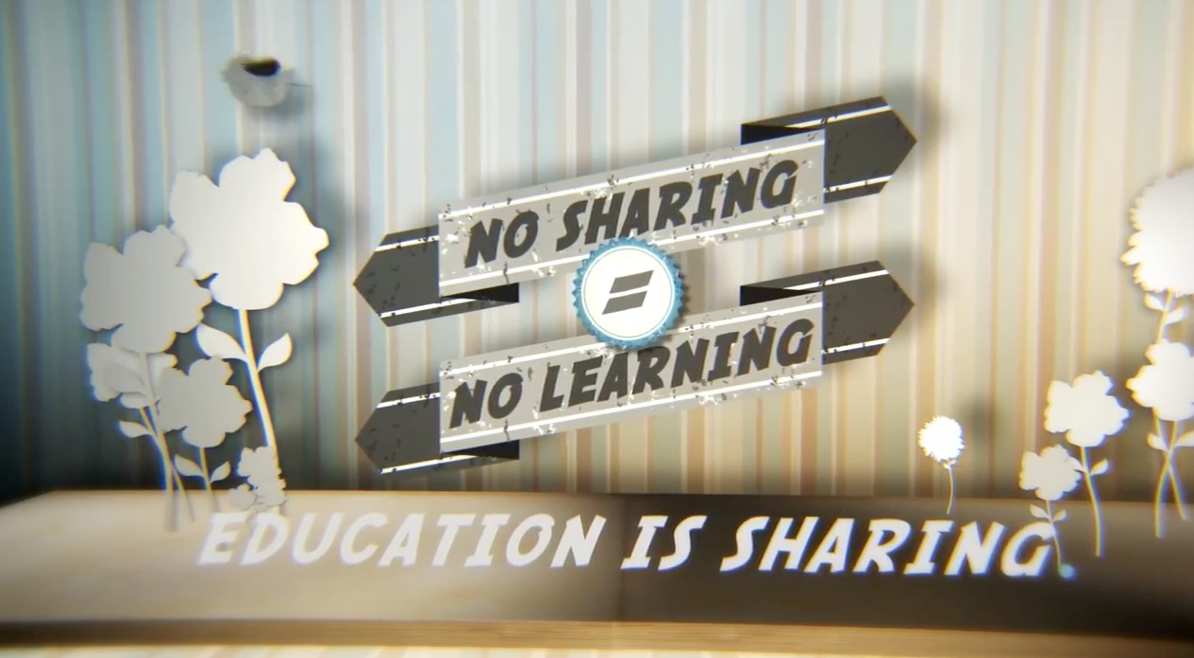
Why Open Matters Video
http://whyopenedmatters.org/video/67/why-open-education-matters/

Slide 4
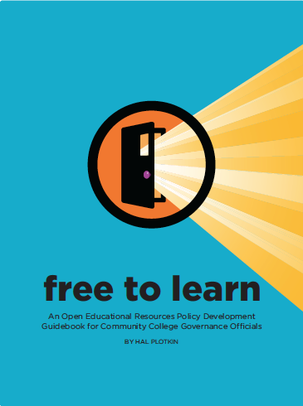
Open Access to Learning Environments
MITx, HarvardX, BerkeleyX, UTx
Notes:
Technologies make it possible to reduce geographical boundaries, cultures, and systems
What a student gets to learn is no longer limited by where they go to school – Pre-K – Lifelong learners
Learning is not limited to formal educational institutions

Slide 5
Why Open Matters
The technology we use every day allows us to:
share our own educational materials freely and extend our reach for teaching and educating others
find & reuse existing materials that meet our own instructional goals and the needs of our students
build upon the works of others to enhance the quality of existing teaching and learning materials

Slide 6
Open Educational Resources
Open Educational Resources (OER) are teaching, learning, and research resources that reside in the public domain or have been released under an intellectual property license that permits their free use and re-purposing by others.
The William and Flora Hewlett Foundation: http://www.hewlett.org/programs/education-program/open-educational-resources
Notes:
Focus on Free

Slide 7
All Rights Reserved
Image – Mike Seyfeng – Flickr - CC BY 2.0
Notes:
Except, for the most part, we can’t
Copyright is a barrier to freely sharing and reusing educational materials and intellectual property

Slide 8
Reusing Copyrighted Educational Content
Copyright - the set of exclusive rights granted to the author or creator of an original work, including the right to copy, distribute and adapt the work
All Rights Reserved
Must ask permission to reuse
Notes:
Not Free

Slide 9
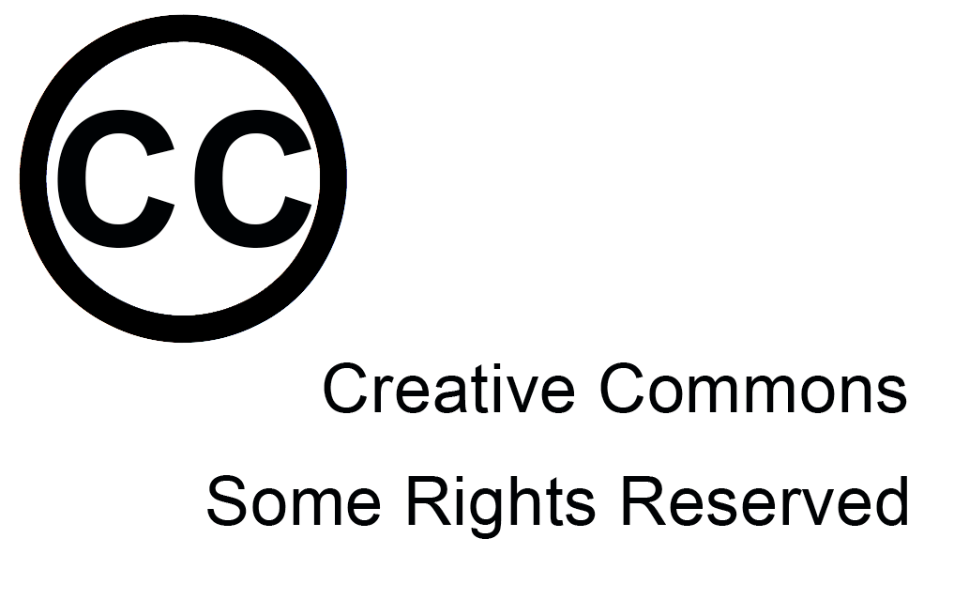
Permissions Granted
Notes:
Some Rights Reserved
Certain permissions granted
Authors/Creators:
keep copyright
decide terms of use
tag creative works with a set of permissions
Users easily know how they may use the works

Slide 10
Creative Commons Licenses
Notes:
Creative Commons Zero – Author has dedicated the work to the public domain
Public Domain Mark – No known copyright

Slide 11
Public Domain in US
Works registered or first published before 1923
There are other ways works arrive in the public domain
http://copyright.cornell.edu/resources/publicdomain.cfm
http://fairuse.stanford.edu/overview/public-domain/welcome/

Slide 12
Free Access + Free Permissions
Free Access + Free Permissions - The 5 R’s
Open licenses provides at least 2 kinds of permissions:
Reuse – Permission to make and reuse exact copies
Redistribute – Permission to share copies with others
Open should also provide these additional permissions:
Revise – Permission to change, adapt, and alter the resource
Remix – Permission to combine the OER with other materials to produce a new work
Retain – Users have the right to make, archive, and “own” copies of the content
- David Wiley - http://opencontent.org/blog/

Slide 13
Types of OER
OER
Courses
Learning Objects
Videos
Test Banks
Modules
Textbooks
Images

Slide 14
Creating, Adapting, Using OER
OER
Adapt
Create
Share
Use
Find
Remix

Slide 15
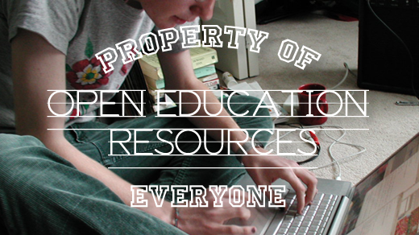
Increase Access
Increase Affordability
Increase Student Success
Image: Opensource.com CC BY-SA 2.0
Why Open Matters

