Slide 1
ALG 101: An Introduction to Affordable Learning Georgia
Jeff Gallant
Program Manager, Affordable Learning Georgia

Slide 2
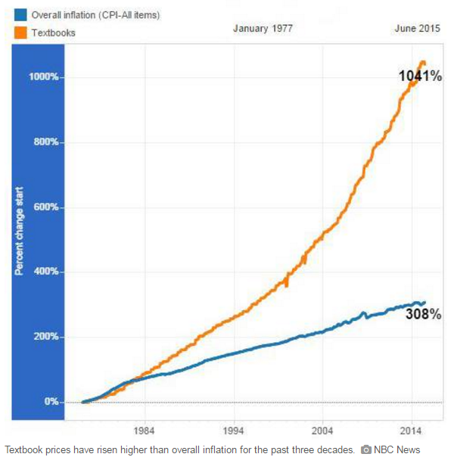
Group Question!
Since 1977, the Consumer Price Index (all items) has risen 308%. This is normally seen as overall inflation. How much has the cost of textbooks risen in the same period of time?
308%
452%
689%
1,041%
3,141.59%
Trick Question, it decreased!
Answer: D

Slide 3
Open Textbooks Can Help: …But What is “Open?”
Open = Free + Permissions
An open resource is both free in some format and has either a license or legal status that allows for extra permissions to the user beyond “all rights reserved” copyright.

Slide 4
Where has “Open” been all my life?
Open-Source Software (initially Free Software): 1980s
GNU, Linux, Open/LibreOffice, BSD Free Software License
Focused on sharing code, the back-end of information distribution
Open Access: 2000s
PubMedCentral, ArXiv, institutional repositories
Focused on sharing research with the public
Open Education: 2010s
We’ll go through a list of these later!
Focused on sharing expertise and foundational knowledge with public learners

Slide 5
Education: The “5R” Open Definition
Open licenses give users the power to:
Retain the content (hard drive, bookshelf, etc.)
Redistribute the content (to students, friends, etc.)
Reuse the content (not a rental, no expiration)
Revise the content (for your course, for an update)
Remix the content (with other content)
From David Wiley’s definition of Open: http://www.opencontent.org/definition/

Slide 6
What open license should I use?
Because we’re in open education and not open-source software, Creative Commons is easily the best option.
Details on every CC License:
https://creativecommons.org/licenses/

Slide 7
Original infographic: http://visual.ly/what-creative-commons

Slide 8
Original infographic: http://visual.ly/what-creative-commons

Slide 9
Why would I avoid “No Derivatives?”
If you would like someone to be able to update your work in the future to keep it relevant, derivative works are important. This also helps with accessibility and modularity.
Therefore, ND is “less open” when it comes to education.

Slide 10
OER = Educational Resources + 5 R’s
Question:
What would you consider a type of educational resource?

Slide 11
Aren’t Open Textbooks just “e-textbooks?”
No, because not every open textbook is electronic, and not every electronic textbook is open.
A study on student preferences for commercial e-textbooks vs. commercial print textbooks has been brought out in arguments against OER, but:
OER should have no Digital Rights Management (DRM) software attached to bar access and restrict printing
When the study was conducted, DRM was also far more restrictive than current DRM when it comes to functionality
OER can have print versions for those who need them, such as OpenStax Textbooks

Slide 12
Is every open resource free?
Yes and no. You can charge for a version of an open resource, but the original open version needs to stay free.
For example, OpenStax charges for two versions of their textbooks:
Print textbooks (mostly at-cost with a small markup for the print shop)
iBooks Enhanced Version ($5)

Slide 13
Aren’t open resources low-quality?
Open resources, like commercial resources, run the spectrum of quality, from individually created and distributed websites to peer-reviewed, foundation-funded textbooks.
OpenStax: Pre-production double-blind peer review
UNG Press: Pre-production double-blind peer review
Open Textbook Library: Post-production peer review

Slide 14
Example: Open Textbook, Remixed Version
The benefits of open go beyond free. Remixable content means you can customize OER for your own course and your students:
OpenStax College Concepts of Biology:
https://openstaxcollege.org/textbooks/concepts-of-biology
UGA Concepts of Biology Remix:
https://openstaxcollege.org/pages/GeorgiaBiology

Slide 15
OER In Summary:
Open = Free + Permissions
Permissions in Education = Creative Commons licenses (or Public Domain materials)
Open in Education = 5 R’s: Retain, Redistribute, Reuse, Revise, Remix
Benefits of Open go beyond free: customizable, remixable

Slide 16
A Brief History of ALG
2004-2005: USG Board of Regents investigates rising textbook prices, implements state guidelines for bookstores, prices kept rising
2006-2013: Office of Faculty Development works on ways of sharing faculty-created resources: USG SHARE Server, US History Open Textbook proof-of-concept
2013: GALILEO was asked to start a pilot to address high textbook costs to students, pilot project begins, Affordable Learning Georgia founded
FY2015: ALG funded by state legislature to address high textbook costs to students, contribute to student success, enhance GALILEO discovery
FY2016-present: Continued funding

Slide 17
Now that we’re funded…
…what have we done with that money?

Slide 18
Incentives, Not Mandates: Textbook Transformation Grants
Grants awarded to teams of faculty and professional staff with a plan to adopt, adapt, and create open and/or affordable educational resources to replace a commercial textbook
Grant methodology based on preserving academic freedom with incentives, not mandates, peer review selection process, about 50% acceptance rate
Funding model based on average cost of course release with flexibility to institutions

Slide 19
Incentives, Not Mandates: Textbook Transformation Grants
First round awarded in Fall 2014
Round Nine to be awarded in Summer 2017
$2,395,265 awarded
$35.1 million projected savings in textbook costs…
…to 266,412 students!
This is $131.75 per student enrolled in a course selected as a high-impact project

Slide 20
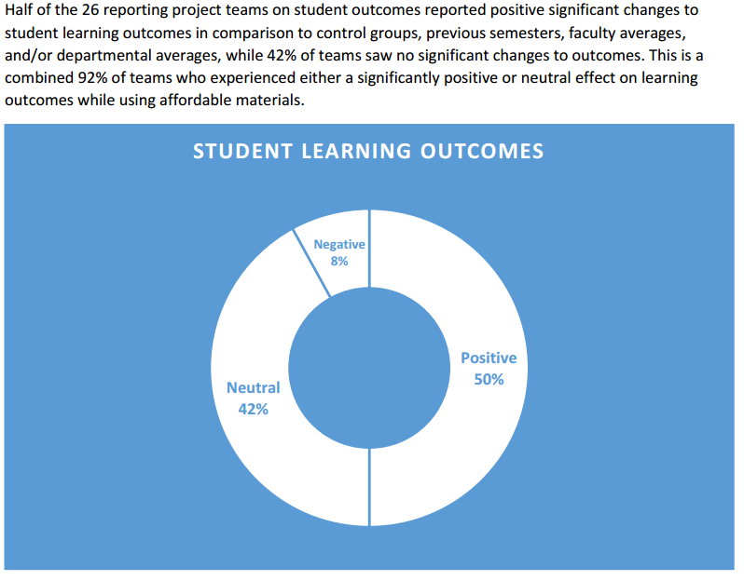
Grant Outcomes
COUP Framework: Cost, Outcomes, Usage, Perception
Cost and # students
Learning Outcomes
Retention: Drop, Fail, Withdraw (DFW) rates
Summarized at completion of a round of grants
R1 & R2: Positive student satisfaction, positive or neutral student learning outcomes, positive or neutral DFW
http://affordablelearninggeorgia.org/documents/R2_Summary.pdf

Slide 21
How Do They Work?
Team proposes a project during a Request for Proposals
Proposal is reviewed by administrators and three Peer Reviewers
Proposals either accepted or rejected, any rejected proposal teams receive peer review and administrative feedback
Proposal becomes the Statement of Work: the work that needs to be done by the deadline of the project
Statement of Work is part of the Service Level Agreement between USG and their institution
Funds are allocated ½ upon SLA being fully signed, ½ upon submission of Final Report

Slide 22
How Are They Reviewed?
Rubric with:
Each major section of the proposal
Transformative impact on course, program, department, institution(s), etc.

Slide 23
Current RFP:
http://www.affordablelearninggeorgia.org/about/rfp_r9/

Slide 24
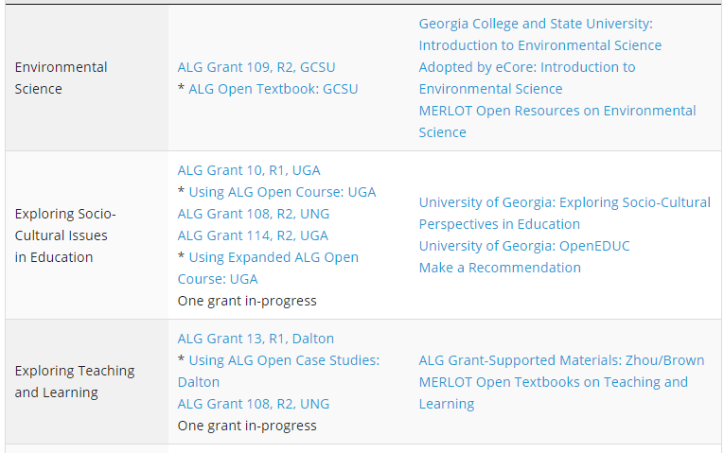
Looking for Impact: Top 100 Undergraduate Courses
All undergraduate course enrollments analyzed by ALG each academic year
Involves name deduplication, course number norming, etc.
All grants and partner textbooks listed, along with other OER that could be used
Top 100 Courses without implementations of OER are a priority for Textbook Transformation Grants

Slide 25
Open Textbook Publishing with UNG Press
Open Textbook Publishing with UNG Press
Proof of concept was OFD/UNG Press/eCore US History I
Model carried forward to create new open textbooks
USG faculty-authored, USG faculty-peer-reviewed pre-production
ALG funds production
UNG Press manages the workflow, designs texts, manages copyright when remixing external materials, administrates peer review
eCore implements course-wide
ALG provides hosting through new Open Educational Resources repository

Slide 26
Current UNG Press Open Textbooks
World Literature I
US History I
World History I
Art Appreciation
Music Appreciation
American Literature
Human Communication (coming soon)
eCore project
Six more planned, to be created by end of 2018

Slide 27
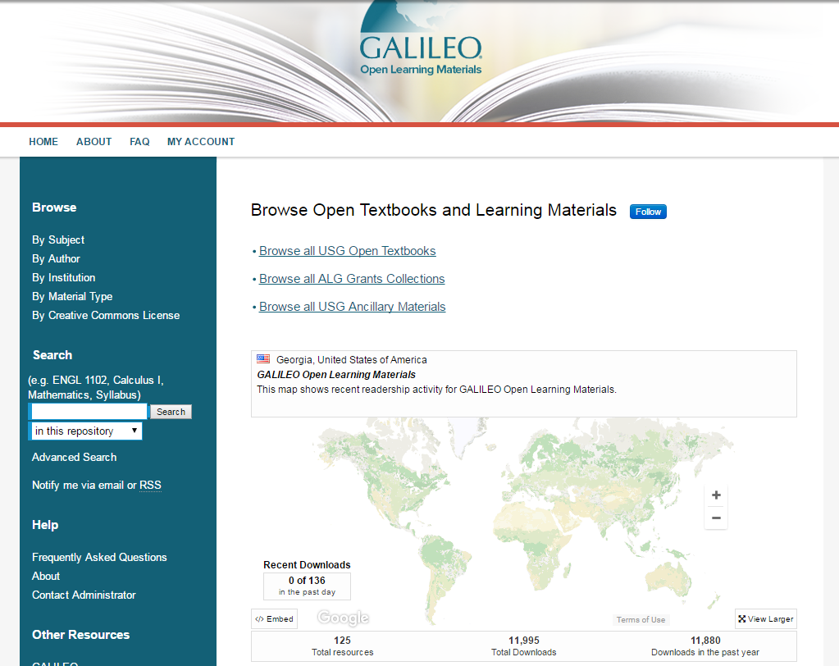
GALILEO Open Learning Materials
Digital repository for all OER created by ALG projects and grants
Contains all UNG Press Textbooks, all grant reports/syllabi, all ancillary materials, all grant-created textbooks
Over 10,000 full-text downloads since launch in October 2016

Slide 28
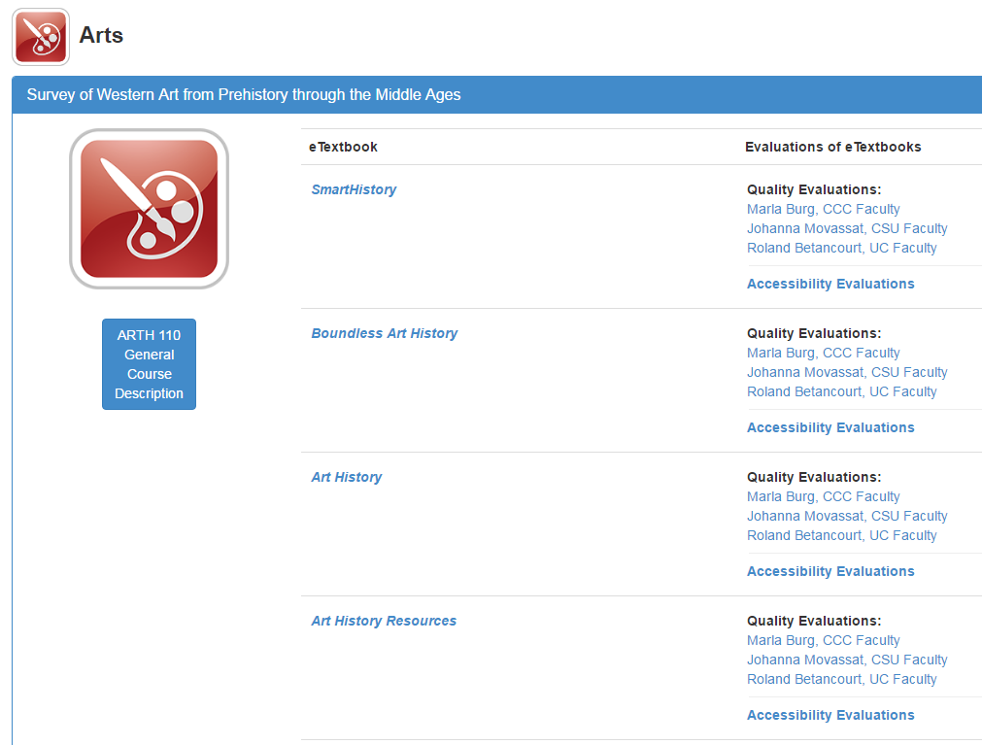
Partner: California State University: MERLOT / Affordable Learning Solutions
Assisted ALG with pilot project in 2013-2014
Provided website template for first iteration of ALG website
Provides support for MERLOT (extensive OER searchable index)
Runs COOL4Ed, covering CSU courses w/ post-production peer reviews
Runs SkillsCommons, providing access to all community college TACCCT Grant materials

Slide 29
Partner: OpenStax
From Rice University, funded by foundations, donations, and institutions
Creates high-quality, peer-reviewed open textbooks with faculty from across the nation
Provides multiple / accessible formats including PDF, HTML, DAISY/Bookshare
Support for faculty and institutions adopting OpenStax textbooks
Working on adaptive learning systems

Slide 30
Partner: eCore
Georgia’s Online Core Curriculum
Worked with ALG and UNG Press
Open and Free Textbooks for all courses except Human Communication, Intermediate Spanish
Human Communication in-progress
Foreign Language OER difficult due to demand for online platform
Does not include online STEM labs
High-impact implementations, at-scale OER validation

Slide 31
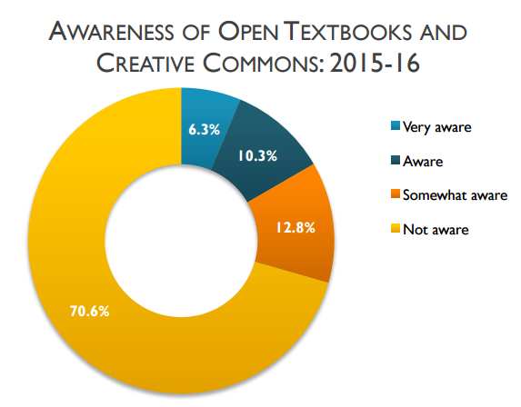
Raising Awareness, Providing Support
Campus Champions and Library Coordinators
Online Training and Development Series
Promotional Videos
In-person symposia and presentations at state events
One-stop website with modular tutorials for adoption, adaptation/creation
Babson Survey Research Group, “Opening the Textbook,” https://www.onlinelearningsurvey.com/reports/openingthetextbook2016.pdf

Slide 32
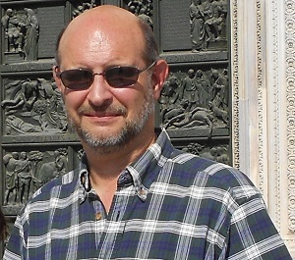
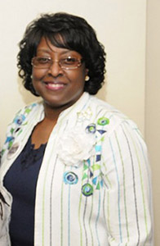
Advocacy on Every Campus
Campus Champion and Library Coordinator on each campus
Champion: usually faculty or teaching/learning staff, advocates to faculty
Coordinator: librarian, helps with finding, evaluating resources, assists Champion with on-campus events

Slide 33
How Can I Learn More?
Tutorials on affordablelearninggeorgia.org
Help > Tutorial 1 and Tutorial 2
Information on open resources, finding textbooks, etc.
Contact your Campus Champion and Library Coordinator
http://www.affordablelearninggeorgia.org/about/champions_coordinators

Slide 34
Questions?
Any further questions, send me an email!
Jeff.Gallant@usg.edu

