Slide 1
Creating Accessible Documents
Presenter: Valerie Morrison, Ph.D.
E-text Manager, CIDI

Slide 2
Contents of this PowerPoint
Part 1: Overview of CIDI and our Services: Slides 1 through 8
Part 2: Microsoft Word Accessibility: Slides 9 through 41
Part 3: PDF Accessibility: Slides 42 through 54
Part 4: Excel Accessibility: Slides 55 through 64
Part 5: PowerPoint Accessibility: Slides 65 through 78
Part 6: Social Media Accessibility: Slides 79 through 85
Part 7: Additional Information and Resources: Slides 86 through 92

Slide 3
AMAC and CATEA, the College of Design’s largest research centers, have joined to create the Center for Inclusive Design & Innovation (CIDI).

Slide 4
CIDI’s Products and Services
E-Text Services: we transform textbooks, supplements, journals, brochures, manuals – basically any print material – into a variety of accessible electronic formats, including PDF, DOC, EPUB, DAISY, HMTL, and PowerPoint files.
Braille Services produce timely, cost-effective, high-quality electronic and embossed Braille and custom tactile graphics.
Captioning and Described Media Services make classroom lectures, meetings, labs, or webinars fully accessible for deaf or hard-of-hearing and provide post-production transcripts, captioning, and described video.
Certified Assistive Technology Team conducts on-site and remote assessments, and offer demonstrations, training, and assistive technology for education, work, and daily living environments.
ICT Accessibility Compliance Consultations focus on the accessibility needs of organizations, offering technical assistance, customer support, and evaluation of overall website accessibility.

Slide 5
History of the E-Text Department
In 2006, AMAC was founded by the University System of Georgia and the Board of Regents as an E-Text provider, and it was once our main mission to convert textbooks into accessible formats.
Over the years AMAC grew, adding more departments and services, and E-Text expanded from making 1 file format (PDF) to offering 10.
In early 2019, we merged with CATEA, who specialize in accessibility research, to form CIDI, housed in Georgia Tech’s College of Design.
We have built a repository of over 38,000 titles and offer a large variety of file formats to meet many needs.

Slide 6
Who Uses Accessible Media
The audience for Accessible Media is not just people with disabilities. It is far larger than you would imagine…
People who have blindness, color blindness, or low vision
People with mobility issues who cannot hold a textbook
People with motor disabilities who cannot turn pages
The Deaf and Hard of Hearing Community
People with learning disabilities such as dyslexia or ADHD
People with head injuries, trauma, or cognitive disabilities
Auditory learners
Aging population

Slide 7
What Needs to Be Accessible?
Ideally, everything in an educational environment or posted online should be made accessible:
Textbooks, Course Materials, and Transcripts
Course Syllabi, Exams, Handouts, Readings, Course Packets
Course Websites and anything posted on a Learning Platform
PowerPoint Presentations, Emails, and Social Media posts
Brochures, Pamphlets, Menus, Directories, and Instructions
Hiring Forms, Employee Guidelines, basically…everything

Slide 8
3 Tips for Greater Accessibility
Keep these 3 ideas in mind for greater accessibility across all programs:
1. Is my content easy to navigate?
Have I created headings and bookmarks for easy navigation?
2. Are my visuals clearly and fully described?
Have I written alt text descriptions and captions for my images?
3. Are my design choices accessible?
Have I chosen fonts, colors, and backgrounds that are easy to discern?

Slide 9
Microsoft Word Accessibility
Choosing accessible design features, fonts, and color contrast.
Creating white space with page layout tools (not tab, enter, or space).
Creating multiple levels of headings for navigation.
Generating an automated table of contents.
Creating accessible numbered and bulleted lists.
Establishing a logical reading order.
Formatting accessible tables and not using tables for layout purposes.
Using clear hyperlinks.
Writing alternative text descriptions and/or captions for images.
Inserting useful metadata.
Using the built-in checker to create an accessibility report.
Saving as an accessible PDF.

Slide 10
Accessible Design Features
Try to use plain text whenever possible, avoiding unnecessary tables, borders, or graphics if they do not convey meaning.
Use normal or expanded character spacing, rather than condensed spacing.
Use language that is clear, direct, and easy to understand.
Explain all acronyms, symbols, and abbreviations.
Provide meaningful context for all hyperlinks.

Slide 11
Choose Accessible Fonts
Use font sizes between 12 and 18 points for body text.
Use standard fonts with clear spacing and easily recognized upper and lower case characters. The following fonts are the most accessible: Calibri, Arial, Verdana, Tahoma, and Times New Roman.
Sans serif fonts (e.g., Calibri, Arial, Verdana) are generally considered easier to read than serif fonts (e.g., Times New Roman, Garamond).
Avoid large amounts of italicized, bold, or underlined text. Text in all caps is also difficult to read and produces eye strain.

Slide 12
Use Sufficient Color Contrast
Provide sufficient color contrast between text and background colors. Do not use color as the sole means of communicating information such as required fields and error messages.
Text should be easy to read.
Color contrast in comparison to the background should be a ratio of 4.5:1.
A good tool to test the color contrast is Colour Contrast Analyser found at The Paciello Group (www.paciellogroup.org).

Slide 13
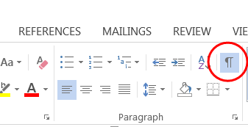
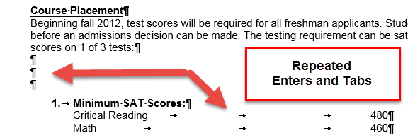
Avoid Repeated Blank Characters
To see the blank characters, turn on Show/Hide paragraph marks as seen in the first image below. Blank characters are caused by hitting space, tab, and enter unnecessarily.
A screen-reader may say the word, “paragraph mark,” or “blank space,” or “tab,” for each of these blank characters, which could confuse the listener.

Slide 14
Create Accessible White Space
When creating white space in your document,
DO NOT:
Hit Enter, Tab, or Spacebar more than once.
DO:
Use line spacing.
Use tab stops.
Use column breaks, section breaks, and page breaks.

Slide 15
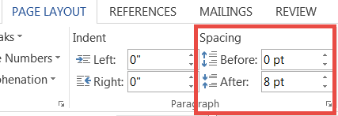
Use Accessible Line Spacing
Put your cursor either before or after the word where you want white space.
Use the Line Spacing option in the Page Layout tab and add space before or after the word as seen below.
Delete any repeated hard line breaks.

Slide 16
Column, Section, and Page Breaks
Only adjust spacing using page layout, line spacing, section breaks, and ruler. Do not hit enter or tab repeatedly to create white space.
Create columns with Microsoft Word’s formatting tools, not by tabbing or creating a makeshift table to arrange text.
Inserting section breaks and adjusting your margins can help you change the layout of your page if necessary.

Slide 17
Using Section Breaks
If you want to format a certain section of the document:
Turn on show/hide paragraph marks.
Place your cursor before the section you are formatting.
Click the Page Layout Tab> Breaks> Section Break.
Then insert another section break after the section. Within the two section breaks, you can format the text however you wish and this formatting will not affect the rest of your document.

Slide 18
Adding Headings
Headings help users navigate and they also help you organize your content.
Screen reader users can use quick key commands or shortcuts to navigate documents by Heading levels.
Your headings will retain your document structure when exporting to different file formats.

Slide 19
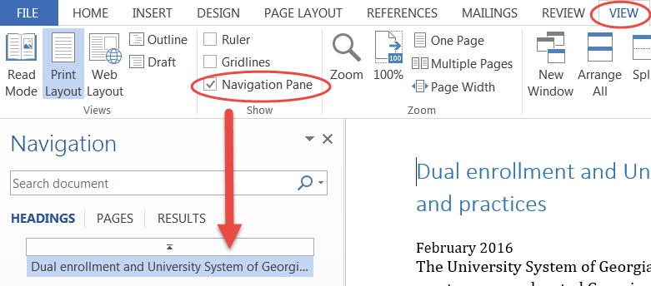
View Your Headings
Click the View Tab and check the Navigation Pane box to view all the headings in the document.
Highlight some text and choose the Heading style from the Home Tab and your heading will show up in the Navigation Pane on the left.

Slide 20
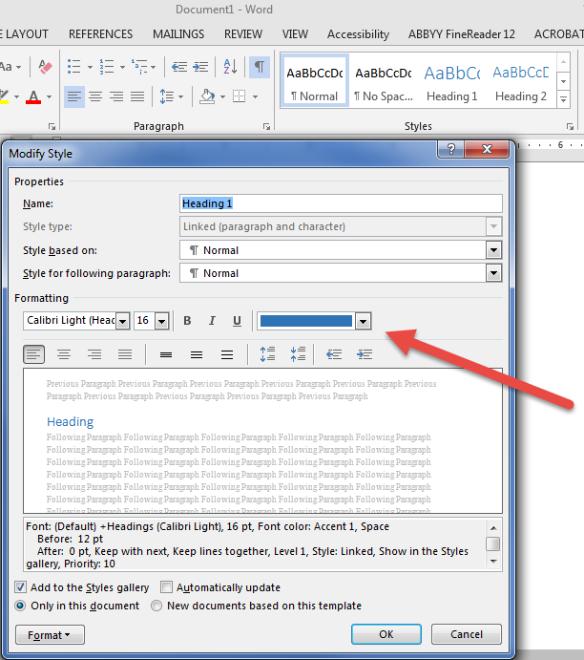
Customized Headings
Heading styles can also be customized, so you can keep style options while also adding meaningful structure for screen reader users.
Right click on a Heading Style on the Home Tab and then select Modify Style to adjust your formatting options.

Slide 21
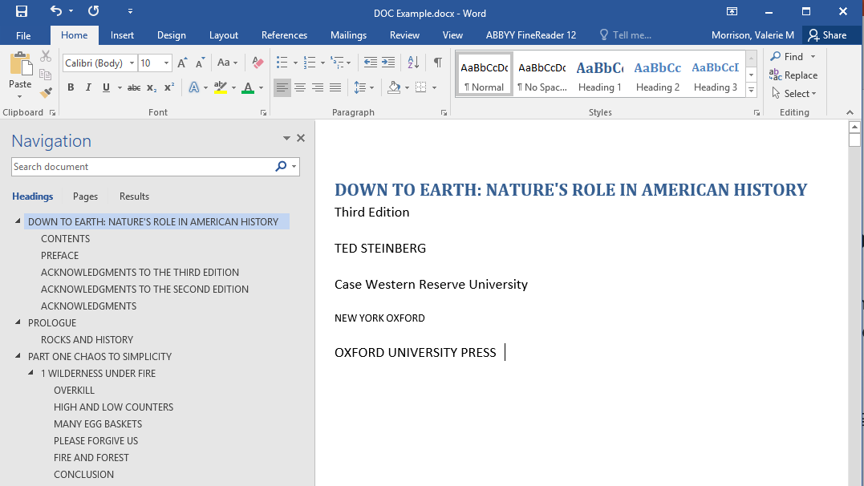
Example of Headings

Slide 22
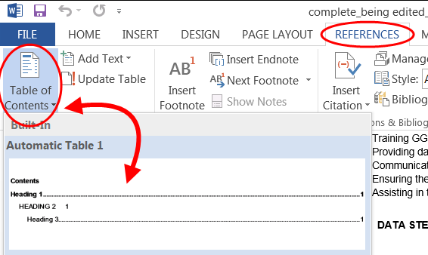
Automated Table of Contents
Once you've applied heading styles, you can insert your table of contents by clicking the References tab and then the Table of Contents command.
Select a built-in table of contents.

Slide 23
Updating the Table of Contents
The TOC is automatically updated whenever you open the document.
You update the TOC by clicking the References tab and then Update Table, in the Table of Contents group.
When you update the TOC, you will choose to update the entire TOC, or just the page numbers.
Only edit the headings within the body of the document, not in the table of contents itself.

Slide 24
Creating Accessible Lists
Use Word’s list builder to create true lists rather than creating your own lists with icons or graphics as bullets.
This will ensure that a screen reader will recognize it as a true list, and the formatting will be preserved if saved as another file format.
This is an example of a list:
Click the bullet or numbered list icon in the Ribbon.
Create your list.
You can also select existing text and click the list icon to create a list.
You can customize your list by selecting from the list icon drop-down menu.

Slide 25
Reading Order
Avoid too many sidebars and callouts that will sound disruptive and confuse someone using a screen reader if possible.
Avoid too many decorative images.
Use a logical and sensible reading order.

Slide 26
Accessible Tables
Tables should:
Have a specified header row.
Have a logical reading order from left to right, top to bottom.
Contain related information.
Have a title and caption that gives an overview of what’s inside the table. If placed before the table, it can help the person using screen reading software to focus and interpret the data.
Not contain merged cells.
Not contain blank or empty cells.

Slide 27
Specify Header Row
All tables should only have one header row.
To properly specify the header row, first select the table.
Then click the Design Tab.
Now check the box for Header Row.
If the table spans more than one page, edit the table properties to repeat header row on each page.

Slide 28
Alt Text for Tables
It is a good idea to add alt text to your table. To do this, select the table, right click and choose to edit the alt text. Add alt text to the description field (not the title field).
Example table:
Favorite Colors | Favorite Foods | Favorite Drinks
Pink | Potatoes | Water
Blue | Spaghetti | Iced Tea

Slide 29
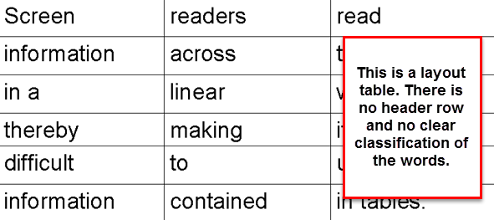
Layout Tables
Do not use tables for layout purposes only.
Tables need to have logically related information with a header row.
You cannot format content into a table just to make it look nice. Tables are not intended to be used for lists, groups of words, or visual purposes only.
If you want to format content like a table, then use column breaks, section breaks, page breaks, or tab stops.

Slide 30
Unclear Hyperlinks
Often the Accessibility Checker will flag hyperlinks in your document. To create fully functional and accessible links, do the following:
Write the name of link in plain language, ie. The Department of Natural Resources News Site.
Highlight the name of the link and right click to Insert a Hyperlink.
Paste the URL in so that the title turns into a clickable link.
Add the URL in parentheses after your hyperlink for print audiences, and right click to remove the hyperlink from the URL.
Example: To learn more about our educational programs, workshops, classes, and events, please visit The Department of Natural Resources Education website (www.gadnr.org/education).

Slide 31
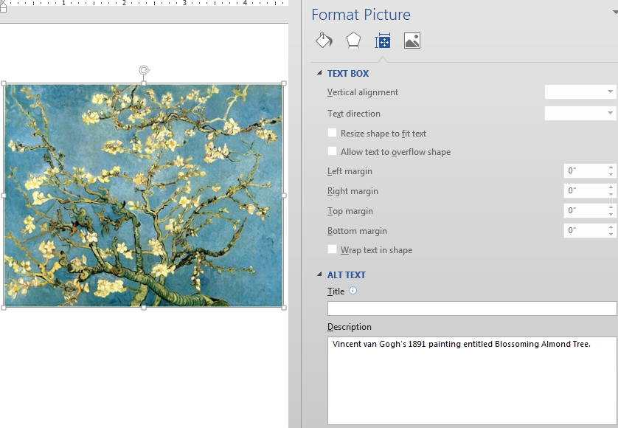
Alternative Text Descriptions
All images in a document should be fully described using proper capitalization, grammar, spacing, and punctuation.
To add alternative text:
Right-click on the image.
Choose Format Picture.
Select the Layout Properties icon.
Click on the Alt Text link.
Type in the description field.

Slide 32
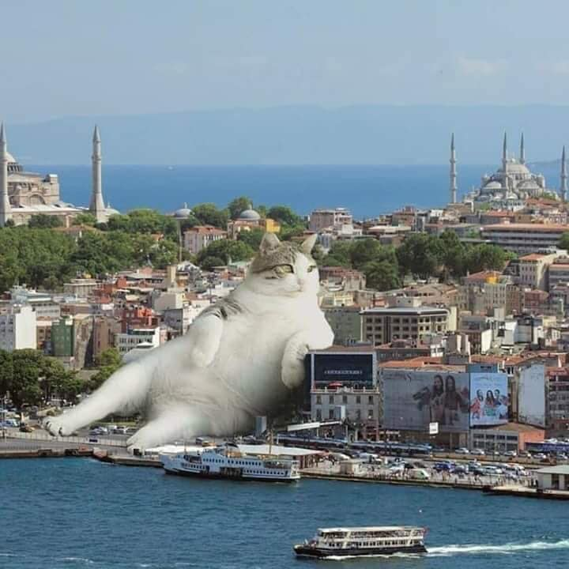
How to Describe Images
First describe the type of image you’re attempting to describe.
Next, summarize the information contained in the image in a general informative sentence.
Avoid adding subjective information or opinion in your alt text, keeping your description neutral and informative.
Skip purely decorative images; these will be read simply as “Graphic.” Icons may have meaning, but flourishes are fluff.

Slide 33
Who Uses Alternative Text?
Screen reader users and text-to-speech software users often rely on alt text. This includes people with learning disabilities, people with mobility issues or cognitive impairments, people who are blind or low-vision, and auditory learners.
Search engines also “need” alt text because they rely on alt text in the semantic markup of the website for images that can’t be displayed.
To be fully accessible, documents and websites should have all images fully described using proper capitalization, grammar, spacing, and punctuation.

Slide 34
Consider Cognitive Load
Consider Cognitive Load and Auditory Fatigue
Cognitive load is something to consider when writing alternative text, so that you don’t overwhelm the listener.
If there is too much information contained in an alt text, it is best to shorten the alt text and add a table or list to accompany the image. This table or list can hold the information in a more logical way.
Keep your alt text descriptions as concise as possible and edit out repetition. Also try to group items so your description is easier for someone to process.

Slide 35
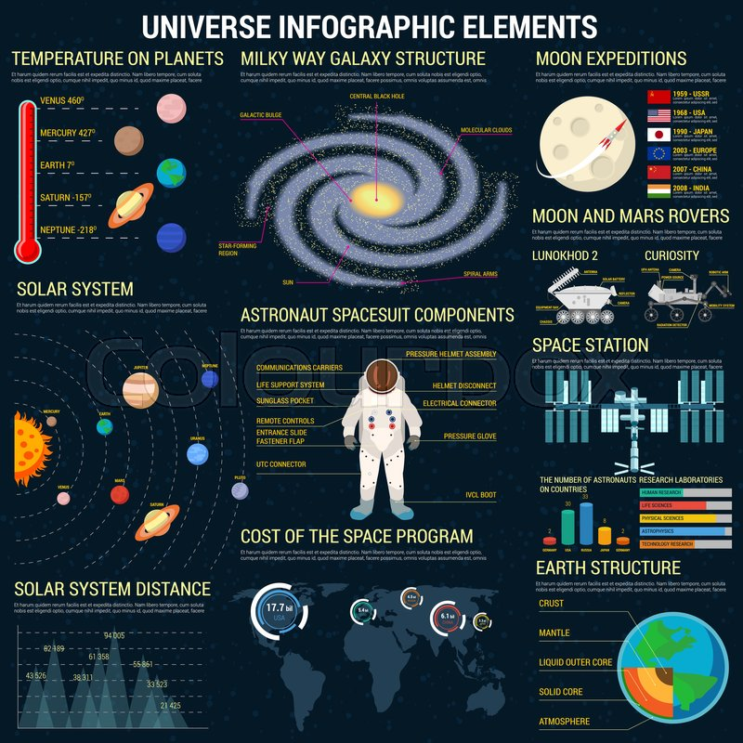
Effective Alt Text Practices
Review captions before writing your alt text. If the caption does not summarize the information, then write alt text that does to fill in the blanks.
Alt text should have proper capitalization, subject/verb agreement, usage of articles such as a/an, spacing, grammar, spelling, and punctuation.
Do not include hard line breaks.
Avoid using abbreviations if possible.
Symbols: instead of "&" write out the word "and"; do not use mathematical symbols (ex: write out "divided by," "minus," and "equals").

Slide 36
Example 1: Alternative Text
Suggested Alt Text for a Simple Image:
A tiger wearing a birthday hat.

Slide 37
Example 2: Alternative Text
Suggested Alt Text for a Simple Image:
A large waterfall flows from a tall cliff into a body of water. Moss and other green plants overlay the cliff and nearby rocks.

Slide 38
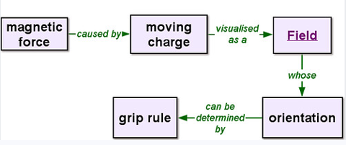
Example 3: Alternative Text
Suggested Alt Text for a Complex Image:
A flow chart of the magnetic force. Magnetic force is caused by a moving charge and is visualized as a field. The field’s orientation can be determined by grip rule.

Slide 39
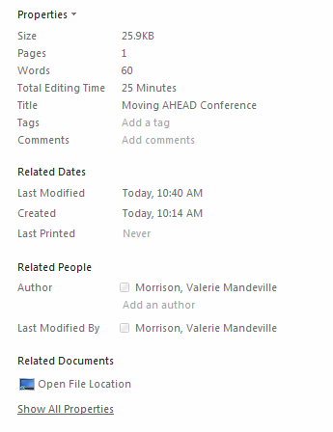
Adding Metadata
By clicking on the File tab and viewing the Document Properties, you can edit information such as Author, Title, Subject Tags, or Comments to provide further information about what the document contains. This data will be retained if you save as an accessible PDF.

Slide 40
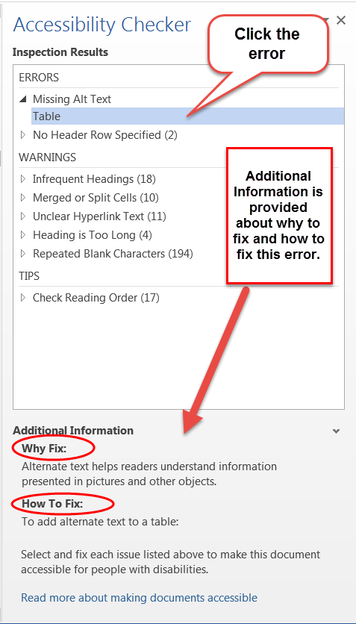
Check Accessibility
Save your document as a .docx file.
Go to the File tab and click on Check for Issues, and select Check Accessibility.
The accessibility checker will open in a separate pane and list all accessibility issues with links to each potential problem.
Additional information appears below, instructing you on why this might cause a problem and how to fix the issue.

Slide 41
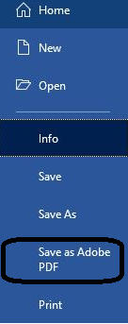
Saving as an Accessible PDF
MS Word 2010 includes the option to save and retain accessible formatting including headings and alt text when the doc is saved as a PDF.
To export your Word doc to an accessible PDF format, go to File > Save As Adobe PDF > and then click Options.

Slide 42
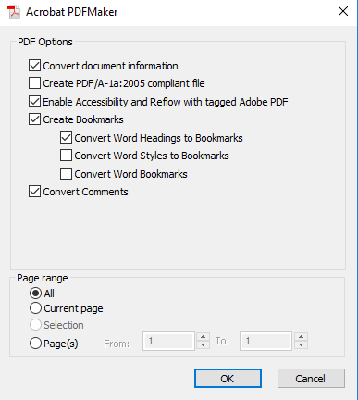
Accessible PDF Options
In the dialog box:
Check box to convert document information.
Check box to enable accessibility and reflow with tagged Adobe PDF
Check box to create bookmarks (convert Word headings to bookmarks)
Check to convert comments (if applicable)
Select all pages from page range

Slide 43
PDF Accessibility
Save as PDF from MS Word to retain accessibility features.
Text is accessible and highlights in proper reading order.
Bookmarks provide organization and easy navigation.
Pagination is clear and navigable.
Tags are present, or the file is autotagged.
File size is manageable, ideally under 25 MB.
File names are clear and contain no symbols.
Images have alt text descriptions if necessary, using T.U.R.O. tool.
Avoid inaccessible forms.
Language and metadata are included in document properties.
Color contrast is high for ease of reading.
Check Accessibility

Slide 44
Determining PDF Accessibility
If text is not selectable, your file could be an image pdf and would need to be processed through an optical character recognition software.
If text is selectable, left-click some text and drag your cursor to watch the order in which the text highlights.
Check that side-bars and callout text do not interrupt main body text.
Ensure that columns read down.
Ensure that tables read across.
In the following screenshot, text in one column reads downward and does not interrupt the next column. This is good reading order.

Slide 45
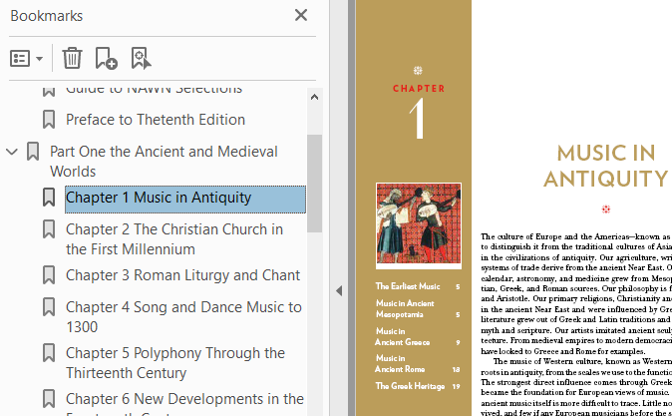
Adding Bookmarks to a PDF
PDFs should have bookmarks to help a user easily navigate to different sections of the file.
Bookmarks can be generated from a Word document with headings, or you can add them directly into your PDF by highlighting text and clicking Control + B or right clicking and choosing “Add Bookmark.”

Slide 46
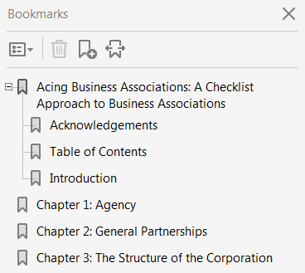
Bookmark Hierarchy
Bookmarks can have different hierarchies for organizational purposes.
To adjust the hierarchy of your bookmarks, drag them up and under the “parent bookmark” so they appear indented.

Slide 47
Pagination Clear and Navigable
When possible, ensure that the thumbnail page numbers match the page number on the actual page.
To optimize the thumbnail page numbers, right click and choose Page Labels.

Slide 48
Ensure Tags are Present
Open the tags panel and ensure that there are tags present.
If there are no tags, you can select Add Tags to Document from the drop-down menu.

Slide 49
File Size and Naming Split Files
To avoid having a large file that takes a long time to open, you can reduce the PDF’s file size. At CIDI, we strive to keep PDF files at 25 MB or below.
Save your PDF as a reduced file size. Go to FILE, select “Save As Other”, and select “Reduced Size PDF.” When prompted to select Acrobat Version Compatibility, select “Acrobat 9.0 or later” from the dropdown menu.
Split the file into smaller sections, naming each section clearly.

Slide 50
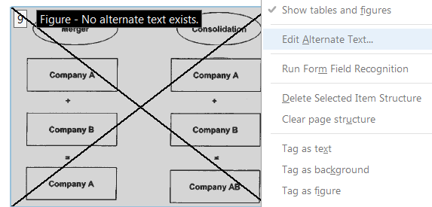
Adding Alt Text to PDF Files
To add alt text descriptions to images in a PDF file, it’s easiest to turn on T.U.R.O. in the Accessibility Tools, which stands for “Touch Up Reading Order.” This highlights all figures for you, and you can then right click on the ones needing descriptions and select “Edit Alternative Text.”

Slide 51
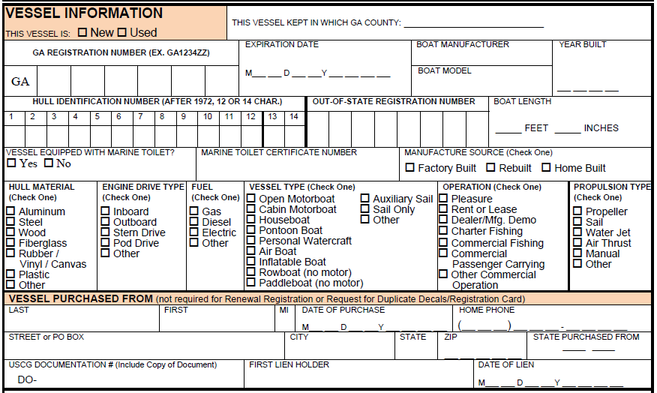
Avoid Inaccessible PDF Forms
This Vessel Registration Application would be very confusing for someone using a screen reader to navigate and edit. It could be remediated, but each check box or radio button would need to be individually formatted with alt text descriptions.

Slide 52
Choose Accessible HTML Forms
The PDF form above could easily be rendered as a table in HTML format, keeping the same content and format, and it would be easier for a person using a screen reader to navigate and edit. Employment forms would be a top priority in conversion, followed by forms on frequently visited pages, and landing or home pages.

Slide 53
Add Language and Metadata
Open Document Properties (control + D) and in the Description tab, add helpful metadata such as title, author, subject, and keywords. This will allow your document to be found when those words are used in a search on your computer.
In the Initial View tab, select to show document title from the drop-down menu. This will allow your file window to display the title you added to your metadata. This will also correct an error that will show up in the accessibility report if you do not make this change.
In the Advanced tab, select the correct language that should be used by the screenreader.

Slide 54
Review Color Contrast
It’s important to ensure that your document contains high color contrast.
Avoid using text and background colors that are hard to differentiate between.
Some options are: White text on black background; black text on white background; yellow text on black background; and many others.
As previously mentioned, a good tool to test the color contrast is Colour Contrast Analyser found at The Paciello Group (www.paciellogroup.org).
To the right is an example of high color contrast. The text can be easily read and does not strain the eye.

Slide 55
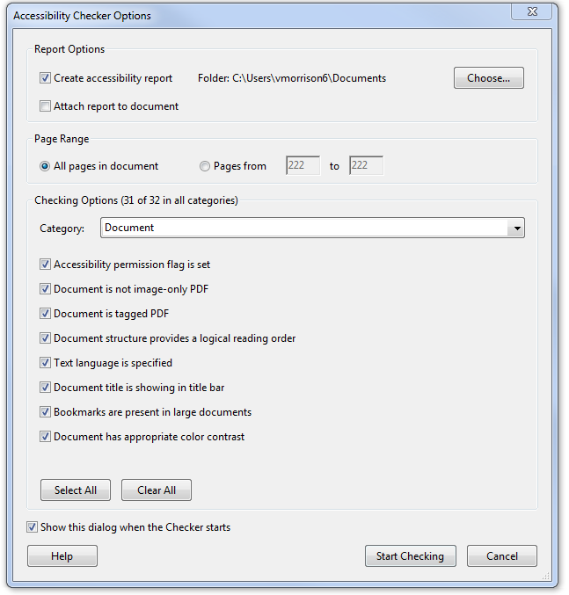
Accessibility Report
You can also generate an Accessibility Report in the Accessibility Tools options. Click on “Full Check” to open a list of things you’d like your check to include, such as figures missing alt text, missing bookmarks, errors in reading order, color contrast, not having a language selected, etc.

Slide 56
Excel Accessibility
Consider design, colors, and formatting in terms of clarity.
Each sheet tab should have its own unique name.
Tables: Do not merge cells or leave table cells blank if possible; Include clear column and row headings in tables.
Accessible graphs.
Table, graphics, smart art, charts, and shapes should have alternate text descriptions.
Include metadata for accessibility.
Go to File, then click on Check Issues, and then Check Accessibility to run a report listing issues you need to fix.
Save as Accessible PDF.

Slide 57
Design, Color, and Formatting
Arrange your data in a way that would make sense when navigated by a screen-reader and not just in a way that seems visually appealing.
Avoid using color alone to convey meaning. Someone who is blind or colorblind will not be able to distinguish the meaning.
Avoid using text and background colors that are hard to differentiate between.
As previously mentioned, a good tool to test color contrast can be found at The Paciello Group (www.paciellogroup.org).
Avoid unnecessary and distracting images and decorative shapes.

Slide 58
Use Unique Names for Sheets
Each Excel sheet should have its own unique name for easy navigation.
In addition, all empty sheet tabs should be deleted to avoid confusion.

Slide 59
Create Accessible Tables
Some tips for creating tables:
Use the built-in table feature in Excel
Avoid Merged or Blank Cells
Include Clear Header Rows
Include Alt Text for tables (see next slide)
Make sure data is clearly navigable and makes sense to a non-sighted user

Slide 60
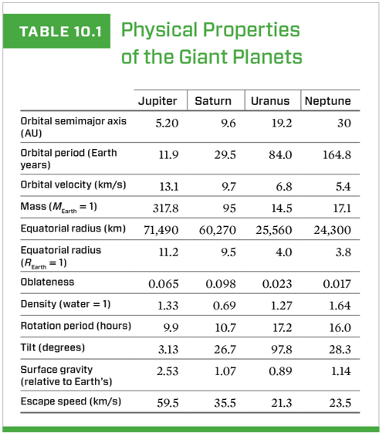
Structural Alt Text for Tables
In addition to adding alt text descriptions for any images or visual content, consider adding structural alt text to summarize your table contents. This gives someone a chance to hear what the table contains before listening to all the data.
Example:
Table 10.1 is titled Physical Properties of the Giant Planets. It has 5 columns and 13 rows. The column headings are Physical Property, Jupiter, Saturn, Uranus, and Neptune.
*Please note that because the first column heading was left blank, we filled it in so that the table would make more sense.

Slide 61
Accessible Graphs in Excel
When creating graphs of data in Excel from tables, be sure to keep the table near the graph. Having a table of data along with a graph will be useful so people can view the data in two different ways to help them process the information.
Also remember to add a clear header row and alt text to the graph.

Slide 62
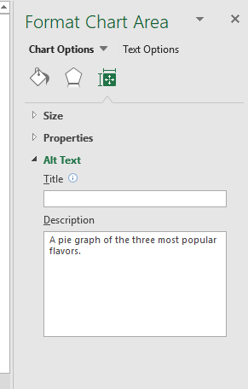
Alt Text for Other Objects
Graphics, smart art, charts, shapes, and tables should have alternative text descriptions.

Slide 63
Insert Metadata
By clicking on the File tab and viewing the Document Properties, you can edit information such as Author, Title, Keywords, or Comments to provide further information about what the document contains. This data will be retained if you save as an accessible PDF.

Slide 64
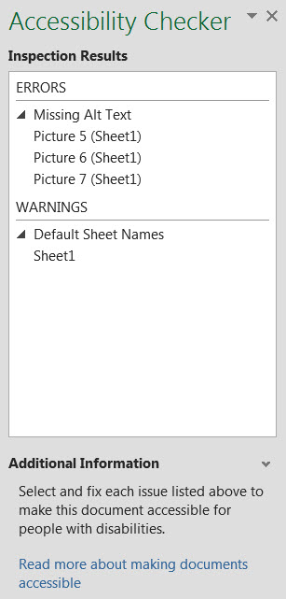
Accessibility Checker in Excel
Use the Accessibility Checker in Microsoft Excel, just as you would in Microsoft Word. Go to File, then click on Check Issues, and then Check Accessibility to run a quick report listing issues you need to fix.

Slide 65
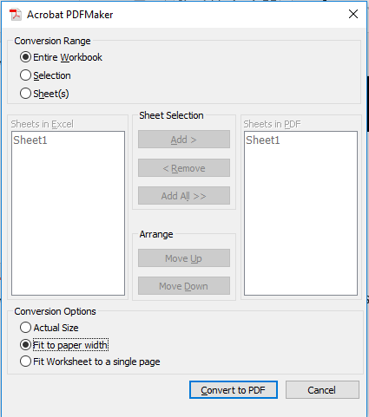
Save Excel File as PDF
You can save your Excel file as an accessible PDF.
Go to File, Save as Adobe PDF.
Options will be presented for you to choose the conversion range, sheet selection, and other conversion options.
Choose the options that meet your needs.

Slide 66
PowerPoint Accessibility
Choose fonts and color contrast for greatest visibility.
Use Layout Templates so that all text is visible in the outline view.
All slides should have unique titles for easy navigation and clarity.
Reading order can be adjusted in the Selection Pane.
Tables should have a header row, alt text description, and caption.
Lists should be created with the bullet and list toolbar buttons.
All graphics/images should have brief alternative text descriptions.
Create white space with page layout tools (not tab, enter, space bar).
Add metadata (title, author) on the File Tab.
Use the built in checker to create an accessibility report.

Slide 67
Clear Design and Format
Fonts - use a readable font in a large enough size that your presentation will be seen throughout the room.
Backgrounds - Always place text on a plain or solid background.
Inserting a background image allows you to include graphics that are not read aloud by screen reading software. For example, the AMAC logo above is simply a background image.
Colors and contrast - text color should provide enough contrast with background color that people can easily read it. Readers with low vision read yellow font on a black background most easily.
Layout - use a standard layout template with text placeholders. This will help with logical reading order and make sure that all of your content will be accessible.

Slide 68
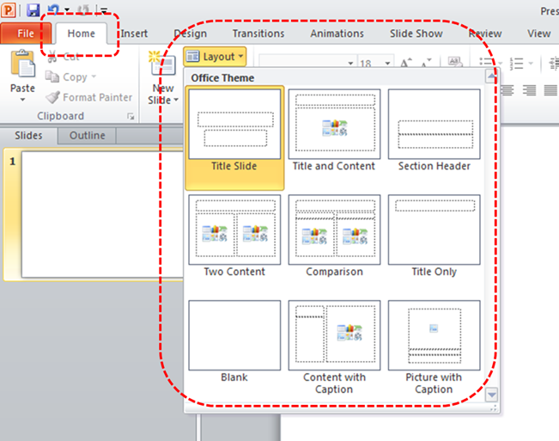
Templates and Layouts
Use PowerPoint’s built-in templates, not the text boxes which can be inaccessible to screen readers.
Go to Home Ribbon
Click on Layout
Right clicking on the slide pulls up layout options, as well.

Slide 69
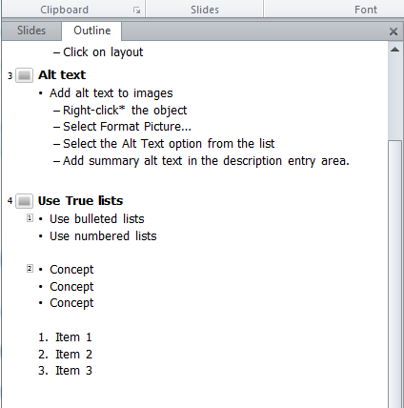
Outline View
Check that text appears in the Outline View.
If accessible templates and proper content placeholders have been used, the text will be viewable in the outline view. If text boxes were used on the slides, screen reading software might skip this text.
Delete extra hard line breaks in the outline view when possible. These will be read as “blank line.”

Slide 70
Descriptive Slide Titles
Give each slide a unique title
Aids in navigation
Clarifies your presentation
Organizes your ideas
Helps your audience focus

Slide 71
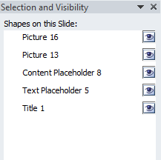
Selecting Reading Order
Go to menu item: Home
In the Drawing section, select Arrange > Selection Pane…
In the Selection and Visibility pane, all the elements on the slide are listed in reverse order. In other words, the tab order of objects begins at the bottom of the list and tabs upwards.
Elements can be re-ordered using the arrows at the bottom of the Selection and Visibility pane.
Note how many objects are in this example screenshot. It would be more accessible if the slide were simplified and streamlined with fewer objects if possible.

Slide 72
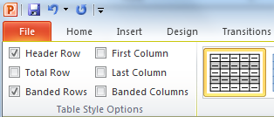
Inserting Tables
To add a table with headings
Go to menu item: Insert
In the Tables section, select the Tables icon
Select the number of rows and columns you would like your table to have
Select the table and a Table Tools menu item should appear
Go to menu item: Table Tools > Design
In the Table Style Options section, select the Header Row check box Note: Whenever possible, keep tables simple with just 1 row of headings.
Add a brief description before table if possible, to give an overview of data.
ID | Institution | Type | Eligible
24 | Emory | Post-doctorate | yes
77 | UGA | Undergraduate | yes
82 | Georgia Tech | Undergraduate | yes

Slide 73
Select Lists Styles
Create bulleted and numbered lists with the built-in list tools.
The Home tab has drop down menus where you can easily create lists and adjust their hierarchy.
Avoid creating a list with icons or graphics as bullets.

Slide 74
Considering Graphics
If most of your images are decorative, can you combine them into one?
If your slide contains an animation, can you include a text description that sums up the main content?
Do your graphics appear crisp and legible?
Can your information be conveyed in a different format either instead or in addition to your graphic?
To determine the alt text to add, determine the purpose and meaning of the image and write a brief text equivalent.

Slide 75
Adding Alternative Text
All Tables, Graphics, and Shapes need to have alt text added.
To add alt text, right click the object and choose Edit Alt Text. If you have an older version of Microsoft Office, you may need to click Format Picture and add alt text in the Size and Properties tab.
Most images only need a brief description.

Slide 76
Use Accessible White Space
You can adjust spacing before and after lines to create white space for formatting.
Avoid creating white space by pressing Enter, Tab, or Space multiple times.

Slide 77
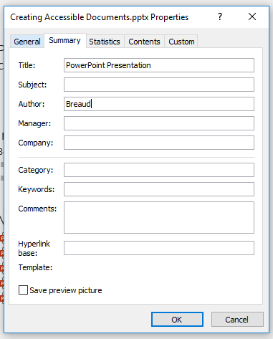
Use Descriptive Metadata
By clicking on the File tab and viewing the Document Properties, you can edit information such as Author, Title, Subject Tags, or Comments to provide further information about what the document contains. This data will be retained if you save as an accessible PDF.

Slide 78
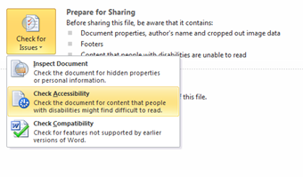
Using the Accessibility Checker
To access the Accessibility Checker, go to the File tab and click Check for Issues
From the drop down menu, select Check Accessibility

Slide 79
Save Your Presentation as a PDF
MS PowerPoint has the option to Save and Export accessible formatting, including alt text when the ppt is saved as a PDF. To export your file to an accessible PDF format, go to File > Save As > from the Save as type drop down menu choose PDF and click on Options.
Under Include Non-Printing Information, be sure to check:
Document properties
Document structure tags for accessibility
If Adobe Acrobat PDF Maker is installed, choose Save as Adobe PDF. An important advantage to exporting with Adobe PDF Maker – slide titles will export as Bookmarks in the PDF.

Slide 80
Social Media Accessibility
Twitter
Facebook
Snapchat
Instagram
Flickr
LinkedIn
The information in this section is obtained from Accessible U (https://accessibility.umn.edu/tutorials/accessible-social-media)

Slide 81
Twitter Best Practices
Go into your settings and turn on alternative text for images
When you tweet a hyperlink, indicate whether it leads to [AUDIO], [PIC], or [VIDEO]
Use a URL shortener (Z Link or another) to minimize the number of characters in the hyperlink
Put mentions and hashtags at the end of your tweets
Capitalize the first letter of each word in a hashtag, (which is called camelbacking; the difference between #screenreaderdemo and #ScreenReaderDemo)
Avoid using acronyms in your posts.
More information found on Accessible U (https://accessibility.umn.edu/tutorials/accessible-social-media)

Slide 82
Facebook Best Practices
Edit the machine-generated alternative text to add richer, contextual descriptions when you post a photo
Add a caption file, or use YouTube’s captioning services for Facebook videos
Avoid using acronyms in your posts
Like Facebook’s Accessibility page for updates on new accessibility features
More information found on Accessible U (https://accessibility.umn.edu/tutorials/accessible-social-media)

Slide 83
Snapchat Best Practices
Plan out your snap stories to make sure they would make sense for all users
Use the larger text option for captions
Make sure there is good contrast between the background and the captions
More information found on Accessible U (https://accessibility.umn.edu/tutorials/accessible-social-media)

Slide 84
Instagram Best Practices
Edit Instagram's machine-generated alternative text to provide more detailed descriptions that also give context to the photo, e.g. "A path in my home town lined with yellow flowers on a sunny day."
Use the post's description area to add alternative text to caption video posts
Use the zoom-in feature to look at photos more closely by “pinching” the image with your fingers on the screen
More information found on Accessible U (https://accessibility.umn.edu/tutorials/accessible-social-media)

Slide 85
Flickr Best Practices
Create accurate descriptions for your photos.
Change the titles of your images to describe what is happening in the image
Use spaces between the words in your tags
More information found on Accessible U (https://accessibility.umn.edu/tutorials/accessible-social-media)

Slide 86
LinkedIn Best Practices
Add descriptive alt text to the images you post.
Use closed captioning when sharing a video on LinkedIn from the desktop experience.
More information found on Accessible U (https://accessibility.umn.edu/tutorials/accessible-social-media)

Slide 87
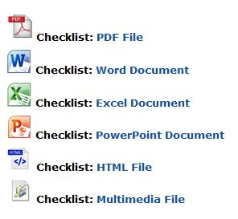
Accessibility Checklists
You can find helpful 508 Checklists on the United States Department of Health and Human Services Website:
Source: Department of Health and Human Services website (https://www.hhs.gov/web/section-508/making-files-accessible/index.html).

Slide 88
AccessGA Videos
To learn more about making your documents accessible, we have some tutorials located at Access GA - Creating Accessible Documents. (http://accessga.org/wiki/Creating_Accessible_Documents)

Slide 89
Stay Informed
Trends:
Sonocent Audio Notetaker (https://sonocent.com/audio-notetaker)- Records notes live; students can highlight and annotate as they listen.
How to Use Microsoft Word Text-to-Speech to Read Out Loud (https://www.techwalla.com/articles/how-to-use-microsoft-word-text-to-speech-to-read-out-loud) - The Speak feature will read the contents of your document aloud. No third-party screen reader is required.
Resources:
Southeast ADA Center: (http://www.adasoutheast.org)- This site provides information about laws, publications, training, news, and events related to the Americans with Disabilities Act.
American Council for the Blind: (http://www.acb.org/) - This site provides information about programs, scholarships, publications, and media. ACB strives to increase independence for all people who are blind or have visual impairments.
Adapt: (https://adapt.org/) - This site organizes disability movements for human rights.

Slide 90
Have Further Questions?
Contact our Customer Support Team by phone (404) 894-7756 or by email cidi-support@design.gatech.edu

