Slide 1
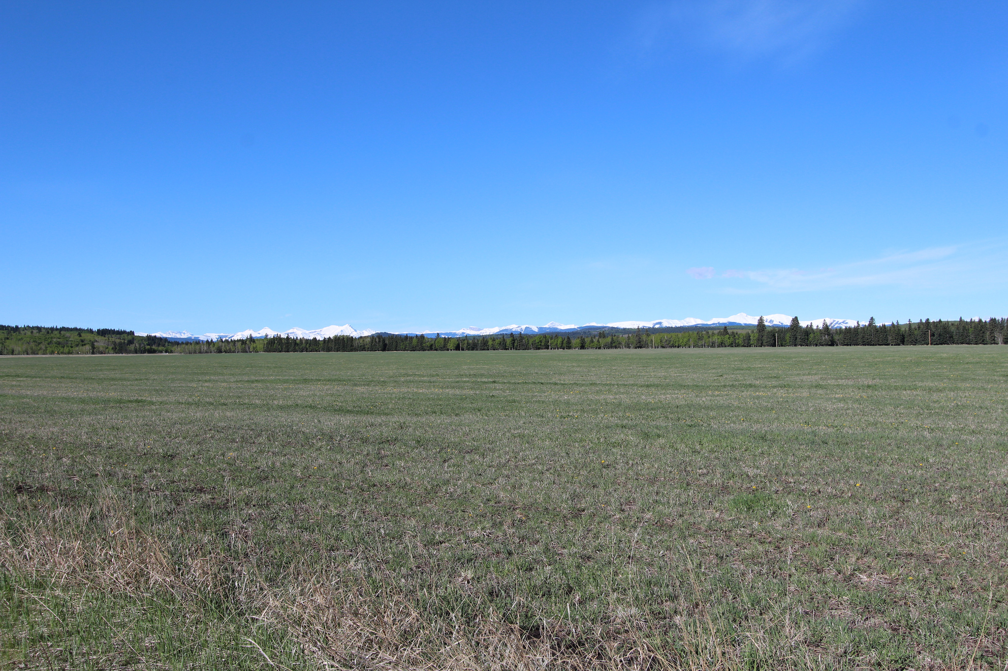
An Introduction to
Open Licenses
Denise Dimsdale
Education Librarian
ALG Library Coordinator
Georgia State University
Unless otherwise noted, content in this presentation is licensed under CCBYNC 4.0.
Image adapted from Wide open space with the mountains calling me by davebloggs007 CCBY 2.0

Slide 2
I’m not a lawyer. The purpose of this presentation is for informational purposes only and not for the purpose of providing legal advice. I am here to share information and tools mostly from the creative commons website, and to have a conversation about how people are thinking about creative commons licenses.

Slide 3
Open licenses
Several types of open licenses
We will be talking specifically about Creative Commons (CC) licenses
CC licenses are not recommended for computer software and hardware

Slide 4
creativecommons.org
creativecommons.org/faq/
wiki.creativecommons.org

Slide 5
What do you think Creative Commons Licenses are about?
Limiting how content may be shared
Providing a standardized way of letting others know how the author/creator wants to share content
The purpose is To promote the progress of Science and useful Arts by securing for limited times to authors and inventors the exclusive right to their writings and discoveries.
--U.S.C. Const. Art. I § 8, cl. 8

Slide 6
What are Creative Commons Licenses?
Provides options for sharing and reusing content
You can apply the license only if you have the rights/are the copyright holder
There’s no need to register content you create with a CC license
Label with text and/or metadata or use the CC License Chooser Tool
Not revocable (Could change it/relicense it but doesn’t revoke the original terms.)

Slide 7
What are Creative Commons Licenses?
Six main licenses:

Slide 8
What are Creative Commons Licenses?
Six main licenses
CC for Creative Commons

Slide 9
What are Creative Commons Licenses?
Six main licenses:
CC for Creative Commons
BY for attribution

Slide 10
What are Creative Commons Licenses?
      CC BY: This license lets others distribute, remix, tweak, and build upon your work, even commercially, as long as they credit you for the original creation. This is the most accommodating of licenses offered. Recommended for maximum dissemination and use of licensed materials.
      CC BY-SA: This license lets others remix, tweak, and build upon your work even for commercial purposes, as long as they credit you and license their new creations under the identical terms. This license is often compared to “copyleft” free and open source software licenses. All new works based on yours will carry the same license, so any derivatives will also allow commercial use. This is the license used by Wikipedia, and is recommended for materials that would benefit from incorporating content from Wikipedia and similarly licensed projects.
      CC BY-ND: This license allows for redistribution, commercial and non-commercial, as long as it is passed along unchanged and in whole, with credit to you.
      CC BY-NC: This license lets others remix, tweak, and build upon your work non-commercially, and although their new works must also acknowledge you and be non-commercial, they don’t have to license their derivative works on the same terms.
      CC BY-NC-SA: This license lets others remix, tweak, and build upon your work non-commercially, as long as they credit you and license their new creations under the identical terms.
      CC BY-NC-ND: This license is the most restrictive of our six main licenses, only allowing others to download your works and share them with others as long as they credit you, but they can’t change them in any way or use them commercially.
CC summary text copied from About the Licenses by Creative Commons. CCBY 4.0

Slide 11
What are Creative Commons Licenses?
CC BY
Provide credit to the creator(s)
Link to the original and the license
Note changes if you made them
      CC BY: This license lets others distribute, remix, tweak, and build upon your work, even commercially, as long as they credit you for the original creation. This is the most accommodating of licenses offered. Recommended for maximum dissemination and use of licensed materials.
CC summary text copied from
About the Licenses by Creative Commons. CCBY 4.0

Slide 12
What are Creative Commons Licenses?
CC BY-SA
Derivative must also be licensed CC BY-SA
This license lets others remix, tweak, and build upon your work even for commercial purposes, as long as they credit you and license their new creations under the identical terms. This license is often compared to “copyleft” free and open source software licenses. All new works based on yours will carry the same license, so any derivatives will also allow commercial use. This is the license used by Wikipedia, and is recommended for materials that would benefit from incorporating content from Wikipedia and similarly licensed projects.
CC summary text copied from
About the Licenses by Creative Commons. CCBY 4.0

Slide 13
Share Alike Question
Can a company include a CC BY SA photo on the cover of a collection of maps when the map collection is sold under all rights reserved and does not include a Creative Commons license?

Slide 14
Share Alike Question
Drauglis v. Kappa Map Group, LLC
http://us.creativecommons.org/archives/1152
The work is a collective work and not a derivative work. Therefore, SA does not apply.

Slide 15
Collective Works/Compilations
Collective works: compilations of pre-existing works
  In a collective work, each work can stand alone. Examples include anthologies and encyclopedias.
  Any of the six CC licenses can be used in a collective work. However, you still cannot use NC content commercially even if it is part of a collection.
  --https://creativecommons.org/faq/

Slide 16
Can a course be a collective work?

Slide 17
What are Creative Commons Licenses?
CC BY-ND
No Derivatives; no remix
This license allows for redistribution, commercial and non-commercial, as long as it is passed along unchanged and in whole, with credit to you.
CC summary text copied from
About the Licenses by Creative Commons. CCBY 4.0

Slide 18
What are Creative Commons Licenses?
CC BY-NC
Non commercial; no monetary compensation
This license lets others remix, tweak, and build upon your work non-commercially, and although their new works must also acknowledge you and be non-commercial, they don’t have to license their derivative works on the same terms.
CC summary text copied from
About the Licenses by Creative Commons. CCBY 4.0

Slide 19
Non commercial question
Should a printing company fill a customer’s order to make photocopies of NC content (and charge for the printing) if the NC licensed content is going to be used non-commercially?

Slide 20
Non commercial question
Great minds (K-12 publisher) vs. FedEx Office
(CC BY NC SA 4.0)
Case dismissed
CC argues that the intent of NC is to allow this.
https://creativecommons.org/2017/02/24/update-great-minds-v-fedex-office-litigation-involving-nc-sa/

Slide 21
Non commercial question
What about college bookstores? Can they sell NC licensed textbooks?

Slide 22
What are Creative Commons Licenses?
CC BY-NC-SA
Non commercial; no monetary compensation
Derivative works must also be licensed CC BY-NC-SA
This license lets others remix, tweak, and build upon your work non-commercially, as long as they credit you and license their new creations under the identical terms.
CC summary text copied from
About the Licenses by Creative Commons. CCBY 4.0

Slide 23
What are Creative Commons Licenses?
CC BY-NC-ND
Non commercial; no monetary compensation
No derivative works
This license is the most restrictive of our six main licenses, only allowing others to download your works and share them with others as long as they credit you, but they can’t change them in any way or use them commercially.
CC summary text copied from
About the Licenses by Creative Commons. CCBY 4.0

Slide 24
Adapting/Remixing Works
SA (Share Alike) licenses
  The share alike part of the license is only applicable to adapted/derivative content.
  When you license your adapted work, you are only licensing the changes that you made.
  “In all license versions, synching CC-licensed audio in timed relation with a video to create an audiovisual work creates an adaptation of that audio work for purposes of the license…” --https://wiki.creativecommons.org/wiki/License_Versions#Adapted_material_usable_under_conditions_of_adapter.27s_license

Slide 25
Adapting content and license compatibility
Creative Commons Compatibility Wizards:
http://www.web2rights.com/OERIPRSupport/creativecommons/
Wizard 1: Which resources are compatible with one another
Wizard 2: I know how I want to license my work, what resources can I remix
Image adapted from Day #142 Remix by Martin Weller CC BY NC 2.0

Slide 26
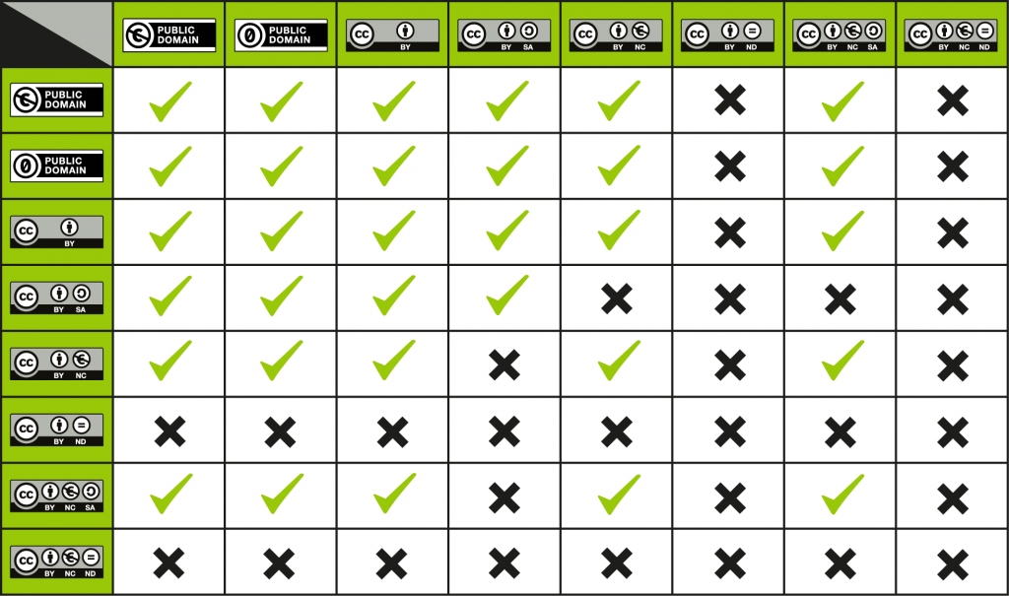
https://wiki.creativecommons.org/wiki/Wiki/cc_license_compatibility: Created by Kennisland published under a CC0 license.

Slide 27
License Compatibility Question
In my adaptation, can I combine a photo licensed CC-BYNC with text that’s licensed CC-BYSA?

Slide 28
License Compatibility Question
Keep in mind that you can always ask permission.

Slide 29
If I am creating an anthology of readings where I am not making any changes to the content, can I combine CC-BYNC with CC-BYSA?

Slide 30
License Compatibility Question
I am using CC-BY content and CC-BYSA content in my adaptation. How should I license my work?

Slide 31
CC License Chooser Tool
https://creativecommons.org/choose/
  Asks simple questions to determine which license to use
  Provides imbed code to make the license machine readable (metadata)
  Has option for inclusion of standard attribution of your work

Slide 32
Attribution
Sometimes the copyright owner tells you how they want their work cited.
Pooling Ideas: We are what we share-Attributing Creative Commons Materials: http://creativecommons.org.au/materials/attribution.pdf
Best practices for attribution: https://wiki.creativecommons.org/wiki/Best_practices_for_attribution
  TASL: Title, Author, Source, License…and anything the user should know
Different versions of CC licenses have different requirements for attribution: https://wiki.creativecommons.org/wiki/License_Versions#Detailed_attribution_comparison_chart
Background image adapted from Sky by Sunny Goo CCBY2.0

Slide 33
Lawsuits
https://wiki.creativecommons.org/wiki/Case_Law
http://us.creativecommons.org
Great Minds v Fedex Office
http://us.creativecommons.org/archives/1159
Drauglis v. Kappa Map Group, LLC, 128 F. Supp.3d 46 (D.D.C. 2015)
http://us.creativecommons.org/archives/1152
  Chang v Virgin Mobile: (photo used in Australian phone advertisement) CC doesn’t cover publicity or privacy rights
  https://wiki.creativecommons.org/wiki/Chang_v._Virgin_Mobile
Curry v. Audax (Dutch): Curry’s BYNCSA photos posted on Flickr were used in a commercial tabloid. The court upheld the CC license.
https://wiki.creativecommons.org/wiki/Curry_v._Audax
No. 71036 N. v. Newspaper (Israel): A newspaper used BYSA photographs without proper attribution. Photographer won was awarded 3500 Shequels.
https://wiki.creativecommons.org/wiki/No._71036_N._v._Newspaper

