Slide 1
Textbook Transformation Grants R1: Final Report Review Lauren Fancher, Director, Affordable Learning Georgia Jeff Gallant, Visiting Program Officer for OER, Affordable Learning Georgia

Slide 2
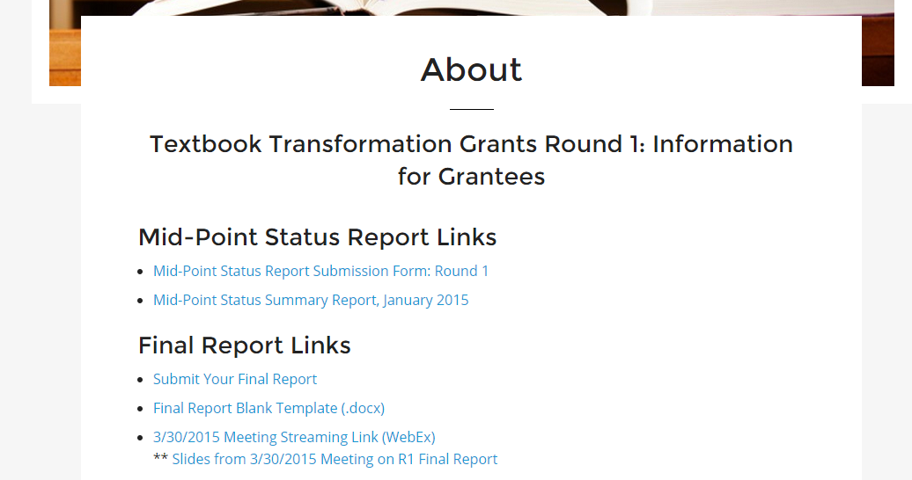
How to Get to the Report

Slide 3
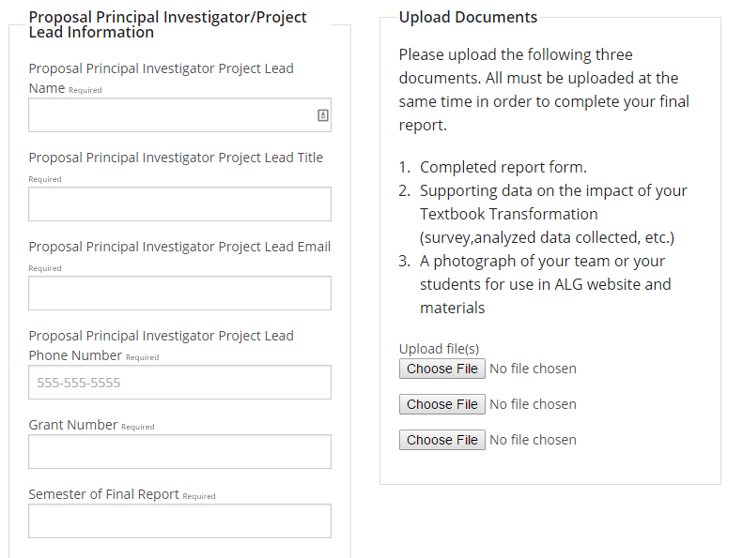
How to Get to the Report

Slide 4
Final Report Overview
Due Date: June 1, 2015
Your final report submission must include three separate component files:
Completed report form. Complete this form per inline instructions. Italicized text is provided for your assistance; please delete the italicized text before submitting your report.
Supporting data on the impact of your Textbook Transformation (survey, analyzed data collected, etc.)
A photograph of your team and/or your students for use in ALG website and materials

Slide 5
Basic Project Information
Date:
Grant Number:
Institution Name(s):
Team Members (Name, Title, Department, Institutions if different, and email address for each):
Project Lead:
Course Name(s) and Course Numbers:
Semester Project Began:
Semester of Implementation:
Average Number of Students Per Course Section:
Number of Course Sections Affected by Implementation:
Total Number of Students Affected by Implementation:

Slide 6
1. List of Resources Used in the Textbook Transformation
For each resource, give the title, author, Creative Commons licenses (if appropriate), and freely accessible URL to the material.
Include all open-access links to all adopted, adapted, and newly created course materials.

Slide 7
2. Narrative
A. Describe the key outcomes, whether positive, negative, or interesting, of your project. Include:
Summary of your transformation experience, including challenges and accomplishments
Transformative impacts on your instruction
Transformative impacts on your students and their performance
B. Describe lessons learned, including any things you would do differently next time.

Slide 8
3. Quotes
Provide three quotes from students evaluating their experience with the no-cost learning materials.

Slide 9
4. Quantitative and Qualitative Measures
In this section, summarize the supporting impact data that you are submitting, including all quantitative and qualitative measures of impact on student success and experience. Include all measures as described in your proposal, along with any measures developed after the proposal submission. Include measures such as:
Drop, fail, withdraw (DFW) delta rates
Course retention and completion rates
Average GPA
Pre-and post-transformation DFW comparison
Student success in learning objectives
Surveys, interviews, and other qualitative measures
When submitting your final report, as noted above, you will also need to provide the separate file of supporting data on the impact of your Textbook Transformation (surveys, analyzed data collected, etc.)

Slide 10
5. Sustainability Plan
Describe how your project team or department will offer the materials in the course(s) in the future, including the maintenance and updating of course materials.

Slide 11
6. Future Plans
Describe any impacts or influences this project has had on your thinking about or selection of learning materials in this and other courses that you will teach in the future.
Describe any planned or actual papers, presentations, publications, or other professional activities that you expect to produce that reflect your work on this project.

Slide 12
7. Description of Photograph
List the names of the people in the separately uploaded photograph and their roles, e.g.:
(left-right) Dr. Transformer, team lead and instructor of record; Agent Graphic, instructional designer; Dr. Philomath, subject matter expert; B. Bibliophile, librarian; A. Einstein, Student.

