Slide 1
Textbook Transformation Grants Kickoff
October 20, 2014
Round One Grantees
Middle Georgia State College

Slide 2
Textbook Transformation Grants, Round 1
Kickoff Training Event: October 20, 2014, 9-4pm
9am-10:45am: Opening General Session
Welcome and Introductions
Introduction to ALG and Textbook Transformation Grants
What is “Open?”
Introduction to OpenStax College
10:50am-11:50am: Grant Category Breakout Sessions
12:00pm-1:00pm: Lunch and Discussion on grant procedures and compliance
1:00pm-1:50pm: General Session: Accessibility
2:00pm-3:00pm: Grant Category Breakout Sessions
3:00pm-4:00pm: Q&A Forum and Wrap-up
Agenda

Slide 3
Lauren Fancher: Director, GALILEO Support Services, Board of Regents, USG
Ongoing point of contact for Service Level Agreements
Jeff Gallant: Visiting Program Officer for OER, GALILEO Support Services, Board of Regents, USG
Ongoing point of contact for implementation assistance and compliance reporting
Welcome and Introductions

Slide 4
Our guest presenters and instructors:
Nicole Finkbeiner: Associate Director of Institutional Relations, OpenStax College
Marie Lasseter: Director, Academic Technologies, USG Office of Faculty Development
Robert Martinengo: Publisher Outreach Specialist, AMAC Accessibility Solutions
Norah Sinclair: Customer Support Supervisor, AMAC Accessibility Solutions
Welcome and Introductions

Slide 5
Summary of Grants and Grantees
19 institutions
7 State Colleges
7 State Universities
2 Comprehensive Universities
3 Research Universities
64 participants
$ 314,590 awarded
$2,206,138 in potential savings to students
19 Top 50 courses addressed
Welcome and Introductions

Slide 6
All Round One Grantees Listed with Links to Proposals on ALG Website
Welcome and Introductions

Slide 7
All Round One Grantees Listed with Links to Proposals on ALG Website
http://affordablelearninggeorgia.org/site/entry/textbook_transformation_grants_round_1
Welcome and Introductions

Slide 8
Provide Textbook Transformation grantees with the information they will need to be successful, including information about the grant process and basic understanding of key subject areas
Bring the cohort together for sharing and community-building
Uncover and address any issues or concerns
Today’s Objectives

Slide 9
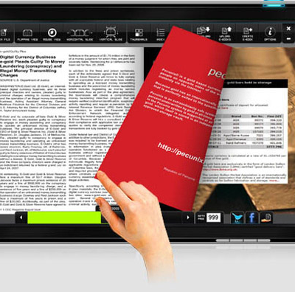
USG Improving Access and Affordability
The State of Georgia’s FY 2015 budget funds this new USG initiative, Affordable Learning Georgia (ALG), which focuses on reducing the cost of textbooks and the enhancement of GALILEO, Georgia’s Virtual Library and ALG’s parent initiative.

Slide 10
Affordable Learning Georgia Is…
A one-stop service to help USG faculty and staff identify lower-cost, electronic, free, and open educational resources (OER), building on the cost-effective subscription resources provided by GALILEO and the USG libraries. www.affordablelearninggeorgia.org
Programs to support more affordable learning materials, including campus advocacy, faculty development, bookstore collaborations, and grants for textbook transformation, including a partnership with eCore, the University System’s core curriculum taught completely online.
An initiative of the University System of Georgia and GALILEO, Georgia’s Virtual Library. www.galileo.usg.edu

Slide 11
ACTIVITIES AND STRATEGIES
Goals and Programs:
OER for Top Fifty Courses
OER for eCore
OER Textbook Transformation Grants: working with campuses
Bookstore program
Symposium on the Future of the Textbook

Slide 12
Scale: Top 50 Lower Division Courses
A framework to support adoption, adaptation, and creation of no-or-low-cost textbook alternatives
http://www.affordablelearninggeorgia.org/find_textbooks/alg_top_courses

Slide 13
Scale: eCore Partnership
eCore has already transitioned 10 courses to use no-cost, open resources.
Validation at-scale of quality
Plans call for ALG to support the transition for 15 additional eCore courses to use no-cost, open resources in FY15 and 6 in FY16

Slide 14
Scale: eCore Partnership
Projected Savings:
15 courses to be transitioned in FY15 are projected to save students $1,884,610 in FY 15-16.
6 courses to be transitioned in FY16 are projected to save students $478,130 in FY16.
Total projected savings for eCore students in FY15-16: $2,362,740.

Slide 15
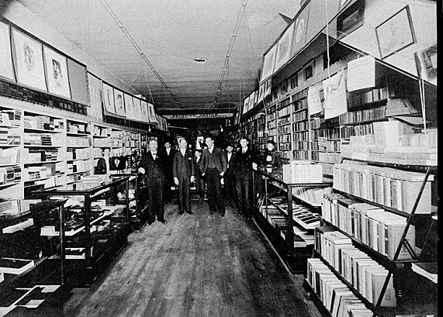
USG college store partners
Lowest price guarantees, rental programs, and more
Data about cost savings as well as adoptions
Software for comparison shopping, adoptions, marketplace
Photograph of McGregor Company bookstore, Athens, Clarke County, Georgia. Vanishing Georgia, Georgia Division of Archives and History, Office of Secretary of State. Digital Library of Georgia.
College Store Program Update

Slide 16
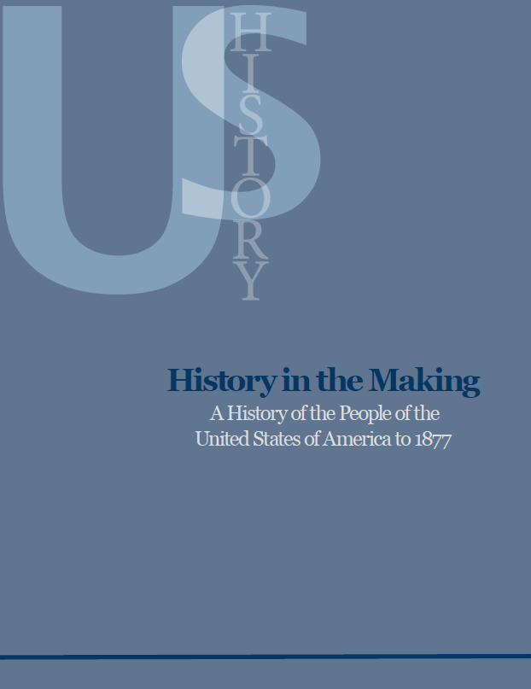
Partner: USG University Presses
Working with USG presses (UNG UGS, KSU) to leverage expertise, catalog, and infrastructure
Peer review and editorial processes
Hosting and distribution models
Adoption/licensing of existing materials in catalog
Original Open Textbook production model developed with USG U.S. History I Textbook
History in the Making:
A History of the People of the United States of America to 1877

Slide 17
Partner: OpenStax College of Rice University

Slide 18
Partner: OpenStax College of Rice University
7 titles now, 11 in 2015, 21 by 2017
High quality, professional publications with peer review and all standard publishing editorial processes
Open to adopt and adapt through free customized hosting
Many already in use in USG, eCore, and more to come
Additional option to purchase very low cost print copy
Funded by Gates, Hewlett, 20 Million Minds, Maxfield, Kazanjian, Lowenstein, and Arnold Foundations
http://openstaxcollege.org

Slide 19
Pilot different approaches in USG courses for textbook transformation including adoption, adaptation, and creation of Open Educational Resources (OER) and/or identification and adoption of materials already available in GALILEO and USG libraries.
Provide support to faculty, libraries, and their institutions to implement these approaches.
Lower the cost of college for students and contribute to their retention, progression, and graduation.
Goals of ALG Textbook Transformation Grants

Slide 20
Why Grants?
Adoption, adaptation, and creation take time. Textbook Transformation Grants allow for:
Course releases or extra-workload compensation for faculty
Assistance from instructional designers
Support for training session travel
Why Grants?
Vector art designed by Freepik: http://www.freepik.com/free-vector/simple-small-icon-vector-material_575034.htm

Slide 21
External Project Impact
Shared evaluations
Sustainability measures
Shared creations and adaptations
Lessons learned
RPG statistics
Student savings
Why Grants?
Vector art designed by Freepik: http://www.freepik.com/free-vector/simple-small-icon-vector-material_575034.htm

Slide 22
Textbook Transformation Grants
RFP’s Round One:
No-Cost-to-Students Learning Materials
OpenStax Textbooks
Course Pack Pilots
RFP’s Round Two:
No-Cost-to-Students Learning Materials
OpenStax Textbooks
Course Pack Pilots
Transformations-at-Scale:
Multiple Course, Sections, or Department-wide
Multiple Institutions
Original Open Textbook

Slide 23
Please hold your questions relative to implementation, budget, agreements, etc. until lunch time.
Grant Procedures

Slide 24
Funding is not a direct stipend to the team members
Goes to the institution to cover the team member’s time (salary/release time/overload/replacement coverage), project expenses including related department needs, and travel expenses (up to $800 is specifically designated for two or more to attend the required in-person kickoff meeting).
The proposing team should coordinate as necessary with their departments and institutional sponsors to determine how to handle the distribution, including amounts, release time/overload/salary/replacement as well as semester(s).
Funding

Slide 25
Gives maximum flexibility to the institution and the team in terms of how many people and what types of skills are needed, amount of compensation vs. replacement of teaching load, and timing in terms of semesters of preparatory work vs. semesters of adoption.
Funding will be released to the sponsoring institutional office in two parts: 50% on return of the USG-drafted Service Level Agreement (SLA) with the original or modified proposal serving as the statement of work, and 50% on submission of the final report.
Funding

Slide 26
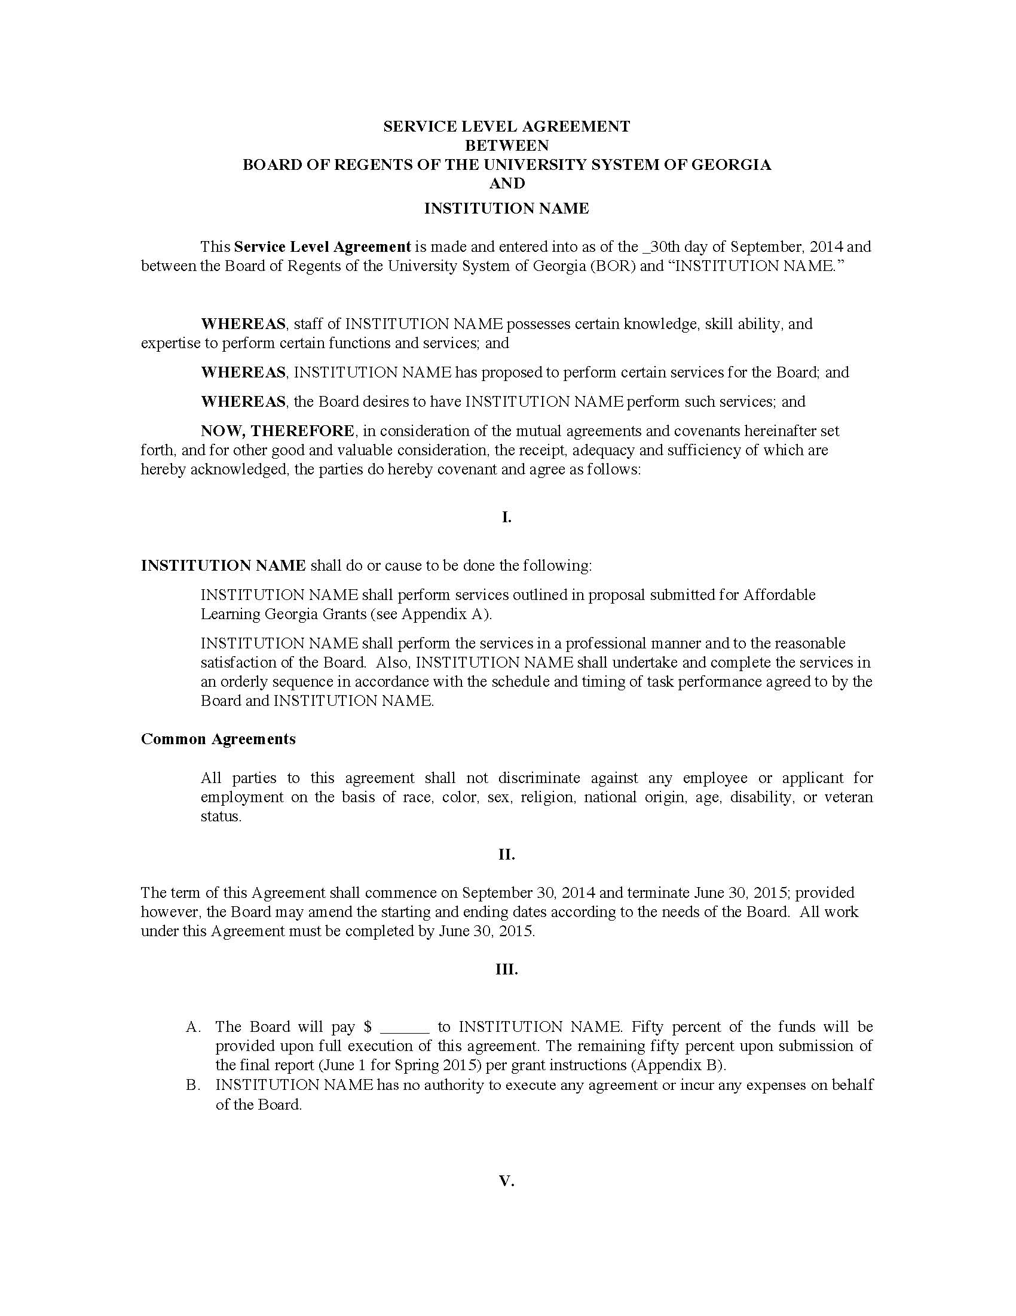
Service Level Agreements
Grant Procedures

Slide 27
Service Level Agreements
Grant Procedures

Slide 28
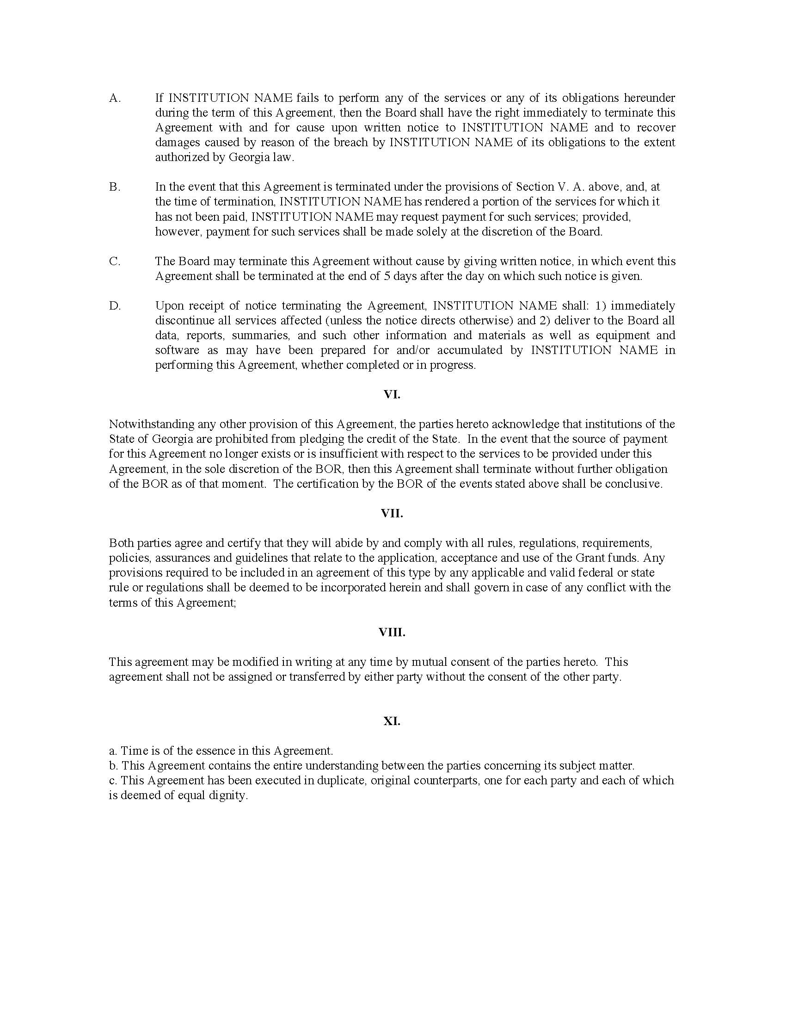
Service Level Agreements
Grant Procedures

Slide 29
Service Level Agreements
Attachment A is Your Proposal and Timeline
Grant Procedures

Slide 30
Service Level Agreements
Pending signatures at USG
Will be sent to project team lead as indicated in confirmation form with instructions, basically:
Acquire signatures as required by your institution (if there is a designated signature authority) as well as your department/unit sponsor (who submitted your letter of support, where funds will be sent)
Return to USG with an invoice in the amount shown on the SLA, with directions on department/unit where payment is to be sent
On receipt by USG, 50% of funds will be disbursed
Remaining 50% on receipt of final report
Grant Procedures

Slide 31
Timeline:
Now-December 19, 2014: Implementation processes
December 19, 2014: Deadline for Mid-Point Status Report
January 2015: Production release in USG course of grant-produced content and attendant course redesign
June 1: Deadline for Final Report
Grant Procedures

Slide 32
The identification, review, selection, and adoption/adaptation/creation of the new course materials.
The course and syllabus instructional design/redesign necessary for the transformation.
The activities expected from each team member and their role(s): subject matter experts, instructional designer, librarian, instructor of record, et al.
The plan for providing open access to the new materials.
Discuss these with your team, make a plan.
Share any questions or needs you have with your group leader this afternoon.
Implementation Processes

Slide 33
Mid-Point Status Report
Report will be an online form
Multiple-choice, paragraph questions
Focused on project being on track for implementation in Spring 2015
Grant Procedures
Vector art designed by Freepik: http://www.freepik.com/free-vector/simple-small-icon-vector-material_575034.htm

Slide 34
Final Report
Report will be a written document
Includes links to adopted materials
Includes measures of impact on student success / RPG
Qualitative measures, surveys, interviews
Grant Procedures
Vector art designed by Freepik: http://www.freepik.com/free-vector/simple-small-icon-vector-material_575034.htm

Slide 35
Measures
Grant proposals may or may not have addressed in depth
Need to plan and consider how to capture/collect data that shows impact on student performance
Need to plan and consider how to capture/collect anecdotal evidence from students about their experience and satisfaction with the materials
Need to consider assessment/improvement quality cycle
Grant Procedures
Vector art designed by Freepik: http://www.freepik.com/free-vector/simple-small-icon-vector-material_575034.htm

Slide 36
RPG =
Retention
Progression
Graduation
New formula funding model in FY16 for USG from General Assembly will take this into account
Research on OER and RPG measures are new and ongoing, but recent case studies are promising:
Retention, Progression, Graduation

Slide 37
Case: University System of Georgia
History in the Making: A History of the People of the United States of America to 1877
Implemented in eCore US History I course in Summer and Fall 2013.
In Spring 2013, prior to open text implementation: 88% HIST 2111 retention rate.
In Summer 2013, the first semester with the Open Textbook, retention increased to 94%.
Successful completion (grades A, B, and C) rose from 56% in the spring to 84% in the summer with the open textbook.
Retention is the measure of non-withdrawals (grades A,B,C,D,F)
Successful course completion is the measure of grades A, B, and C. Non-successful course completion is the measure of grades D, F, W, and WF.

Slide 38
Case: Mercy College Mathematics
In a college-wide adoption or OER: All 27 sections of Basic Mathematics replaced commercial textbooks with OER in fall 2012.
The pass rate for the course increased from 48.40% in spring 2011 to 68.90% in fall 2012.
Students saved $125,000 during the first year.
From David Wiley of Lumen Learning: This is an over 50x increase in passing percentage per dollar spent by students on course materials.
http://opencontent.org/blog/archives/3462

Slide 39
General announcements and reminders to the ALGGRANTEES-L listserv. Feel free to share information and ask questions using this listserv. All ALG grantees (including round 2 and future) will be subscribed.
Round-1-grantee-only communications will be tagged [R1]. Round-2-grantee-only communications will be tagged [R2]. This will allow everyone to understand who the question, or information, or deadline, is intended for.
Communications: Listserv

Slide 40
Lauren Fancher: Director, GALILEO Support Services, Board of Regents, USG
Ongoing point of contact for Service Level Agreements
Jeff Gallant: Visiting Program Officer for OER, GALILEO Support Services, Board of Regents, USG
Ongoing point of contact for implementation assistance and compliance reporting. Including help or referral on questions about content, materials, open licensing, etc.
Please use the question form at: http://tinyurl.com/alggrantsupport
This will greatly expedite response time and ensure that questions are tracked in conjunction with your proposal and compliance information
If for any reason you must use email, please include your Proposal ID in the subject line
Please call on us for help even if you are not sure which person is the correct person, or if we have SME-ise on the topic. We will get someone to help you if possible.
Communications: Lauren and Jeff

