Slide 1
Textbook Transformation Grants: Grant Procedures, Spring 2018 Pilot Round

Slide 2
Communications
Jeff Gallant: Program Manager, Affordable Learning Georgia, Board of Regents, USG
Ongoing point of contact for Service Level Agreements
Ongoing point of contact for implementation assistance and compliance reporting
Jeff.Gallant@usg.edu
Marie Lasseter: Director, Academic Technologies, Affordable Learning Georgia, Board of Regents, USG
Ongoing point of contact for open education, pedagogical / instructional design questions
Marie.Lasseter@usg.edu

Slide 3
Textbook Transformation Grants
Aimed at immediate, direct USG impact
Teams of faculty and professional staff adopt, adapt, and (maybe) create open and/or affordable educational resources to replace a commercial textbook
Grant methodology based on preserving academic freedom with incentives, not mandates, peer review selection process, about 50% acceptance rate
Funding model based on average cost of course release with flexibility to institutions

Slide 4
Spring 2018 Pilots: G2C / Scaling
G2C: Supporting a G2C cohort course redesign to include open/no-cost/low-cost resources
Scaling Up OER: Taking an individual grant project and scaling it up to department-wide
In-person Kickoff: October 29, 2018, Middle Georgia State University

Slide 5
Open Educational Resources
Open Educational Resources (OER) are teaching, learning, and research resources that reside in the public domain or have been released under an intellectual property license that permits their free use and re-purposing by others.
The William and Flora Hewlett Foundation: http://www.hewlett.org/programs/education-program/open-educational-resources
Places to find OER on the Info Page: https://www.affordablelearninggeorgia.org/about/pilots18_info
Notes:
Focus on Free

Slide 6
Free Access + Free Permissions
Free Access + Free Permissions - The 5 R’s
Open licenses provides at least 2 kinds of permissions:
Reuse – Permission to make and reuse exact copies
Redistribute – Permission to share copies with others
Open should also provide these additional permissions:
Revise – Permission to change, adapt, and alter the resource
Remix – Permission to combine the OER with other materials to produce a new work
Retain – Users have the right to make, archive, and “own” copies of the content
http://opencontent.org/blog/

Slide 7
Results
To date, all ALG programs have saved students over $31 million on textbook costs
219,343 students have benefited
$19 million annual projected savings from current grants (as of Spring 2018)

Slide 8
Success Stories
Georgia Southern University
3,500 students per year; previous materials cost an average of $168.89 total
Savings to students: over $590,000 annually
Georgia Highlands College
720 students per year, previous book and lab manual cost $361
Savings to students: $260,000 annually
Open Mathematics in Action
Collaborative, 5-institution project
5,921 students; previous cost averaged $241.50
Savings to students: over $1,400,000 annually

Slide 9
Grant Outcomes
Open Ed Group’s COUP Framework: Cost, Outcomes, Usage, Perception
Cost and # students
Learning Outcomes
Retention: Drop, Fail, Withdraw (DFW) rates
Measures summarized at completion of a year of grants
https://www.affordablelearninggeorgia.org/about/reports

Slide 10
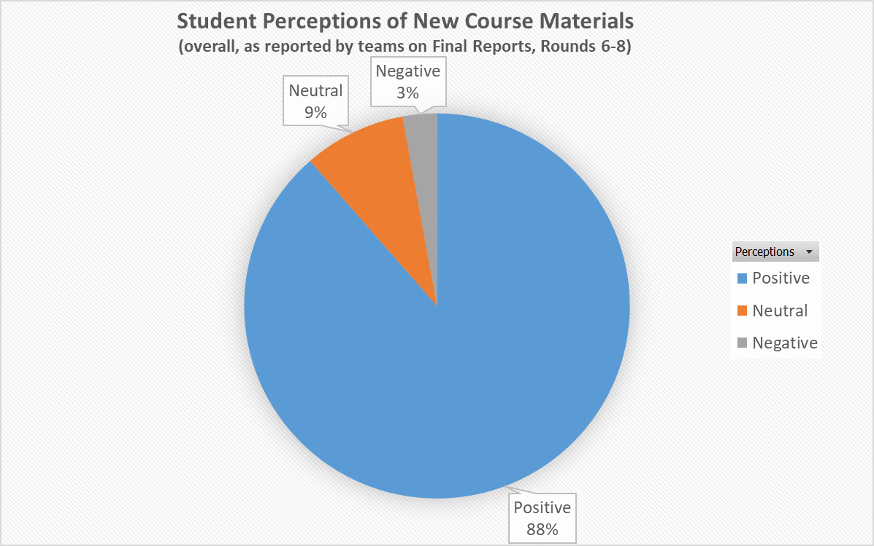
Summary Report of all Grant Projects from 2016-2017

Slide 11
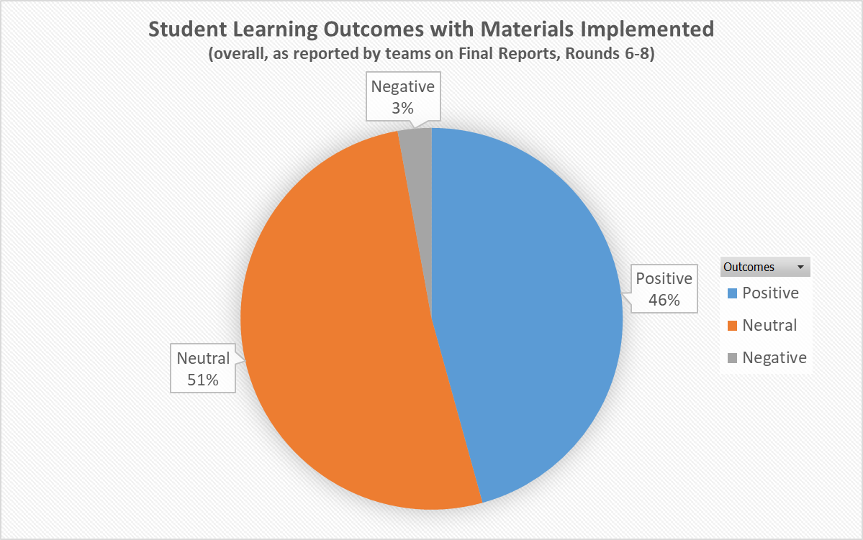
Summary Report of all Grant Projects from 2016-2017

Slide 12
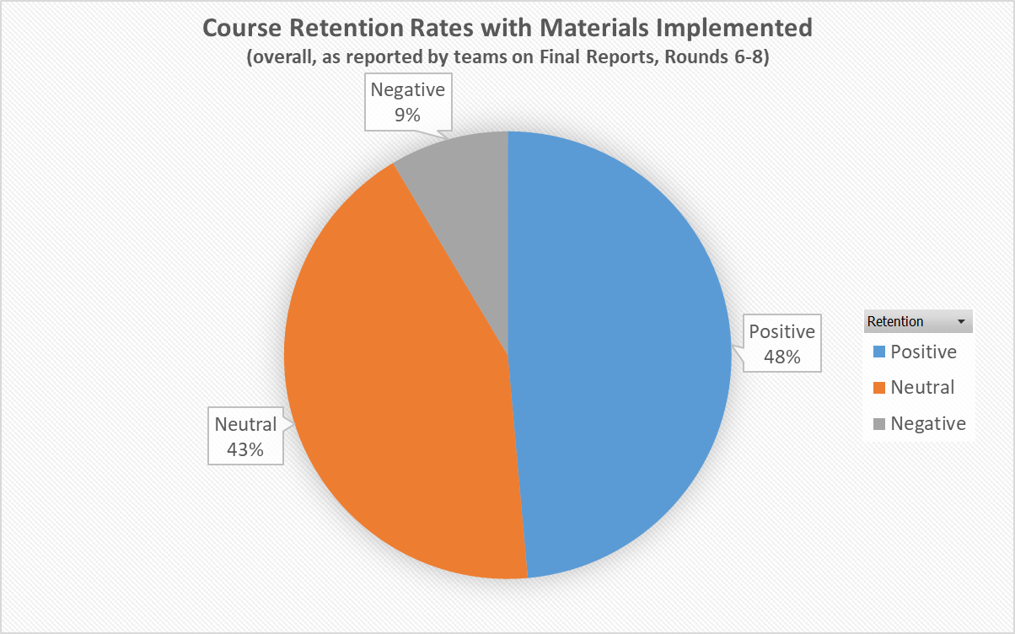
Summary Report of all Grant Projects from 2016-2017

Slide 13
GALILEO Open Learning Materials
262 resources as of Spring 2018
46 open textbooks, created through grants and UNG Press partnership
Two second editions of grant-created textbooks
Made possible through revision mini-grants
Over 174,000 full-text downloads since October 2016 launch
https://oer.galileo.usg.edu/

Slide 14
How Funding Works: Service Level Agreement and Invoices

Slide 15
How Funding Works: Not Your Typical Grant
Funding is not a direct stipend to the team members
Goes to the institution to cover the team member’s time (salary/release time/overload/replacement coverage), project expenses including related department needs, and travel expenses.
Funding will be released to the sponsoring institutional office in two parts: 50% on return of the USG-drafted Service Level Agreement (SLA) with the original or modified proposal serving as the statement of work, and 50% on submission of the final report.

Slide 16
Why?
Gives maximum flexibility to the institution and the team in terms of how many people and what types of skills are needed, amount of compensation vs. replacement of teaching load, and timing in terms of semesters of preparatory work vs. semesters of adoption.
50%/50% further ensures that you have the resources you need to complete the project, and that the project will be completed by the Final Report deadline.

Slide 17
Contact Your Business/Grants Office!
The proposing team should coordinate as necessary with their departments and institutional sponsors to determine how to handle the distribution, including amounts, release time/overload/salary/replacement, as well as semester(s).
Your business/grants office needs to know the following:
These grants, while competitively earned, are essentially special allocations of state funds for the implementation and creation of affordable learning resources.
These grants are not the same as federal grants where indirect costs are considered a part of the grant costs. Direct costs, such as salaries, fringes, and supplies are fine.

Slide 18
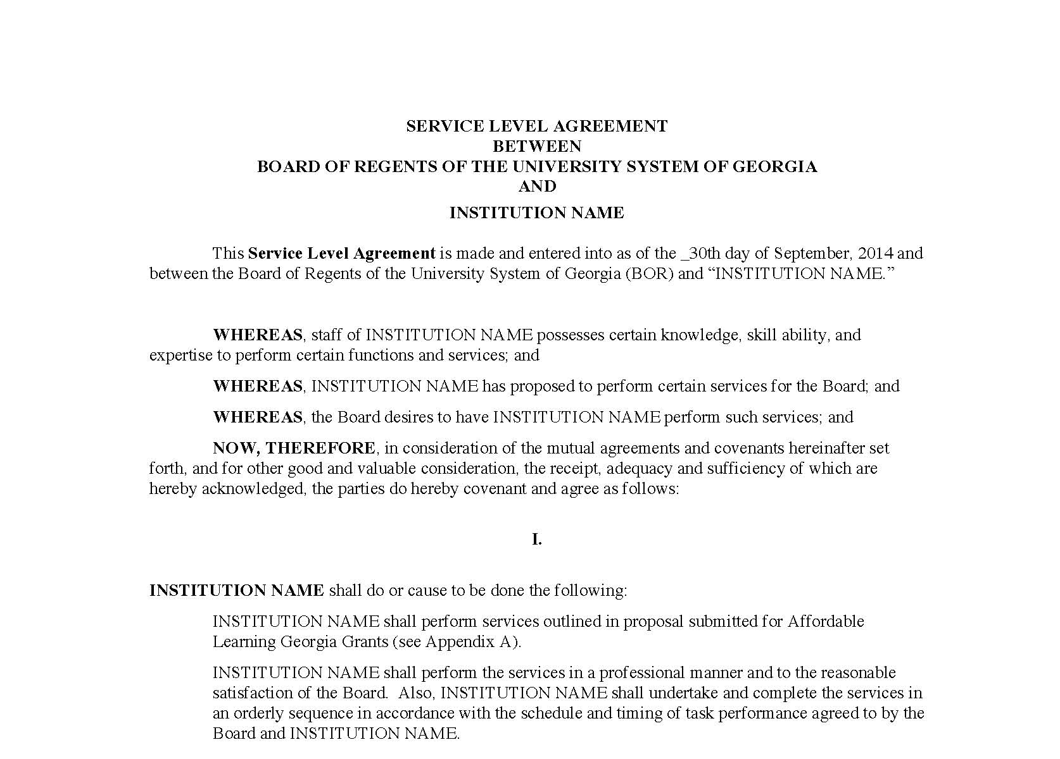
Service Level Agreement (SLA)
“Boilerplate” intergovernmental legal document ensuring that:
We fund the work in the Statement of Work, which is your proposal, and
Your institution ensures the work is completed by the deadline
Foundational document for all Textbook Transformation Grant funding
Includes deadlines (ensure that your Final Semester is correct!)

Slide 19
Steps: From SLA to Funding
ALG (Jeff) sends SLA to Project Lead
Project Lead checks SLA, sends to Grants Office with ALG email
Grants Office obtains signatures, sends to Project Lead
Project Lead sends signed SLA to ALG (Jeff)
ALG (Jeff) sends to BOR Legal
BOR Legal signs SLA, now fully-executed
With invoice, ALG (Jeff/Admin) sends payment request to AP
AP sends payment to institution through ACH

Slide 20
Invoices: Needed for Disbursement of Funds
1st invoice sent to ALG (Jeff) as soon as possible
Some institutions only send invoices after SLA is fully-executed, this takes more time for 1st payment overall
Only for the first half of the grant amount
2nd invoice at the end of the project
Sent as part of your Final Report at the end of your Final Semester
Only for the second half of the grant amount

Slide 21
Invoice within the process
ALG (Jeff) sends SLA to Project Lead
Project Lead checks SLA, sends to Grants Office with ALG email
Grants Office obtains signatures, sends to Project Lead
Project Lead sends signed SLA to ALG (Jeff)
ALG (Jeff) sends to BOR Legal
BOR Legal signs SLA, now fully-executed
With invoice, ALG (Jeff/Admin) sends payment request to AP
AP sends payment to institution through ACH
Jeff sends executed SLA to Grants Office and Project Lead
Preferred here
Sometimes here

Slide 22
Required Reporting

Slide 23
Required Reporting
Each semester, your team submits a status report, including this semester. Which report is determined by your timeline:
If it is not your final semester of instruction, submit a Semester Status Report at the end of the semester.
If it is your final semester, submit a Final Report.
All report links and deadlines are on the Information for G2C and Scaling Up OER Pilots Page :
affordablelearninggeorgia.org/about/pilots18_info
Project leads: Please bookmark this page as soon as possible!

Slide 24
Semester Status Report
Report is an online form
Multiple-choice & short paragraph questions
Focused on project being on track for implementation in your final semester
Link is always on the Information for Spring 2018 Pilots Page:
http://affordablelearninggeorgia.org/about/pilots18_info/

Slide 25
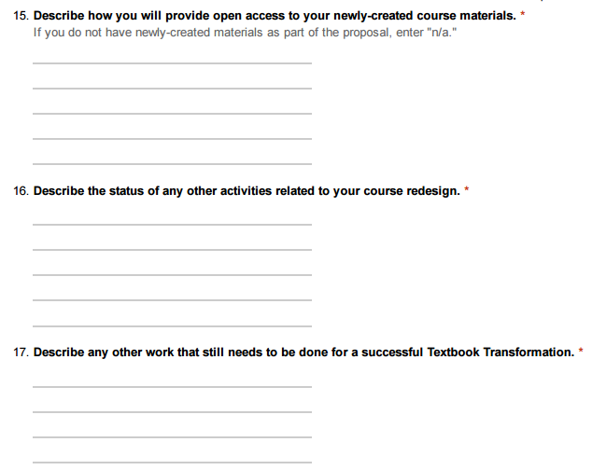
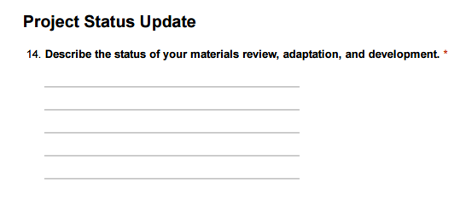

Slide 26
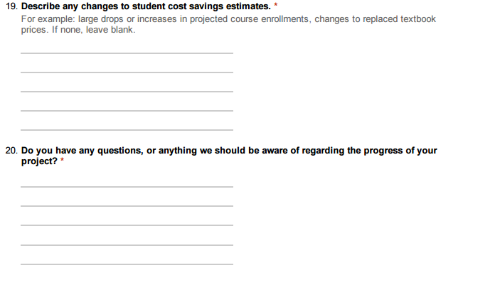

Slide 27
Final Report
1: Word Document with narrative section
Includes highlights from qualitative and quantitative measures, shared with public
2: Syllabus with links to all materials, organized by day/unit/etc., with learning outcomes stated, shared with public
3: File with all qualitative/quantitative data
Includes measures of impact on student success / RPG
Qualitative measures, surveys, interviews
Will not be shared with public
4: High-Resolution photograph of team, students, or both
At least 800x600 pixels (width x height), shared with public
5. Invoice for second payment, ½ the grant amount
Allows ALG to start the payment process as soon as Final Reports are checked
Not shared with public

Slide 28
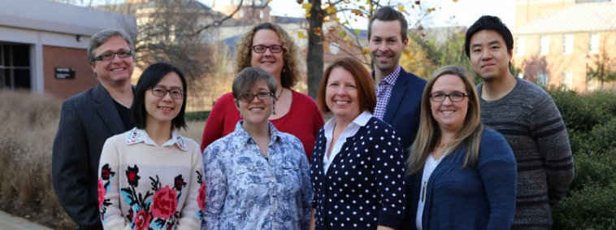
Final Report
Please take a photo like this…
Or it will wind up looking like this…

Slide 29
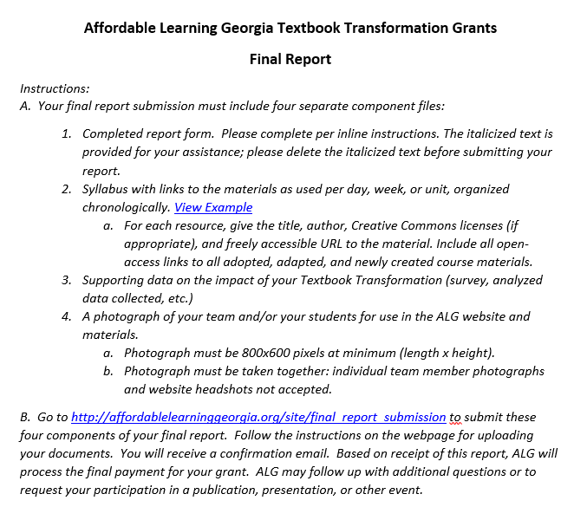
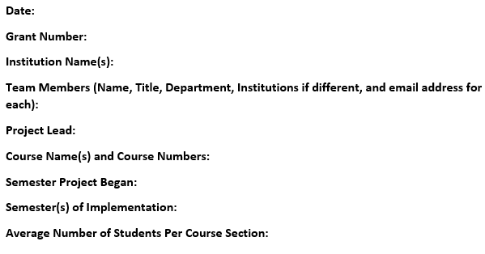

Slide 30
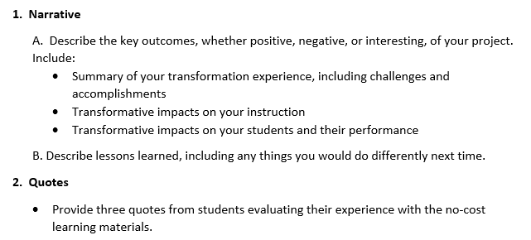

Slide 31
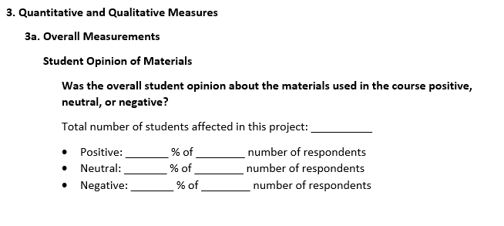

Slide 32
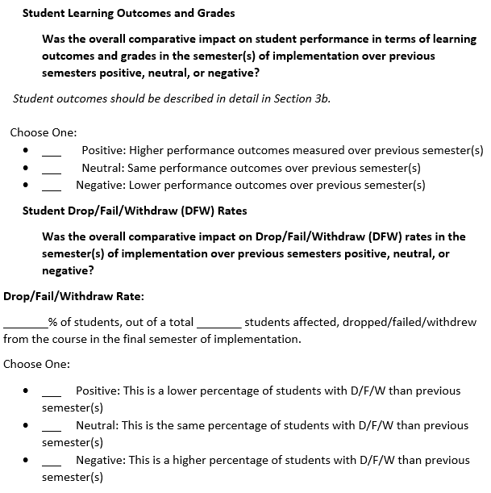

Slide 33
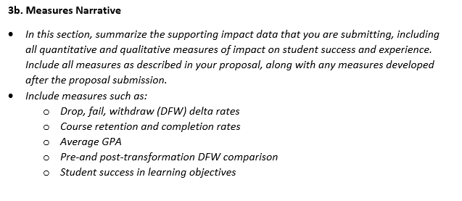

Slide 34
Planning Your Measures
Consider IRB approvals if necessary
Institution IRB procedures differ

Slide 36
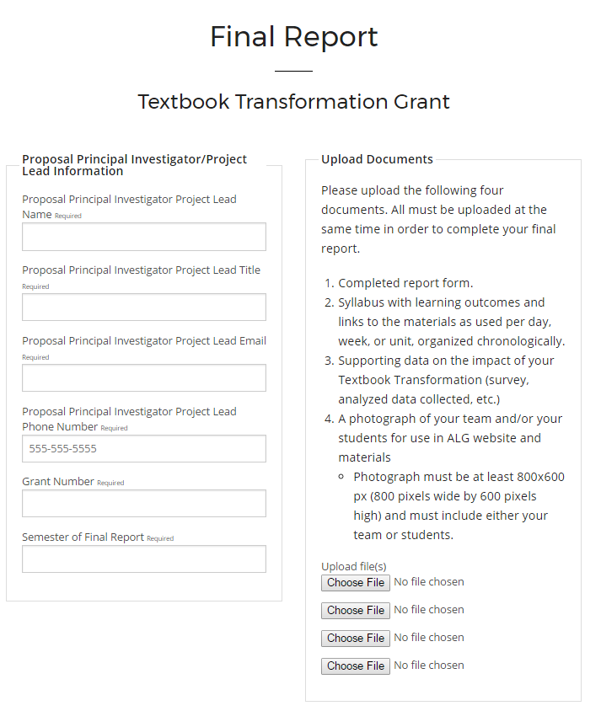

Slide 37
Upcoming Reporting Deadlines
Summer 2018: August 17, 2018
reminder: Kickoff is October 29, 2018!
Fall 2018: December 21, 2018
Spring 2019: May 24, 2019
Summer 2019: August 16, 2019
Fall 2019: December 20, 2019
These are on the Information for G2C and Scaling Up OER Pilots Page:
https://www.affordablelearninggeorgia.org/about/pilots18_info

Slide 38
Questions?

