Slide 1
Copyright and Open Licensing
Jeff Gallant
ALG Round Eleven Kickoff Event
Feb. 26, 2018

Slide 2
What is copyright?
The exclusive rights of a work’s creator to:
Reproduce the work
Create derivative works
Distribute copies of the work
Perform the work in public
Display the work in public physically or otherwise (television, radio, internet)
These works need to be in a “tangible” format, which could be physical or digital.

Slide 3
Is copyright always the creator’s right?
Not if they give it away in a contract.
This often happens through publishing contracts, including author agreements when researchers submit a peer-reviewed article in a non-open journal, or when professors co-write a commercial textbook.
It is the creator’s right to give permissions for others to use their works.

Slide 4
Is every type of work protected?
No. Works not protected by copyright include:
Titles, names, short phrases, slogans
Facts, news, and discoveries
Works created by the U.S. government
Ideas, procedures, methods, systems, processes (but these may be patentable)
Works lacking a modicum of originality (e.g. a phone book in alphabetical order)

Slide 5
What if there’s no copyright indication?
Copyright is now automatic when a work is created, no indications are necessary. If there is no indication of copyright and the work was created after 1923, you must assume it is “all rights reserved.” This is a very common issue on websites.

Slide 6
What was that about 1923?
If a work was created before 1923, it is in the public domain. This takes the work from “all rights reserved” to “no rights reserved.” Attribution isn’t even necessary, although it’s informative.
There are a few other ways a work can be in the public domain, but those are more complicated. Check:
http://fairuse.stanford.edu/overview/public-domain/welcome/

Slide 7
Everything before 1923 is free, then?
Not exactly. If a new edition or derivative work is made of a Public Domain work, the original work is still free to use with no rights reserved, but the new edition has its own copyright.
For example, Plato’s Republic is Public Domain. A new 2010 translation and critical edition of the text has its own copyright, so while you could copy Republic, you couldn’t copy that edition unless the author/publisher released it into the Public Domain.

Slide 8
Is it either “all rights reserved” or none?
Not anymore, thanks to Open Licensing!

Slide 9
What is an Open License?
A legal document that gives permissions beyond copyright to:
Reuse the work,
Redistribute the work,
Revise the work,
Remix the work, and/or
Retain the work.
(These are the “5 R’s” of Open. You’ve probably already heard of them!)

Slide 10
More on the 5 R’s:
From David Wiley, who created the 5 R list:
http://www.opencontent.org/definition/

Slide 11
Equation for an Open Resource:
Open = Free + Permissions
Permissions = Open License
(Not all versions of an open resource need to be free. Not all permissions are the same.)

Slide 12
Where has “Open” been all my life?
Open-Source Software (initially Free Software): 1980s
GNU, Linux, Open/LibreOffice, BSD Free Software License
Focused on sharing code, the back-end of information distribution
Open Access: 2000s
PubMedCentral, ArXiv, institutional repositories
Focused on sharing research with the public
Open Education: 2010s
We’ll go through a list of these later!
Focused on sharing expertise and foundational knowledge with public learners

Slide 13
What open license should I use?
Because we’re in open education and not open-source software, Creative Commons is easily the best option.
Details on every CC License:
https://creativecommons.org/licenses/

Slide 14
Original infographic: http://visual.ly/what-creative-commons

Slide 15
Original infographic: http://visual.ly/what-creative-commons

Slide 16
What if someone makes a bad or inaccurate version of my material?
Creative Commons licenses always include attribution of the original work, with the “CC0” Public Domain license being the one exception.
If someone makes a ‘bad’ derivative of your work, the original should be linked in this derivative work. Your original work should both be visible and unchanged.

Slide 17
What if someone just copies my material and claims it as their own?
This violates the permissions given in a Creative Commons license (unless it’s CC0) and it is infringement, just like any infringement in all-rights-reserved copyright.

Slide 18
Can I remove the license from my work and then sue someone for using it under the old license?
No. A Creative Commons open license is irrevocable in legal cases. The public’s permissions to copy and reuse the work with attribution won’t suddenly disappear with permissible use suddenly becoming infringement.
You can re-license your work, but you cannot enforce anything that was originally permitted under the old license.

Slide 19
This website is free, but not open. Can I link to it in D2L?
Yes, because linking is not infringement.
However, this means that the original site’s creator has the sole permission to copy the material and make changes.
Some links may be dead and irreparable, web addresses may move, and content may be deleted. Sustainability is much more of an issue with no-cost web resources, as periodic link checking is needed.

Slide 20
How do I provide library materials to my class without infringement?
Most library materials are all-rights reserved, but electronic materials often have a “permalink” attached to each resource.
Using the permalink means every student at your institution has access to the material through the library or GALILEO, but this isn’t a copy of a work that would be shared outside of the institution.

Slide 21
Open is Required for New Materials
To ensure that ALG grant projects have a lasting effect throughout the USG, Affordable Learning Georgia requires works created through the grants to be available to the public under a Creative Commons Attribution License (CC-BY).
In other words, grant-created materials will all be OER.

Slide 22
CC-BY Exceptions
Exceptions will be made in these cases:
-Remixing or reusing a file with a more restrictive license (CC-BY-NC-SA, for example)
-Instructor-created assignments within proprietary platforms (WebAssign, etc.)

Slide 23
Open is Optional for Student Assessments
Sharing your assessments with anyone other than your own students is optional:
Tests and Quizzes
Research Paper / Essay assignments
Successful sharers of student assessments (such as OpenStax) have a vetting system in place to distribute tests and quizzes to faculty only. ALG does not yet have this type of system, so open is optional.

Slide 24
Your Learning Management System is Closed
Brightspace D2L is a USG-subscribed Learning Management System (LMS) which allows instructors to share a closed online course with their students.
If you want to make your LMS materials freely-available, you will have to present your material in an another platform, perhaps as a “copy” of what you create in the LMS.

Slide 25
GALILEO Open Learning Materials Demo
http://oer.galileo.usg.edu

Slide 26
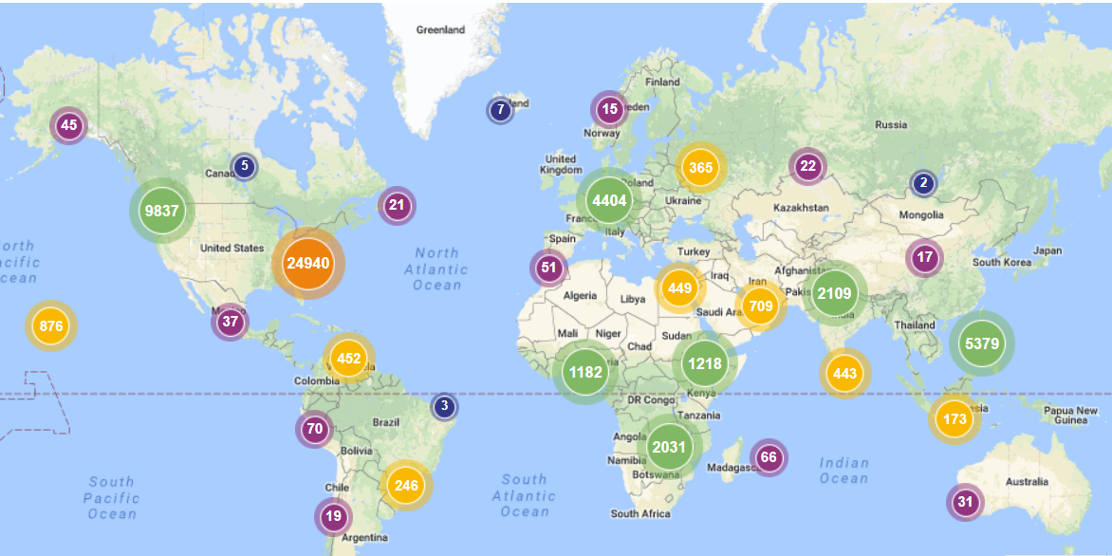

Slide 27
For other hosting options:
ALG Platforms and Hosting Page
http://www.affordablelearninggeorgia.org/open_resources/platforms

Slide 28
What if I still have questions about this after today?
Ask your Librarians!
Contact us: jeff.gallant@usg.edu, marie.lasseter@usg.edu
If this is not a best-practices question but rather a legal advice question, that question is better answered by a lawyer, such as a university attorney or a Scholarly Communications specialist with a J.D.

Slide 29
Questions?

