Slide 1
Textbook Transformation Grants Kickoff
February 26, 2018
Round Eleven Grantees
Middle Georgia State University

Slide 2
Coordinators
Jeff Gallant: Program Manager, Affordable Learning Georgia, Board of Regents, USG
Ongoing point of contact for compliance reporting and Service Level Agreements and payments
Marie Lasseter: Director, Academic Technologies, Affordable Learning Georgia, Board of Regents, USG
Ongoing point of contact for questions regarding instructional design, pedagogy, and educational research
Our partner presenters and instructors:
Nicole Finkbeiner: Associate Director for Institutional Relations, OpenStax

Slide 3
Directions
Directions to restrooms
You can leave for the restrooms at any time!
Lunch Table (at 12pm):
If you answered “Vegetarian” or “Gluten-Free,” you will have your name on a vegetarian or gluten-free lunch.

Slide 4
Objectives
Ensure that all Textbook Transformation grantees have the information they will need to be successful, including information about the grant process and basic understanding of key subject areas
Bring the cohort together for sharing and community-building
Uncover and address any issues or concerns

Slide 5
Agenda
9:00am-9:50am: Introductions and Open Education
9:50am-10:00am: Break
10:00am-10:50am: Grant Processes Discussion
10:50am-11:00am: Break
11:00am-11:50am: Copyright, Open Licensing, Hosting
11:50am-12:00pm: Get Lunch
12:00pm-1:00pm: Working Lunch
1:00pm-1:50pm: Accessibility
1:50pm-2:00pm: Break
2:00pm-2:45pm: OpenStax
2:45pm-3:00pm: Wrap-Up, Q&A

Slide 6
Grantees:
Introduce yourselves!
List of all Round Eleven grantees:
http://affordablelearninggeorgia.org/about/r11_grantees/

Slide 7
ALG is…
A one-stop service to help USG faculty and staff identify lower-cost, electronic, free, and open educational resources (OER), building on the cost-effective subscription resources provided by GALILEO and the USG libraries. www.affordablelearninggeorgia.org
Programs to support more affordable learning materials, including campus advocacy, faculty development, bookstore collaborations, and grants for textbook transformation, including a partnership with eCore, the University System’s core curriculum taught completely online.
An initiative of the University System of Georgia and GALILEO, Georgia’s Virtual Library. www.galileo.usg.edu

Slide 8
Core ALG Strategies
Opt-in programs with incentives will get faculty interested in the topic. (Awareness)
By funding faculty time, and providing $ for assistance, we reduce the barrier for them to participate. (Time, Funding)
Creating an engaged community of practice which can assist others with OER. (Awareness)
Encourage OER and no/low-cost adoption! (Cost Savings)

Slide 9
Textbook Transformation Grants
ALG funds 2 – 4 Grant Rounds per year (~$300,000 each time)
Team proposes a project during a Request for Proposals
Proposal is reviewed by administrators and three Peer Reviewers
Proposals either accepted or rejected, any rejected proposal teams receive peer review and administrative feedback
Proposal becomes a Service Level Agreement between USG and their institution
Funds are allocated ½ upon SLA being fully signed, ½ upon submission of Final Report

Slide 10
Validation at Scale: eCore
eCore has partnered with ALG to transition all of their courses to use no-cost and open resources.
eCore and ALG have funded open textbooks for subjects without pre-existing OER coverage, such as Art Appreciation and World Literature.

Slide 11
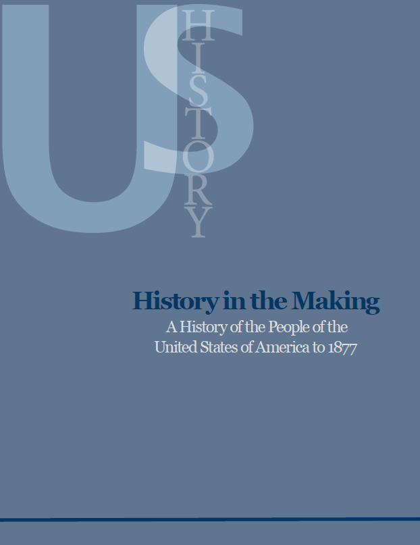
University Press Partnerships
Working with UNG Press to leverage expertise and infrastructure
Peer review and editorial processes
Hosting and distribution models
Adoption/licensing of existing materials in catalog
UNG Press can provide textbook creation services for your team!
History in the Making:
A History of the People of the United States of America to 1877

Slide 12
External Partners: CSU and OpenStax

Slide 13
Why do grants help?
OER and library adoption, adaptation, and creation all take extra time. Faculty and other experts are already pressed for time.
Textbook Transformation Grants allow for:
Course releases or extra-workload compensation for faculty
Assistance from instructional designers
Support for training session travel

Slide 14
It’s not just about savings…
External project impact includes:
Shared evaluations
Sustainability measures
Shared creations and adaptations
Lessons learned
Research on retention, progression, graduation
Vector art designed by Freepik: http://www.freepik.com/free-vector/simple-small-icon-vector-material_575034.htm

Slide 15
Communications: Listserv
General announcements and reminders to the ALGGRANTEES-L listserv. Feel free to share information and ask questions using this listserv. All ALG grantees will be subscribed to the list.
Round Eleven-only communications will be tagged [R11]. This will allow everyone to understand who the question, or information, or deadline, is intended for.
With personal and SLA questions, do not to reply to the entire listserv. Respond to Jeff directly. Your email program may include the listserv by default, be sure to check the “To:” address.

Slide 16
Communications: Email
Jeff.Gallant@usg.edu , Marie.Lasseter@usg.edu
Please ALWAYS include your proposal ID in the subject line of any email that you send.
Please coordinate questions through the team leader.
Please make sure your campus business office copies team leader on any communications and includes the proposal ID #.

Slide 17
Questions?

