Slide 1
Textbook Transformation Grants: Grant Procedures

Slide 2
How Funding Works: Not Your Typical Grant
Funding is not a direct stipend to the team members.
Funding goes to the institution to cover the team member’s time (salary/release time/overload/replacement coverage), project expenses including related to department needs, and travel expenses.
Funding will be released to the sponsoring institutional office in two parts:
50% on return of the USG-drafted Service Level Agreement (SLA) with the original or modified proposal serving as the statement of work
50% on submission of the final report

Slide 3
Why?
Institutional disbursement gives maximum flexibility to the institution and the team in terms of how many people and what types of skills are needed, amount of compensation vs. replacement of teaching load, and timing in terms of semesters of preparatory work vs. semesters of adoption.
50%/50% disbursement further ensures that you have the resources you need to complete the project, and that the project will be completed by the Final Report deadline.

Slide 4
Contact Your Business/Grants Office!
The proposing team should coordinate as necessary with their departments and institutional sponsors to determine how to handle the distribution, including amounts, release time/overload/salary/replacement, as well as semester(s).
Your business/grants office needs to know the following:
These grants, while competitively earned, are essentially special allocations of state funds for the implementation and creation of affordable learning resources.
These grants are not the same as federal grants where indirect costs are considered a part of the grant costs. Direct costs, such as salaries, fringes, and supplies are fine.

Slide 5
Service Level Agreement (SLA)
“Boilerplate” intergovernmental legal document ensuring that:
We fund the work in the Statement of Work, which is your proposal.
Your institution ensures the work is completed by the deadline. Ensure that your Final Semester is correct.
All Start Dates are June 1, 2020 (Kickoff Date).
Spring 2021 End Date: May 17, 2020 (Final Report Deadline).
Summer 2021 End Date: August 16, 2021 (Final Report Deadline).

Slide 6
Steps: From SLA to Funding
ALG drafts SLAs
ALG distributes SLAs to the Business / Grants Office with Project Leads CCd
Institution obtains signatures on SLA
Business/grants office OR project leads send SLA and the invoice for first payment (1/2 the award) to ALG in one email if possible Some institutions need the fully-executed SLA first (UGA, GA Tech, KSU), this is okay
ALG submits signed SLAs to the BOR Business Office
BOR Business Office sends to Legal, Legal signs
Business Office creates PO and sends to ALG
With first invoice, ALG sends first payment to institution through ACH
Final Report: with second invoice, ALG sends second payment to institution through ACH

Slide 7
Semester Status Report
Report is an online form
Includes multiple-choice & short paragraph questions
Focuses on project being on track for implementation in your final semester
Is always available via link on the Grants Information Center: http://affordablelearninggeorgia.org/about/grants_info/

Slide 8
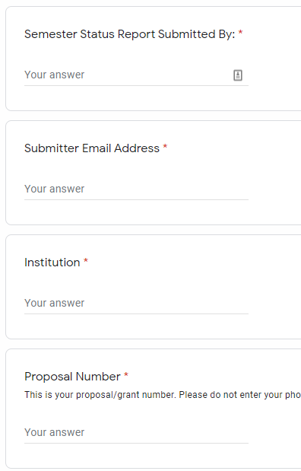
Semester Status Reports

Slide 9
Semester Status Reports

Slide 10
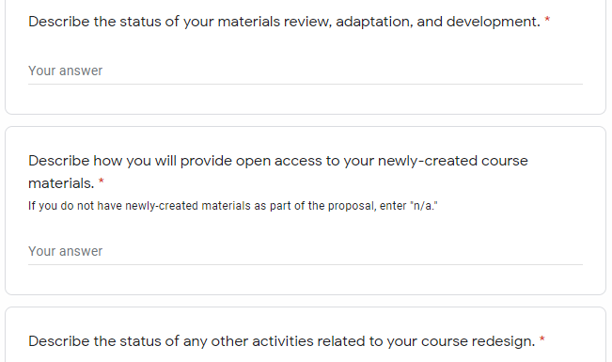
Semester Status Reports

Slide 11
Final Report
Is only submitted at the end of the final semester of the project
Is always available from the Grants Information Center: http://affordablelearninggeorgia.org/about/grants_info/

Slide 12
Final Report Walk-Through

Slide 13
Final Report Submission
Check the Grants Information Center for the link: http://affordablelearninggeorgia.org/about/grants_info/
Five items:
Word document
All data (can use a .zip folder if more than one file)
Syllabi (same here, .zip works well)
Photo (team or class) (optional)
2nd invoice (work with your offices beforehand to make sure this is ready) Same issue with some institutions—they may not want to make an invoice until the Final Report is finished

Slide 14
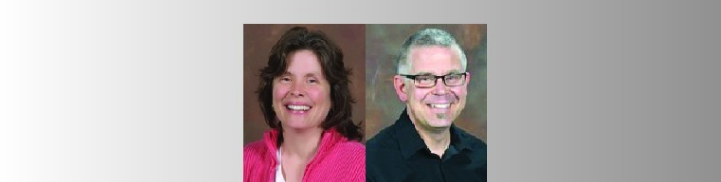
Photos (Optional)
If you are submitting a team or class photo, please do not send separate headshots.

Slide 15
Upcoming Reporting Deadlines
Summer 2020: August 14, 2020
Fall 2020: December 23, 2020
Spring 2021: May 17, 2021
Summer 2021: August 16, 2021
These will be on the Grants Information Center. Please bookmark the page! We will also email the link later.
https://affordablelearninggeorgia.org/about/grants_info/

Slide 16
Listserv
You were added to the ALG-GRANTEES-L Listserv with all standard-scale, large-scale, and mini- grantees.
General emails from us on the listserv will not have brackets.
Emails for only you will be [R17], [R17 Mini] (if applicable), or [All Mini] (if applicable).
As always please be careful when replying to the entire listserv.
If you have any personal questions, please let us know as jeff.gallant@usg.edu and/or tiffani.reardon@usg.edu.

Slide 17
Copyright and Open Licensing

Slide 18
What is copyright?
The exclusive rights of a work’s creator to:
Reproduce the work
Create derivative works
Distribute copies of the work
Perform the work in public
Display the work in public physically or otherwise (television, radio, internet)
These works need to be in a “tangible” format, which could be physical or digital.

Slide 19
Is copyright always the creator’s right?
Usually, but it is the creator’s right to give permissions for others to use their works.

Slide 20
Is every type of work protected?
No. Works not protected by copyright include:
Titles, names, short phrases, slogans
Facts, news, and discoveries
Works created by the U.S. government
Ideas, procedures, methods, systems, processes (but these may be patentable)
Works lacking a modicum of originality (e.g. a phone book in alphabetical order)

Slide 21
What if there’s no copyright indication?
Copyright is now automatic when a work is created, no indications are necessary. If there is no indication of copyright and the work was created after 1923, you must assume it is “all rights reserved.”
This is a very common issue on websites.

Slide 22
What was that about 1923?
If a work was created before 1923, it is in the public domain. This takes the work from “all rights reserved” to “no rights reserved.” Attribution isn’t even necessary, although it’s informative.
There are a few other ways a work can be in the public domain, but those are more complicated. Check the Fair Use Website: http://fairuse.stanford.edu/overview/public-domain/welcome/

Slide 23
Open is Required for New Materials
To ensure that ALG grant projects have a lasting effect throughout the USG, Affordable Learning Georgia requires works created through the grants to be available to the public under a Creative Commons Attribution License (CC-BY).
In other words, grant-created materials will all be OER.

Slide 24
CC-BY Exception
Exceptions can be made. For example:
Remixing or reusing a file with a more restrictive license (CC-BY-NC-SA, for example)
Instructor-created assignments within proprietary platforms (WebAssign, etc.)

Slide 25
Open is Optional for Student Assessments
Sharing your assessments with anyone other than your own students is optional:
Tests and Quizzes
Research Paper / Essay assignments
Successful sharers of student assessments (such as OpenStax) have a vetting system in place to distribute tests and quizzes to faculty only. ALG does not yet have this type of system, so open is optional.

Slide 26
D2L and Canvas Courses are Not Open
Brightspace D2L is a USG-subscribed Learning Management System (LMS) which allows instructors to share a closed online course with their students.
If you want to make your LMS materials freely-available, you will usually want to present your material in an another platform, perhaps as a “copy” of what you create in the LMS.
In some cases, a total LMS course export may work.

Slide 27
Luckily, we can host your materials!
GALILEO Open Learning Materials Demo: http://oer.galileo.usg.edu

Slide 28
What if I still have questions about this after today?
Ask your Campus Champions and Library Coordinators – they’re there to help!
Contact me: jeff.gallant@usg.edu
Contact Tiffani: tiffani.reardon@usg.edu
If this is not a best-practices question but rather a legal advice question, that question is better answered by a lawyer, such as a university attorney or a Scholarly Communications specialist with a J.D.

