Slide 1
Textbook Transformation Grants Kickoff
September 12, 2016
Round Six Grantees
Middle Georgia State University

Slide 2
Jeff Gallant: Program Manager, Affordable Learning Georgia, Board of Regents, USG
Ongoing point of contact for implementation assistance and compliance reporting
Ongoing point of contact for Service Level Agreements and payments
Welcome and Introductions

Slide 3
Our partner presenters and instructors:
Jeff DiGiovanni: Assistant Director of Customer Support, OpenStax
AMAC Accessibility Solutions
Welcome and Introductions

Slide 4
Directions to restrooms
You can leave for the restrooms at any time!
Directions

Slide 5
Lunch Table (at 12pm):
If you answered “Vegetarian” or “Gluten-Free,” you will have your name on a vegetarian or gluten-free lunch.
Directions

Slide 6
Ensure that all Textbook Transformation grantees have the information they will need to be successful, including information about the grant process and basic understanding of key subject areas
Bring the cohort together for sharing and community-building
Uncover and address any issues or concerns
Objectives

Slide 7
Textbook Transformation Grants, Round Five
Kickoff Training Event: February 8, 9-4pm
9:00am-9:50am: Welcome and Introductions
9:50am-10:00am: Break, Meet and Greet
10:00am-10:55am: Grant Processes Discussion
10:55am-11:00am: Quick Break
11:00am-11:50am: OpenStax, AMAC Accessibility
11:50am-12:00pm: Get Lunch (outside 212)
12:00pm-1:00pm: Working Lunch
1:00pm-1:05pm: Pickup / Quick Break
1:05pm-1:55pm: Copyright, Open Licensing, Platforms, Hosting
1:55pm-2:00pm: Quick Break
Agenda

Slide 8
Textbook Transformation Grants, Round Five
Kickoff Training Event: February 8, 9-4pm
2:00pm-2:45pm: Breakouts by Discipline
2:45pm-3:00pm: Groups Share Results, Discussion
3:00pm-4:00pm: Wrap-Up and Q&A
Agenda

Slide 9
Summary of Grants and Grantees
19 proposals were received from 14 USG institutions
12 proposals from 11 USG institutions were awarded grants
Total estimated student savings:
$1.4 million / year
Welcome and Introductions

Slide 10
Grantees:
Introduce yourselves!
List of all Round Six grantees:
http://affordablelearninggeorgia.org/about/textbook_transformation_grants_round_6_grantees/

Slide 11
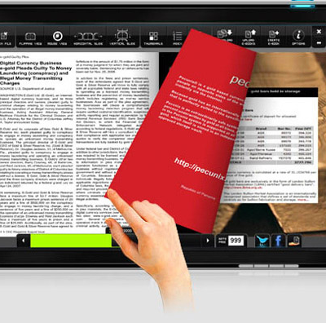
USG Improving Access and Affordability
The State of Georgia’s FY 2017 budget funds Affordable Learning Georgia (ALG), which focuses on reducing the cost of textbooks and the enhancement of GALILEO, Georgia’s Virtual Library and ALG’s parent initiative.

Slide 12
Affordable Learning Georgia Is…
A one-stop service to help USG faculty and staff identify lower-cost, electronic, free, and open educational resources (OER), building on the cost-effective subscription resources provided by GALILEO and the USG libraries. www.affordablelearninggeorgia.org
Programs to support more affordable learning materials, including campus advocacy, faculty development, bookstore collaborations, and grants for textbook transformation, including a partnership with eCore, the University System’s core curriculum taught completely online.
An initiative of the University System of Georgia and GALILEO, Georgia’s Virtual Library. www.galileo.usg.edu

Slide 13
ACTIVITIES AND STRATEGIES
Goals and Programs:
Top 100 Courses
eCore Partnership
Textbook Transformation Grants: working with campuses
College Store program
Training and Development Activities

Slide 14
Scale: Top 100 Undergraduate Courses
A framework to support adoption, adaptation, and creation of no-or-low-cost textbook alternatives
http://www.affordablelearninggeorgia.org/find_textbooks/alg_top_courses

Slide 15
Scale: eCore Partnership
eCore has transitioned 25 courses to use no-cost and open resources.
Validation at-scale of quality

Slide 16
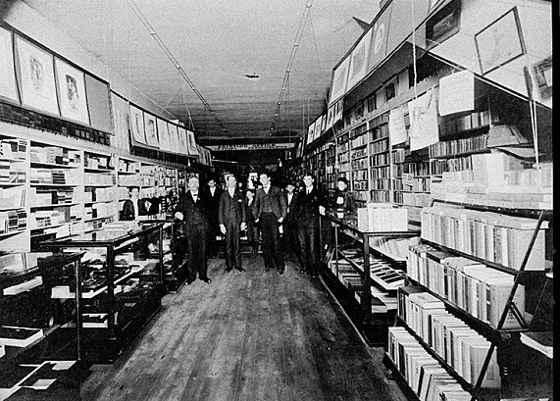
USG college store partners
Lowest price guarantees, rental programs, and more
Data about cost savings as well as adoptions
Software for comparison shopping, adoptions, marketplace
Photograph of McGregor Company bookstore, Athens, Clarke County, Georgia. Vanishing Georgia, Georgia Division of Archives and History, Office of Secretary of State. Digital Library of Georgia.
College Store Program Update

Slide 17
Partner: USG University Presses
Working with UNG Press to leverage expertise, catalog, and infrastructure
Peer review and editorial processes
Hosting and distribution models
Adoption/licensing of existing materials in catalog
Original Open Textbook production model developed with USG U.S. History I Textbook
History in the Making:
A History of the People of the United States of America to 1877

Slide 18
Partner: OpenStax College of Rice University

Slide 19
Why Grants?
Adoption, adaptation, and creation take time. Textbook Transformation Grants allow for:
Course releases or extra-workload compensation for faculty
Assistance from instructional designers
Support for training session travel
Why Grants?
Vector art designed by Freepik: http://www.freepik.com/free-vector/simple-small-icon-vector-material_575034.htm

Slide 20
External Project Impact
Shared evaluations
Sustainability measures
Shared creations and adaptations
Lessons learned
RPG statistics
Student savings
Why Grants?
Vector art designed by Freepik: http://www.freepik.com/free-vector/simple-small-icon-vector-material_575034.htm

Slide 21
Implementation is:
The identification, review, selection, and adoption/adaptation/creation of the new course materials.
The course and syllabus instructional design/redesign necessary for the transformation.
The activities expected from each team member and their role(s): subject matter experts, instructional designer, librarian, instructor of record, et al.
The plan for providing open access to the new materials.
Implementation Processes

Slide 22
RPG =
Retention
Progression
Graduation
Affordable Resources, Equal Day-One Access for students
Retention, Progression, Graduation

Slide 23
General announcements and reminders to the ALGGRANTEES-L listserv. Feel free to share information and ask questions using this listserv. All ALG grantees (including round 1-6 and future) will be subscribed.
Round Six-only communications will be tagged [R6]. This will allow everyone to understand who the question, or information, or deadline, is intended for.
With personal and SLA questions, be sure not to reply to the listserv. Respond to Jeff directly. Your email program may do this by default, be sure to check the “To:” address.
Communications: Listserv

Slide 24
To ensure the best possible service and response to your needs and questions:
Please ALWAYS include your proposal ID in the subject line of any email that you send.
Please coordinate questions through the team leader.
Please make sure your campus business office copies team leader on any communications and includes the proposal ID.
Communications

