Slide 1
Textbook Transformation Grants Kickoff
January 30, 2017
Round Eight Grantees
Middle Georgia State University

Slide 2
Coordinators
Jeff Gallant: Program Manager, Affordable Learning Georgia, Board of Regents, USG
Ongoing point of contact for implementation assistance and compliance reporting
Ongoing point of contact for Service Level Agreements and payments
Our partner presenters and instructors:
Nicole Finkbeiner: Associate Director for Institutional Relations, OpenStax
AMAC Accessibility Solutions

Slide 3
Directions
Directions to restrooms
You can leave for the restrooms at any time!
Lunch Table (at 12pm):
If you answered “Vegetarian” or “Gluten-Free,” you will have your name on a vegetarian or gluten-free lunch.

Slide 4
Objectives
Ensure that all Textbook Transformation grantees have the information they will need to be successful, including information about the grant process and basic understanding of key subject areas
Bring the cohort together for sharing and community-building
Uncover and address any issues or concerns

Slide 5
Agenda
9:00am-9:50am: Welcome and Introductions
9:50am-10:00am: Break, Meet and Greet
10:00am-10:55am: Grant Processes Discussion
10:55am-11:00am: Quick Break
11:00am-11:50am: OpenStax, Accessibility
11:50am-12:00pm: Get Lunch
12:00pm-1:00pm: Working Lunch
1:00pm-1:05pm: Pickup / Quick Break
1:05pm-1:55pm: Copyright, Open Licensing, Platforms, Hosting
1:55pm-2:00pm: Quick Break

Slide 6
Agenda
2:00pm-2:45pm: Breakouts by Discipline
2:45pm-3:00pm: Groups Share Results, Discussion
3:00pm-4:00pm: Wrap-Up and Q&A

Slide 7
Welcome and Introductions
Summary of Grants and Grantees
35 proposals were received from 16 USG institutions
16 proposals from 12 USG institutions were awarded grants
Total estimated student savings:
$2.4 million / year

Slide 8
Grantees:
Introduce yourselves!
List of all Round Eight grantees:
http://affordablelearninggeorgia.org/about/textbook_transformation_grants_round_8_grantees/

Slide 9
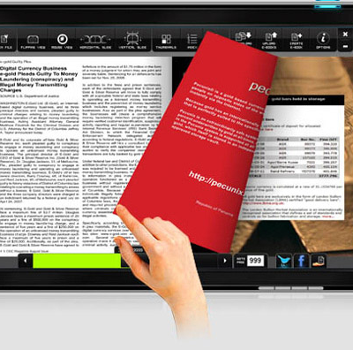
Improving Cost and Affordability
The State of Georgia’s FY 2017 budget funds Affordable Learning Georgia (ALG), which focuses on reducing the cost of textbooks and the enhancement of GALILEO, Georgia’s Virtual Library and ALG’s parent initiative.

Slide 10
ALG is…
A one-stop service to help USG faculty and staff identify lower-cost, electronic, free, and open educational resources (OER), building on the cost-effective subscription resources provided by GALILEO and the USG libraries. www.affordablelearninggeorgia.org
Programs to support more affordable learning materials, including campus advocacy, faculty development, bookstore collaborations, and grants for textbook transformation, including a partnership with eCore, the University System’s core curriculum taught completely online.
An initiative of the University System of Georgia and GALILEO, Georgia’s Virtual Library. www.galileo.usg.edu

Slide 11
Goals and Programs
Top 100 Courses
eCore Partnership
Textbook Transformation Grants: working with campuses
College Store program
Training and Development Activities

Slide 12
Top 100 Enrolled Undergraduate Courses
http://www.affordablelearninggeorgia.org/find_textbooks/alg_top_courses

Slide 13
Validation at Scale: eCore
eCore has partnered with ALG to successfully transition 25 courses to use no-cost and open resources.
eCore and ALG have funded open textbooks for subjects without current OER coverage, such as Art Appreciation and World Literature.

Slide 14
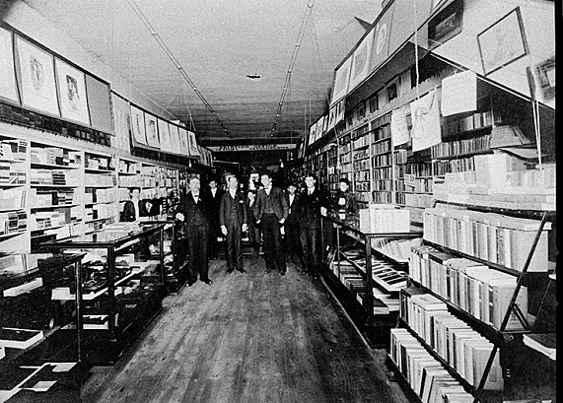
Bookstore Partnerships
USG independent college store partners through Verba
Lowest price guarantees, rental programs, and more
Data about cost savings as well as adoptions
Software for comparison shopping, adoptions, marketplace
Last year of Verba funding
May work with bookstores on the Textbook Affordability Conference 2017
Photograph of McGregor Company bookstore, Athens, Clarke County, Georgia. Vanishing Georgia, Georgia Division of Archives and History, Office of Secretary of State. Digital Library of Georgia.

Slide 15
University Press Partnerships
Working with UNG Press to leverage expertise, catalog, and infrastructure
Peer review and editorial processes
Hosting and distribution models
Adoption/licensing of existing materials in catalog
History in the Making:
A History of the People of the United States of America to 1877

Slide 16
External Partners: CSU and OpenStax

Slide 17
Why are we awarding grants?
Why do Grants help save students money?
OER and library adoption, adaptation, and creation all take extra time. Faculty and other experts are already pressed for time.
Textbook Transformation Grants allow for:
Course releases or extra-workload compensation for faculty
Assistance from instructional designers
Support for training session travel
Vector art designed by Freepik: http://www.freepik.com/free-vector/simple-small-icon-vector-material_575034.htm

Slide 18
Why are we awarding grants?
External Project Impact
Shared evaluations
Sustainability measures
Shared creations and adaptations
Lessons learned
RPG statistics
Student savings
Vector art designed by Freepik: http://www.freepik.com/free-vector/simple-small-icon-vector-material_575034.htm

Slide 19
RPG =
Retention
Progression
Graduation
Affordable Resources, Equal Day-One Access for students

Slide 20
Communications: Listserv
General announcements and reminders to the ALGGRANTEES-L listserv. Feel free to share information and ask questions using this listserv. All ALG grantees (including round 1-7 and future) will be subscribed.
Round Seven-only communications will be tagged [R7]. This will allow everyone to understand who the question, or information, or deadline, is intended for.
With personal and SLA questions, do not to reply to the listserv. Respond to Jeff directly. Your email program may include the listserv by default, be sure to check the “To:” address.

Slide 21
Communications: Email
Jeff.Gallant@usg.edu
Email is the best way to reach me
Expect delays of up to a week if you leave an office voicemail instead due to a travel-heavy conference schedule
Expect me to still follow up with you via email if you call while I am in the office.
Please ALWAYS include your proposal ID in the subject line of any email that you send.
Please coordinate questions through the team leader.
Please make sure your campus business office copies team leader on any communications and includes the proposal ID #.

Slide 22
Questions?

