Slide 1
Textbook Transformation Grants: Grant Procedures

Slide 2
Communications
Jeff Gallant: Program Manager, Affordable Learning Georgia, Board of Regents, USG
Ongoing point of contact for Service Level Agreements
Ongoing point of contact for implementation assistance and compliance reporting
Jeff.Gallant@usg.edu
Marie Lasseter: Director, Academic Technologies, Affordable Learning Georgia, Board of Regents, USG
Ongoing point of contact for open education, pedagogical / instructional design questions
Marie.Lasseter@usg.edu

Slide 3
How Funding Works: Not Your Typical Grant
Funding is not a direct stipend to the team members
Goes to the institution to cover the team member’s time (salary/release time/overload/replacement coverage), project expenses including related department needs, and travel expenses.
Funding will be released to the sponsoring institutional office in two parts: 50% on return of the USG-drafted Service Level Agreement (SLA) with the original or modified proposal serving as the statement of work, and 50% on submission of the final report.

Slide 4
Why?
Gives maximum flexibility to the institution and the team in terms of how many people and what types of skills are needed, amount of compensation vs. replacement of teaching load, and timing in terms of semesters of preparatory work vs. semesters of adoption.
50%/50% further ensures that you have the resources you need to complete the project, and that the project will be completed by the Final Report deadline.

Slide 5
Contact Your Business/Grants Office!
The proposing team should coordinate as necessary with their departments and institutional sponsors to determine how to handle the distribution, including amounts, release time/overload/salary/replacement, as well as semester(s).
Your business/grants office needs to know the following:
These grants, while competitively earned, are essentially special allocations of state funds for the implementation and creation of affordable learning resources.
These grants are not the same as federal grants where indirect costs are considered a part of the grant costs. Direct costs, such as salaries, fringes, and supplies are fine.

Slide 6
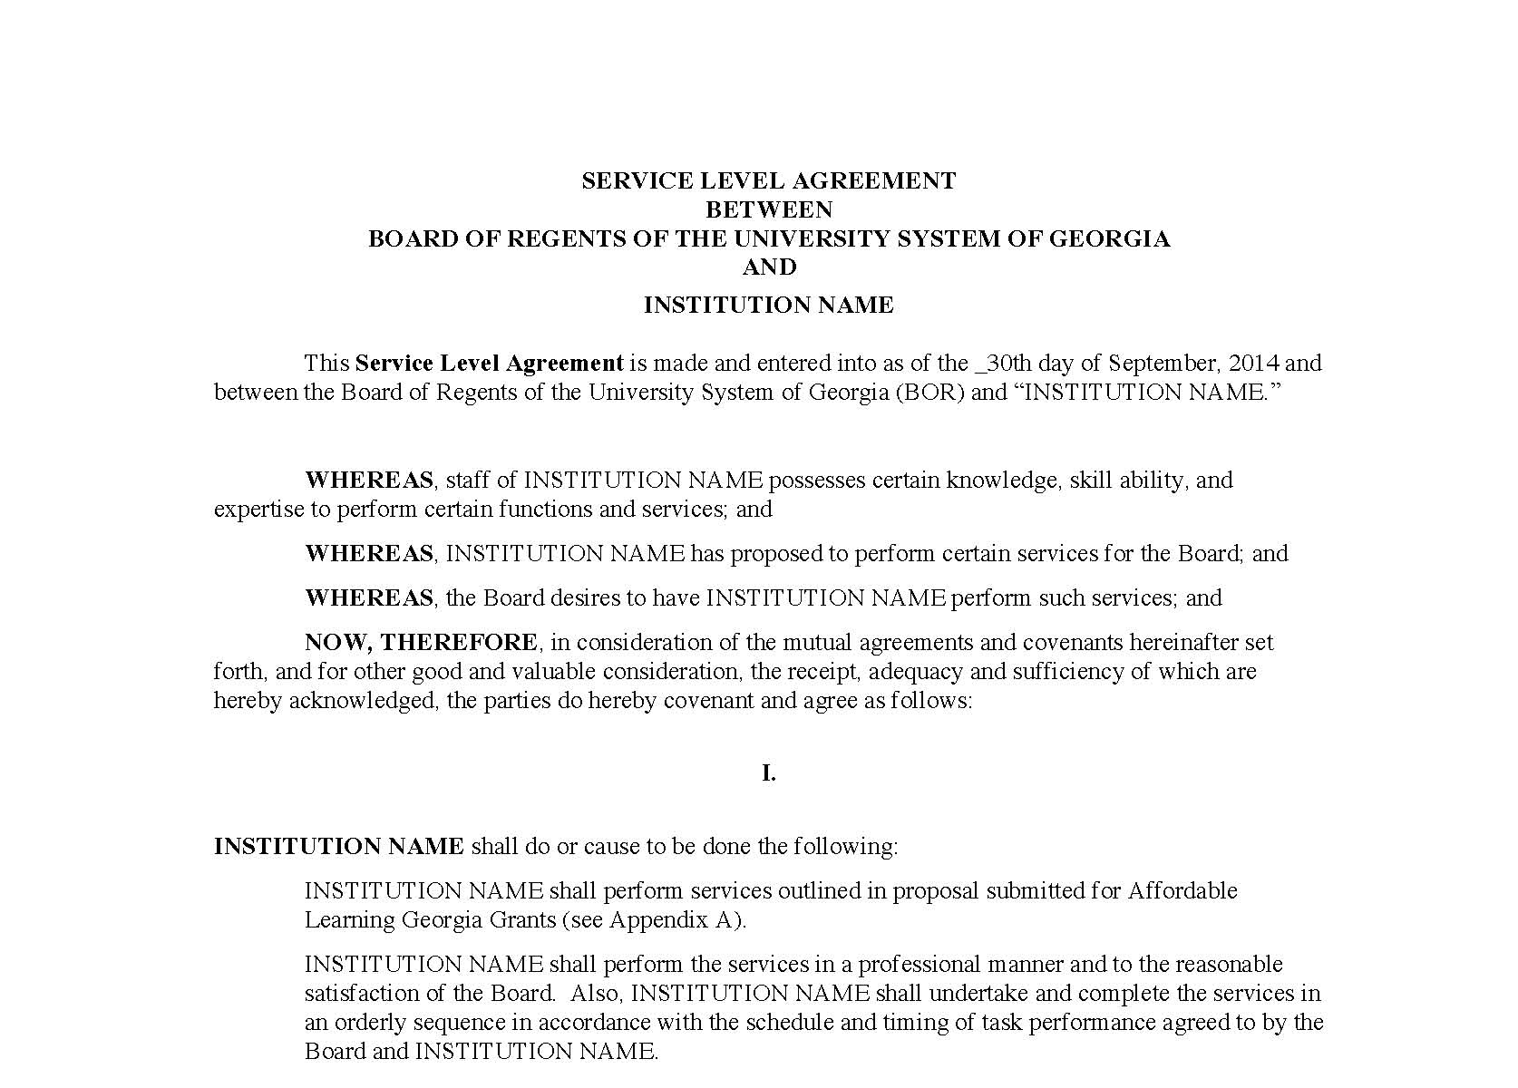
Service Level Agreement (SLA)
“Boilerplate” intergovernmental legal document ensuring that:
We fund the work in the Statement of Work, which is your proposal, and
Your institution ensures the work is completed by the deadline
Foundational document for all Textbook Transformation Grant funding
Includes deadlines (ensure that your Final Semester is correct!)

Slide 7
Steps: From SLA to Funding
SLAs drafted by Jeff
SLAs distributed to Project Leads with detailed instructions
Project Leads read the SLA and forward to appropriate business or grants office
Signatures obtained by business office
SLA and the invoice for first payment (1/2 the award) sent to Jeff in one email
This is extremely new! The USG Business Office now wants one invoice per payment for audit purposes.
Jeff enters signed documents into online system for Board of Regents approvals and signatures
Funds distributed from USG business office to institution: 50% now, 50% upon receiving Final Report
Jeff is point of contact for SLA status

Slide 8
This is new!
Rounds 1-5 were done through a paper system that the USG offices have had in place. All procedures and inquiries were done through email. The System Office is just now starting to use an online platform.
These changes should speed up the entire process, given institutions can send the signed SLA and invoices in quickly. The bottleneck in the payment process is getting the SLA and invoice back from your Business Office.

Slide 9
Steps: From SLA to Funding
Ensure that you are in communication with your business/grants office as soon as possible and know where to send the SLA.
I cannot start any Board of Regents-side approvals until I have the signed SLA sent back to me with an invoice from your institution.
Some business offices only issue invoices on one day each month. Please let them know that your team needs the invoice as soon as possible in order for the initial payment to be sent.
(Quick note for Round 9: We’re in the middle of a Fiscal Year transition. USG offices - and most institutional offices - will not be able to make payments until at least mid-July.)

Slide 10
Semester Status Report
Report is an online form
Multiple-choice & short paragraph questions
Focused on project being on track for implementation in your final semester

Slide 11
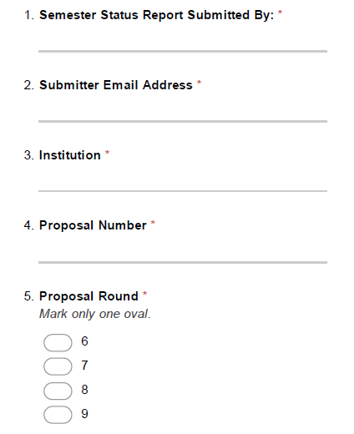
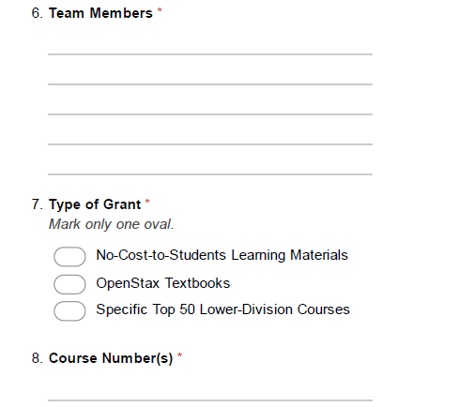

Slide 12
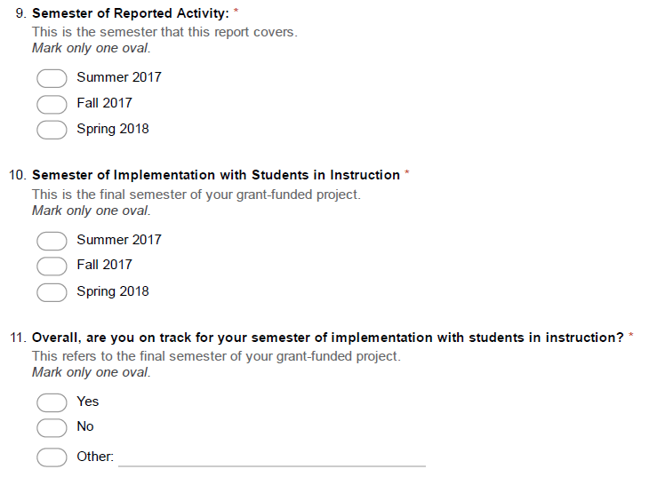
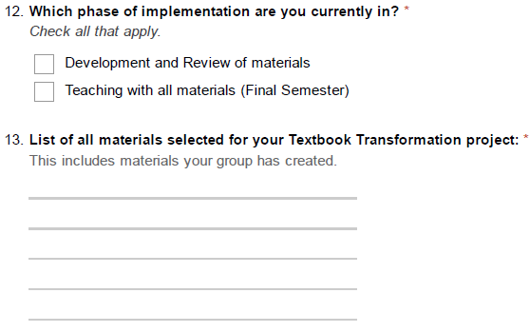

Slide 13
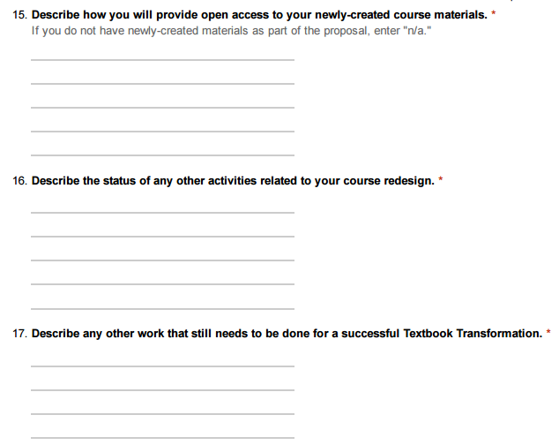
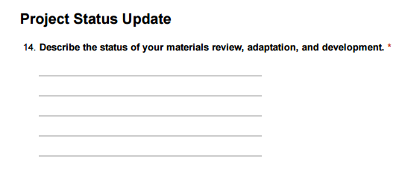

Slide 14
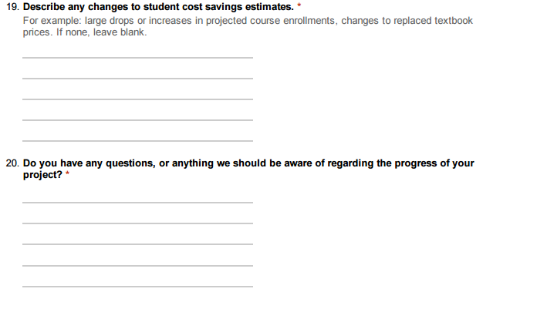

Slide 15
Final Report
Multiple Documents:
1: Word Document with narrative section
Includes highlights from qualitative and quantitative measures
Will be shared with public
2: Syllabus with links to all materials, organized by day/unit/etc., with learning outcomes stated
Will be shared with public
3: File with all qualitative/quantitative data
Includes measures of impact on student success / RPG
Qualitative measures, surveys, interviews
Will not be shared with public
4: High-Resolution photograph of team, students, or both
At least 800x600 pixels (width x height)
Will be shared with public

Slide 16
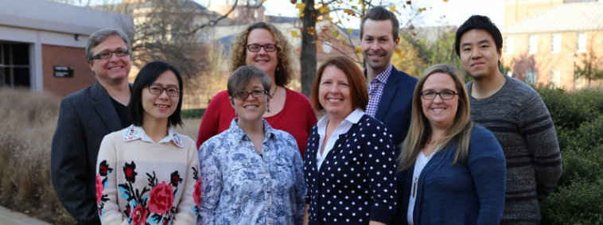
Final Report
Please take a photo like this…
Or it will wind up looking like this…

Slide 17
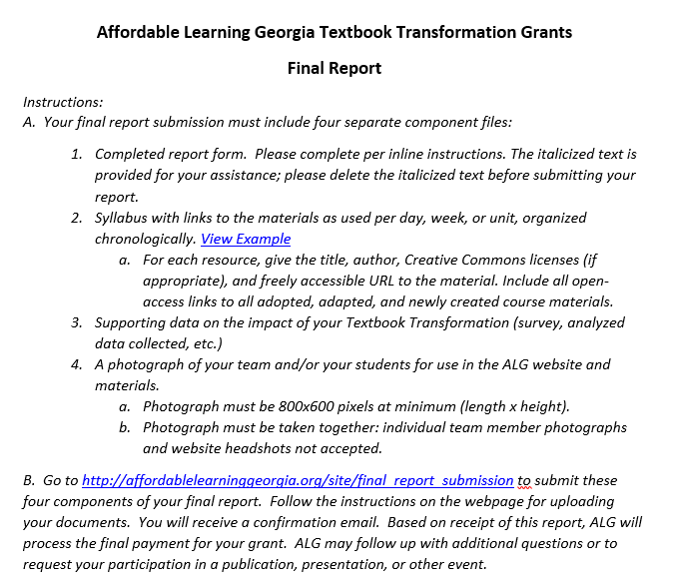
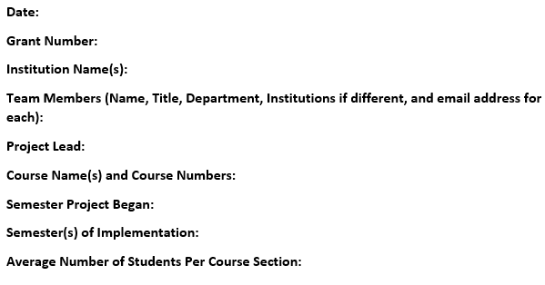

Slide 18
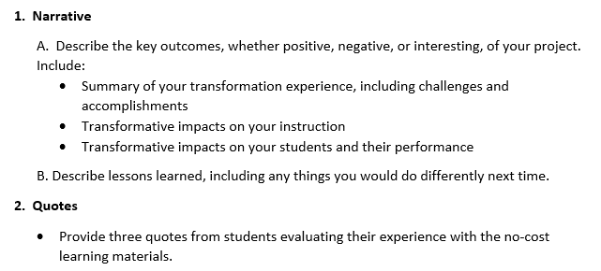

Slide 19
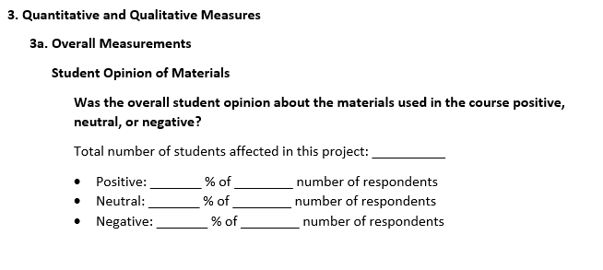

Slide 20
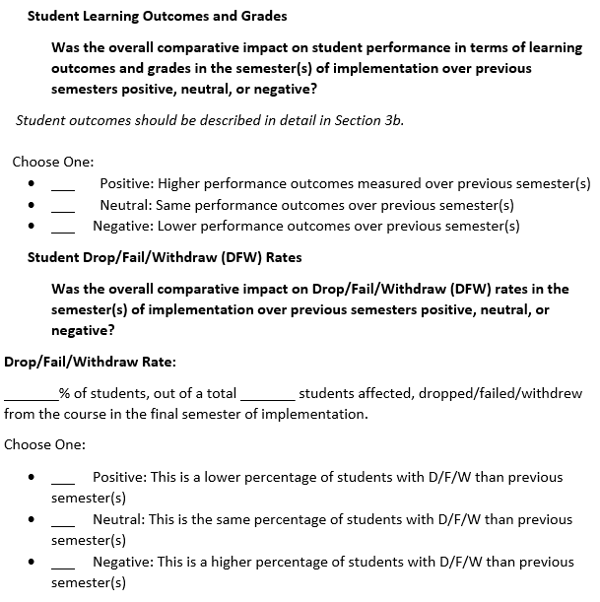

Slide 21
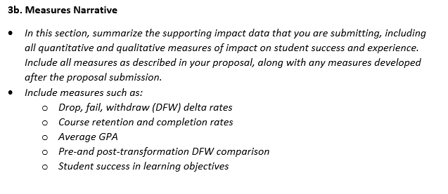

Slide 23
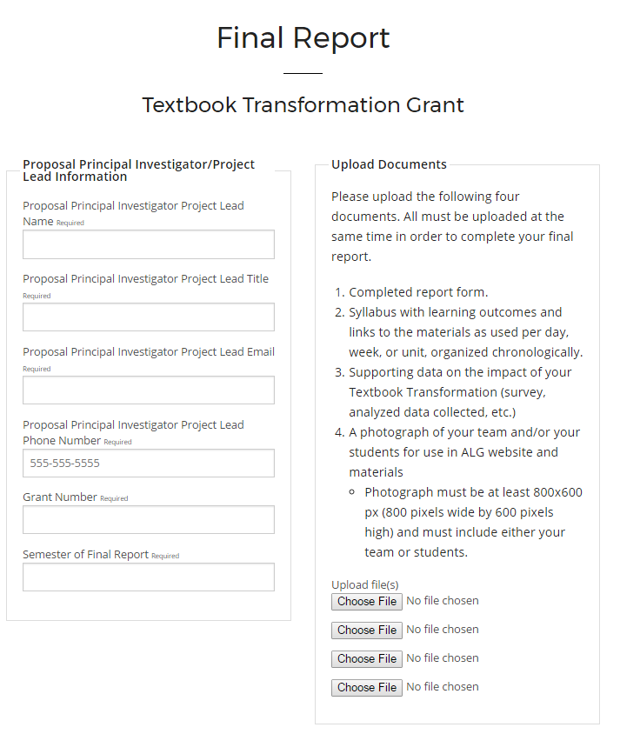

Slide 24
Required Reporting
Timeline:
Each semester, submit a status report, including this semester, Summer 2017.
If it is not your final semester of instruction, submit a Semester Status Report at the end of the semester.
If it is your final semester, submit a Final Report.
All report links will be on the Information for Round Nine Grantees page:
affordablelearninggeorgia.org/about/r9_info
Project leads: Please bookmark this!
Also accessible through the Textbook Transformation Grants main page

Slide 25
Planning Your Measures
Need to plan and consider how to capture/collect data that shows impact on student performance
Need to plan and consider how to capture/collect qualitative evidence from students about their experience and satisfaction with the materials
Consider IRB approvals if necessary
Every institution’s IRB procedures are different!

Slide 26
Upcoming Reporting Deadlines
Summer 2017: August 11, 2017
Fall 2017: December 22, 2017

Slide 27
Questions?

