Slide 1
An Introduction to Affordable Learning Georgia and OER
Unless otherwise indicated, presentation content is under a Creative Commons Attribution 4.0 License.
https://creativecommons.org/licenses/by/4.0/

Slide 2
Introduction: ALG Video
https://www.youtube.com/watch?v=ix2WvkHPkVs

Slide 3
Back in the Day…
When books were only able to be printed on paper, textbook publishing had quite a bit of overhead costs – materials, machines, staff, etc.
With digital publishing, you can distribute copies of learning materials at the effective cost of $0.
You can make changes in an instant
Customize to meet the needs of your students
You can share them as many times as you want
This should be wonderful for education! However…

Slide 4
Copyright Gets in the Way
©
All rights reserved as soon as anything is created in a “tangible” form
Unless you get legal permission from the rights holder:
No distribution
No changes
No remixes
No sharing
This would still work if the market was working in the best interests of students, but…

Slide 5
Textbook Costs Have Skyrocketed
According to The College Board, the average estimated course materials budget for a college student is over $1200 per year.
Average in-state tuition in a public 4-year, in-state, on-campus institution: $9139.
2012 Florida Textbook Survey: Students reported that due to textbook costs:
64% did not purchase the required textbook for a course.
45% did not register for a course.
27% dropped a course.
21% withdrew from a course.
17% failed a course.
70% indicated that having lifetime access to the digital textbook in their major area of study was important or very important.
The College Board: Trends in Higher Education 2014-15: http://trends.collegeboard.org/college-pricing/figures-tables/average-estimated-undergraduate-budgets-2014-15
Florida Virtual Campus: 2012 Florida Student Textbook Survey:
http://www.openaccesstextbooks.org/%5Cpdf%5C2012_Florida_Student_Textbook_Survey.pdf

Slide 6
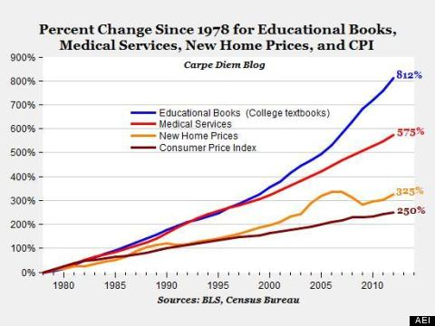
Why Is This Happening?
“The Cardinal Lesson is that prices rise unchecked if the people who order the goods aren’t paying the prices.”
-Craig Richardson, Professor of Economics, Winston Salem State University
http://www.wsj.com/articles/craig-richardson-the-250-econ-101-textbook-1421192341
Graph from Mark Perry, Carpe Diem Blog, American Enterprise Institute:
https://www.aei.org/publication/the-college-textbook-bubble-and-how-the-open-educational-resources-movement-is-going-up-against-the-textbook-cartel/

Slide 7
Have you had any students never buy the textbook for a course?

Slide 8
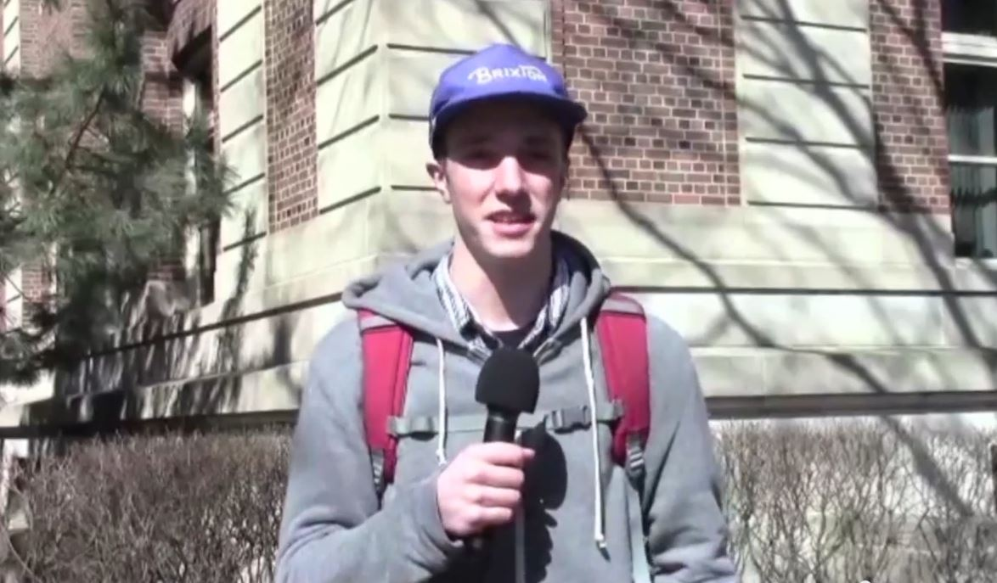
University of Minnesota Students Share their Textbook Stories:
https://youtu.be/fpFPP9m_nug?t=1h27m30s
David Ernst, from the ALG Symposium on the Future of the Textbook

Slide 9
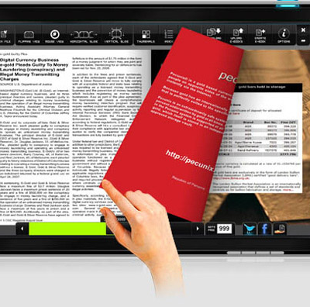
The State of Georgia’s FY 2015 and FY 2016 budgets fund a new USG initiative, Affordable Learning Georgia (ALG), which focuses on reducing the cost of textbooks and the enhancement of GALILEO, Georgia’s Virtual Library and ALG’s parent initiative.

Slide 10
USG Improving Access and Affordability
Interest on the part of the Governor and Chancellor in reducing the overall costs of higher education.
ALG is part of other efforts that the System in undertaking, including consolidations, shared services, more effective use of facilities, improved stewardship of existing resources, etc.
These efforts in the context of Complete College Georgia:
Georgia must produce an additional estimated 250,000 graduates in upcoming years.
Under the direction of Governor Nathan Deal’s Complete College Georgia initiative, the University System of Georgia and the Technical College System of Georgia address this critical need in Georgia’s Higher Education Completion Plan for 60 institutions of higher education to rapidly increase the proportion of young adults with a certificate or degree, while maintaining a commitment to quality.
Accountability, performance, and college readiness and access.

Slide 11
RPG =
Retention
Progression
Graduation
Research is beginning to demonstrate that early and low-cost access to textbooks can improve RPG
Retention, Progression, Graduation

Slide 12
Affordable Learning Georgia Is…
What is ALG?
A one-stop service to help USG faculty and staff identify lower-cost, electronic, free, and open educational resources (OER), building on the cost-effective subscription resources provided by GALILEO and the USG libraries and a partnership with CSU. www.affordablelearninggeorgia.org
Programs to support more affordable learning materials, including campus advocacy and faculty development, partnerships with University presses, bookstores, and national leaders in OER, grants for textbook transformation, and a partnership with eCore, the University System’s core curriculum taught completely online.
An initiative of the University System of Georgia and GALILEO, Georgia’s Virtual Library. www.galileo.usg.edu

Slide 13
ACTIVITIES AND STRATEGIES
Goals and Programs:
Advocacy
Partnerships for Quality
Bookstore program
Symposium on the Future of the Textbook
OER for Top Fifty Courses
OER for eCore
OER Textbook Transformation Grants: working with campuses

Slide 14
Scale: eCore Partnership
By the end of FY16, a zero-textbook-cost solution for The University System’s core curriculum taught completely online.
eCore transitioned 10 courses to use no-cost, open resources in FY14
ALG is supporting the transition for 15 additional eCore courses to use no-cost, open resources in FY15 and 6 in FY16.
Validation of quality at scale
Rapid results
Total Projected enrollments FY15-16: 27,295
Total Projected Savings FY15-16: $2,729,500

Slide 15
Textbook Transformation Grants
Round 1
Fall 2014: 30 proposals from 19 USG institutions were awarded grants to transform individual courses in Spring 2015
Round 2
Spring 2015: 27 proposals from 16 USG institutions were awarded grants, 10 to transform individual courses and 17 for at-scale transformations (multi-course, section, department-wide, etc.) in Summer 2015-Spring 2016
Total:
58 grants to faculty to transform their use of the textbook to no-or-low-cost materials, with more to come if funding continued in FY16.
Total projected enrollments FY15-16: 61,996
Total Projected Savings FY15-16: $6,450,612
Campus Choice:
Textbook Transformation Grants

Slide 16
Projected Totals for eCore and Grants funded in FY 15 for FY15-16
ENROLLMENTS: 89,291
SAVINGS FY15-16: $9,180,112
Combined Totals for
eCore and Grants

Slide 17
What are OER? But First… What is Open?
Open if:
You can access it at no cost
You can share it with no restrictions
You can transform it into something new
You can adapt and modify it for your students’ needs

Slide 18
Open Textbooks and Student Success
David Wiley on the Mercy College Developmental Math OER Project:
https://youtu.be/fpFPP9m_nug?t=1h43s
From the ALG Symposium on the Future of the Textbook

Slide 19
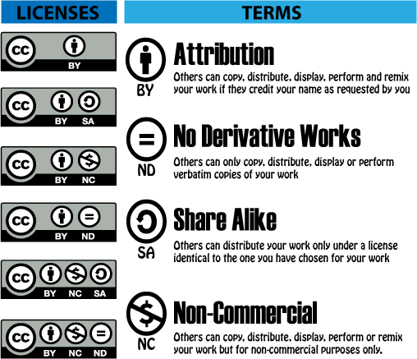
Creative Commons
Creative Commons licenses work within copyright law as permissions given by the creator of a work.
Image originally from http://education-copyright.org/creative-commons/ Site discontinued

Slide 20
Creative Commons
The easiest way to pick a license is to use this website:
http://www.creativecommons.org/choose/

Slide 21
Leading to Our Definition…
An open educational resource (OER) is any educational resource that is accessible, modifiable, adaptable, and shareable.
Open = Free + Legal Permissions
OER are largely made open through Creative Commons licenses or are in the Public Domain.

Slide 22
Evaluating OER
OER give you the opportunity to evaluate resources and modify them if you find there is a need. This differs from most commercial textbooks, where “what you see is what you get” without permissions to modify materials.
ALG has an evaluation criteria list on our site:
http://www.affordablelearninggeorgia.org/find_textbooks/selecting_textbooks

Slide 23
OpenStax College – Original, High-Quality
http://www.openstaxcollege.org/
Focused collection by Rice University’s OpenStax College
Double-Blind Peer Review for each textbook
Options for ordering print textbooks
Powerpoints and evaluations included, partnerships with homework providers (Sapling, WebAssign, etc.)

Slide 24
UMN Open Textbook Library – Mid-Size, Faculty-Reviewed
http://open.umn.edu/
Focused collection
Some peer reviews
Browsing by subject is much easier

Slide 25
MERLOT – Large, Diverse
http://www.merlot.org/
Many resources, a bit of “information overload”
Use the left column’s categories to filter your search
Sort your results by date

Slide 26
Not Just OER…
Library and GALILEO Resources
No-Cost-to-Students Materials
Not open, but at least free
Low-Cost Alternatives

Slide 27
Ask a Librarian!
Librarians are professionals at finding, providing access to, evaluating, and acquiring research and educational resources.
Many librarians have been at the forefront of Open Access and OER, and ready to help you transform your course!

Slide 28
Azell Francis, SGA President, Georgia Southern University:
https://youtu.be/fpFPP9m_nug?t=22m54s
From the ALG Symposium on the Future of the Textbook

Slide 29
Questions?

Slide 30
Thank You!
For more information:
http://www.affordablelearninggeorgia.org/

