Slide 1
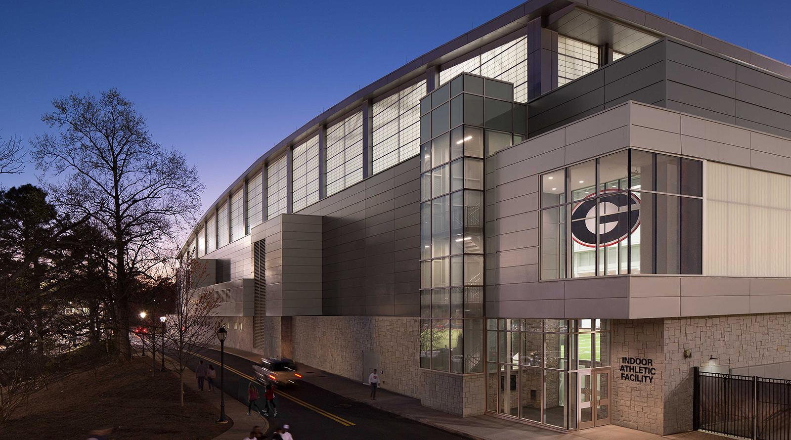
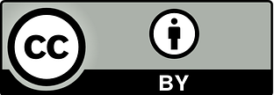
Note: This presentation uses the free, open “Titillium” font from https://www.fontsquirrel.com/fonts/Titillium. Please remove this text box when presenting.
OPEN,
EMPOWERED
An Introduction to OER and Grant Opportunities
Jeff Gallant,
Program Manager, Affordable Learning Georgia

Slide 2
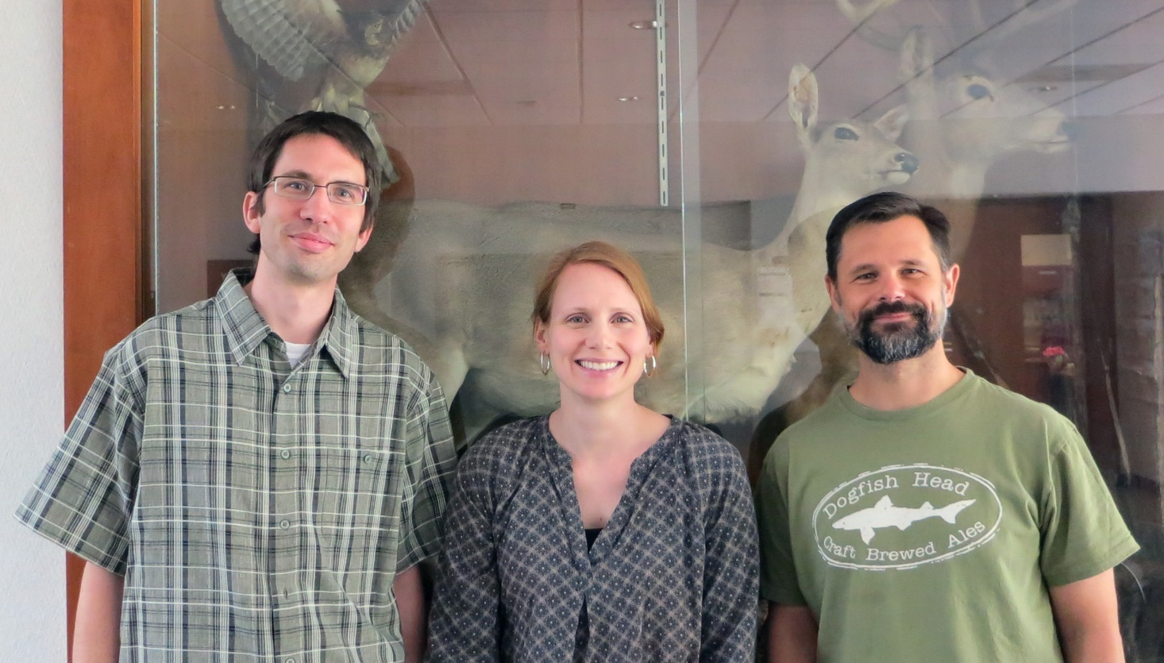
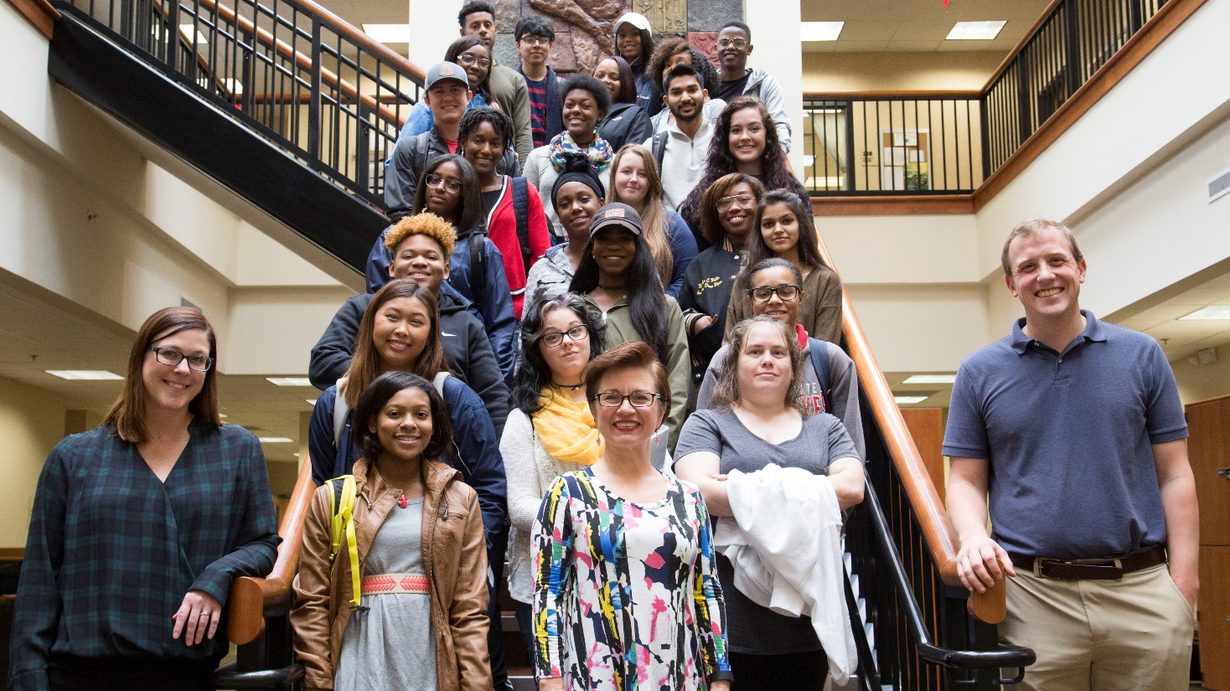
LET’S DISCUSS: PART I
Please tell us:
Your name
Your position (What do you teach? What do you support?)
What brings you to OER and affordable materials?

Slide 3
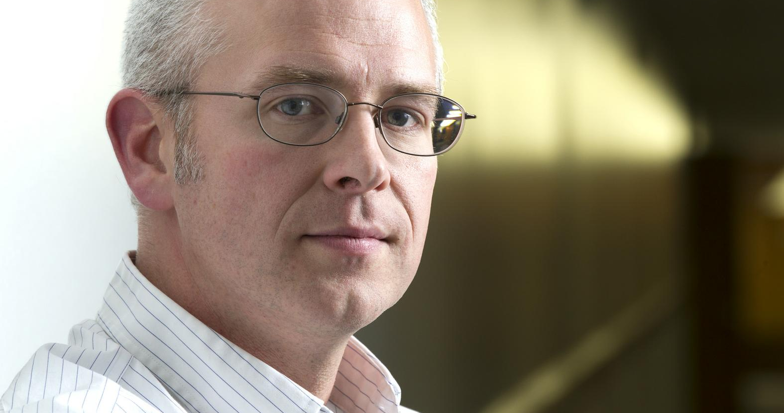
OPEN
CONTENT
David Wiley CEO/Founder, Lumen
“As long as everyone in the world has free permission to make copies of a resource and redistribute them, there will always be free access to that resource (so long as anyone cares about the resource).
As long as everyone in the world has free permission to make changes to and mashups of a resource, and reuse those however they choose, it will be possible for people to do things that were illegal / impossible / impractical to do before.”
https://opencontent.org/blog/archives/5463, CC-BY
Photo: https://about.me/davidwiley

Slide 4
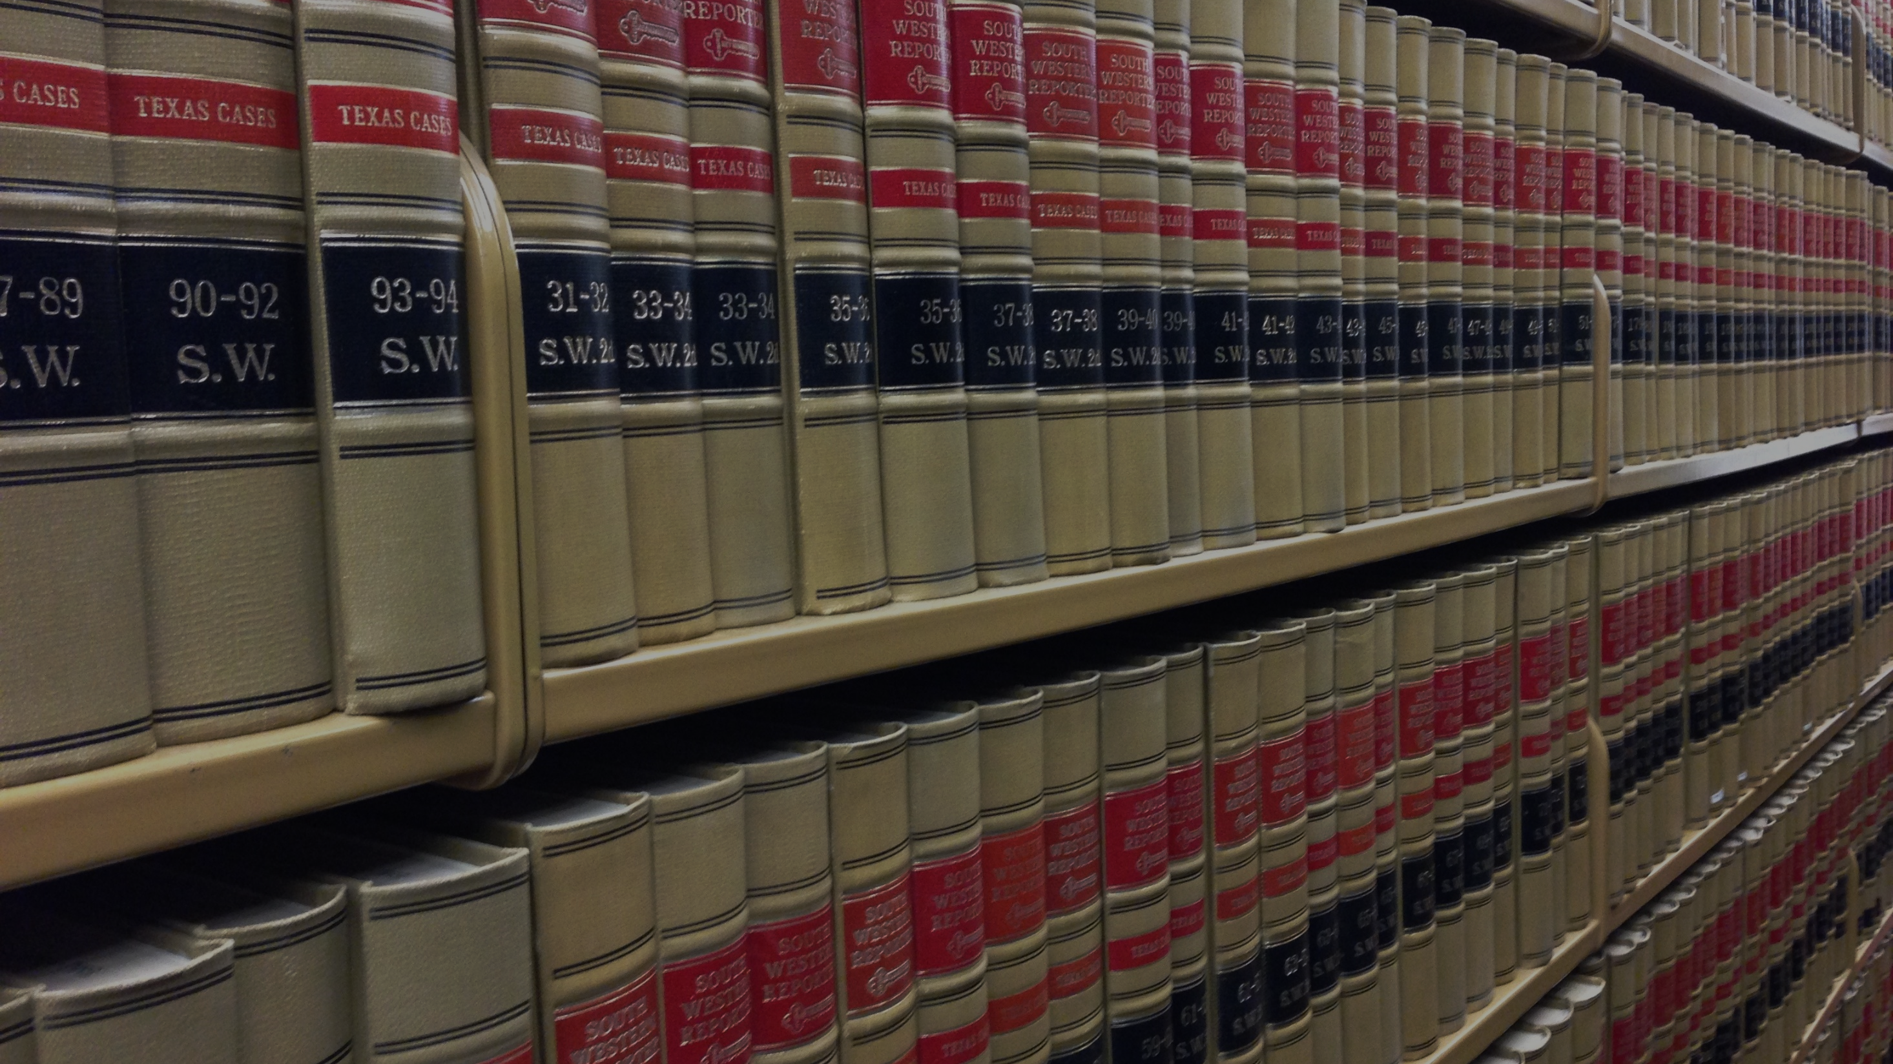

Notes:
Discussion about how we (as instructors) often break copyright law in order to teach the way we want to teach, but a truly open resource would allow this use, not put us at risk for lawsuits.

Slide 5
OPEN = FREE + PERMISSIONS
OPEN = ACCESS + POSSIBILITIES
Open resources afford creators and users these 5R Permissions:
RETAIN
REUSE
REVISE
REMIX
REDISTRIBUTE
You can keep any open resource. Access does not disappear.
You can use open content in a wide range of ways without restrictions.
You can adjust, modify, or alter the content itself to fit the needs of you and your students.
You can combine open content with other open materials, like a custom textbook or a mashup.
You can share copies of open content, including your revisions, with others.

Slide 6
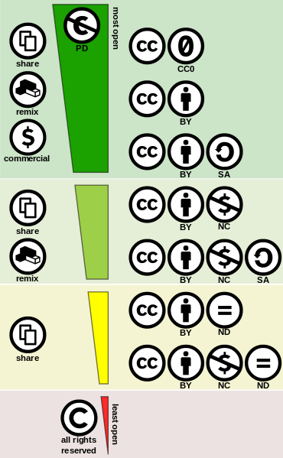
Through CC licenses, authors give everyone these 5R permissions with the following restrictions:
Attribution (BY): You must attribute the original work when you make a copy or a new work.
Share-Alike (SA): You must put the same license on your work.
Noncommercial (NC): You may not use works made with this work for profit.
No Derivatives (ND): You may not alter this work, only copy it.
  Do not use ND in education.
Creative Commons: Engine of Open Content

Slide 7

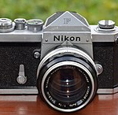
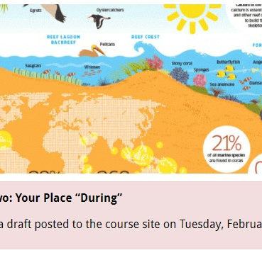
OER = OPEN + EDUCATIONAL RESOURCES
OPEN TEXTBOOKS
OPEN ANCILLARIES
OPEN ASSESSMENTS
Open resources that comprehensively cover the content of an entire course.
Student-facing materials which supplement the instruction of a course, such as lecture slides, videos, images, or audio recordings.
Assessments of student learning which are hosted and/or performed in public spaces

Slide 8
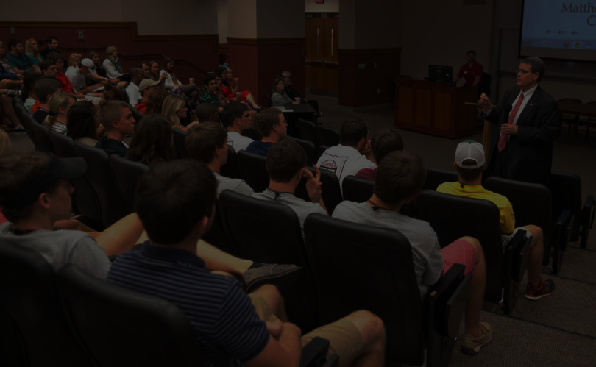
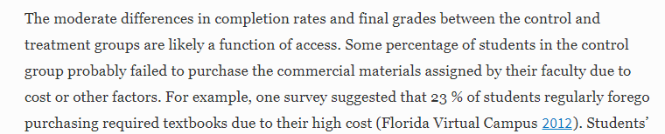
It’s about equity and access.
With OER, everyone in class has free and open access to the same educational materials on day one.
Fischer, L., Hilton, J., Robinson, T.J. et al. J Comput High Educ (2015) 27: 159. https://doi.org/10.1007/s12528-015-9101-x

Slide 9
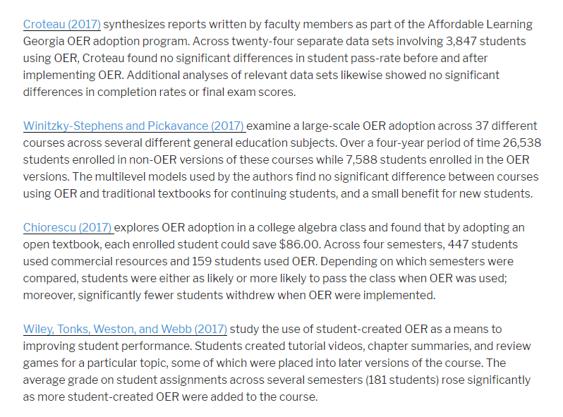
Research on OER is growing.
http://openedgroup.org/

Slide 10
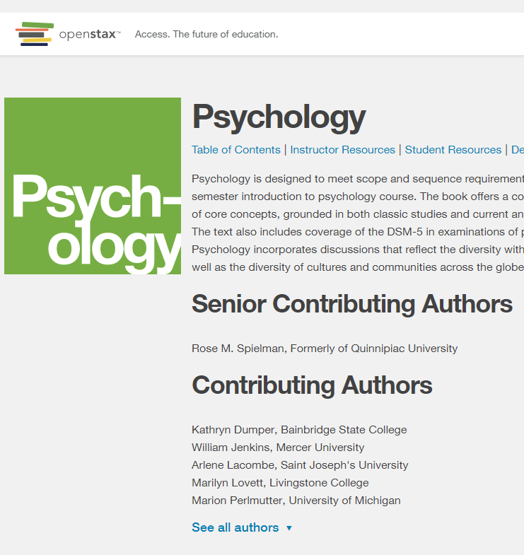
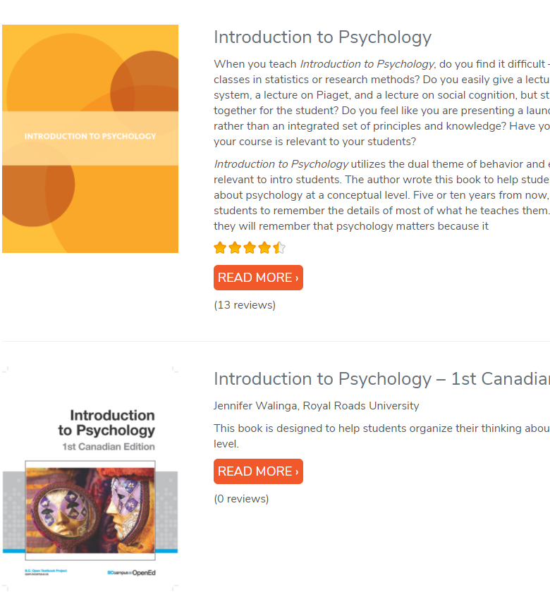
Finding OER: Starting Small
OpenStax: https://openstax.org/
Open Textbook Library: https://open.umn.edu/opentextbooks

Slide 11
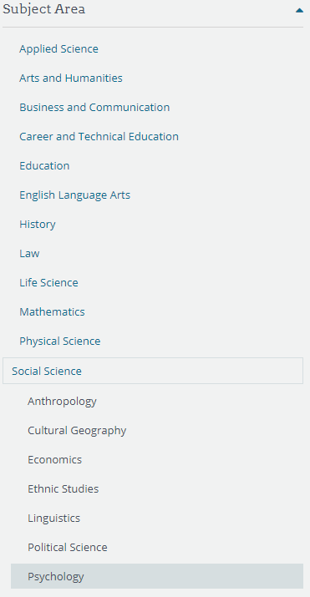
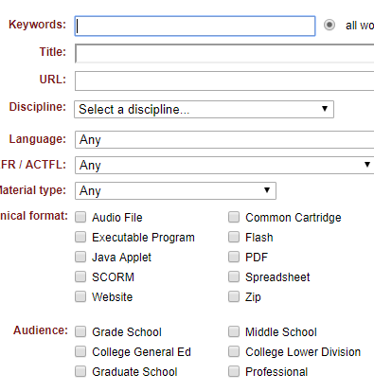
Finding OER: Ending Big
OER Commons: https://oercommons.org/
  Search in Social Sciences, possibly for a subject within a chapter in an open textbook or NOBA module
  Narrow the results by facets
SUNY OASIS: https://oasis.geneseo.edu/
  Narrow the results by type, subject, source, and even reviews

Slide 12
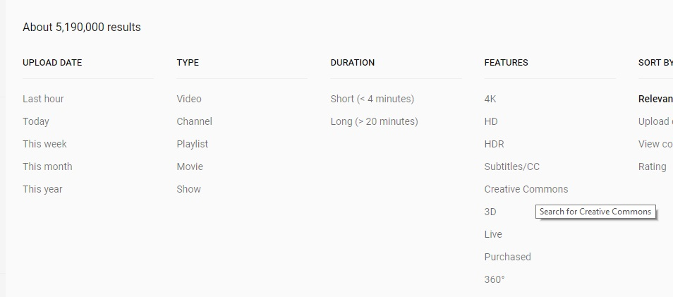
Creative Commons Filters on Common Websites
YouTube
Google Images
Flickr

Slide 13

What if my field doesn’t have comprehensive OER?
This is normal! OER are often funded to affect a large amount of students – many intro courses.
Consider remixing small OER into a larger resource if possible.
OER may not be available, but library resources could help.
Just like with research, congratulations – you have a publishing opportunity!

Slide 14
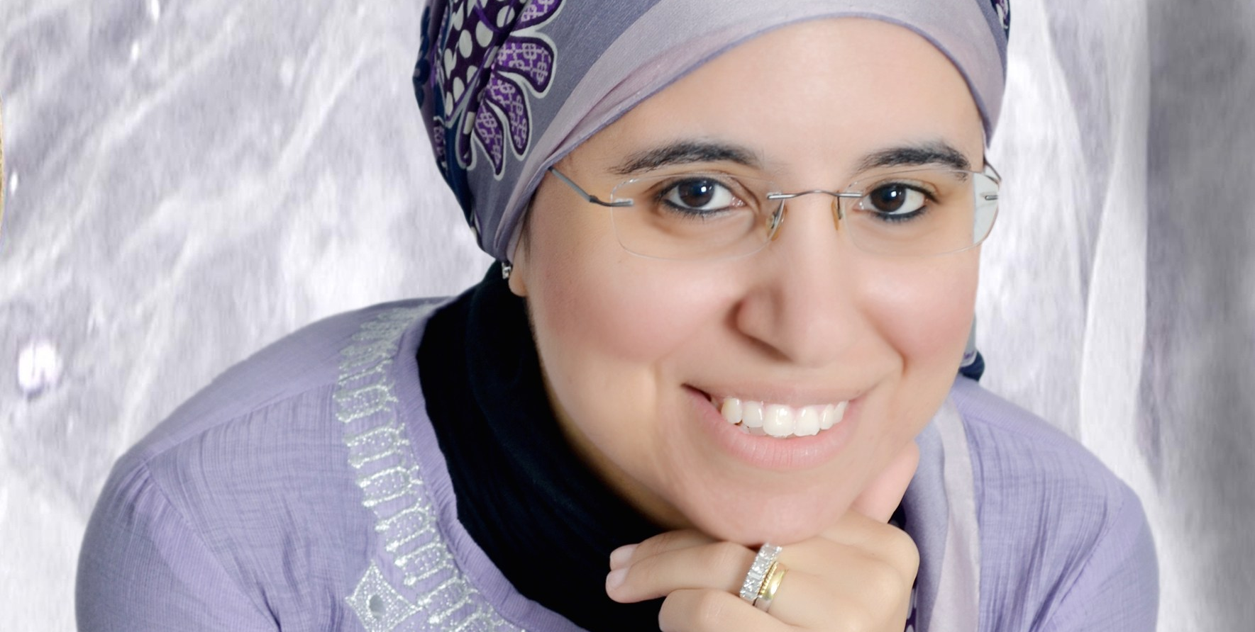
OPEN
PEDAGOGY
Maha Bali
Associate Professor of Practice,
American University in Cairo
OPEN
CONTENT
David Wiley CEO/Founder, Lumen
“I would say open pedagogy is an ethos that has two major components:
A belief in the potential of openness and sharing to improve learning
A social justice orientation – caring about equity, with openness as one way to achieve this.
…It’s someone who [is] open to making themselves vulnerable in the open for the purpose of supporting others”
https://www.yearofopen.org/april-open-perspective-what-is-open-pedagogy/

Slide 15
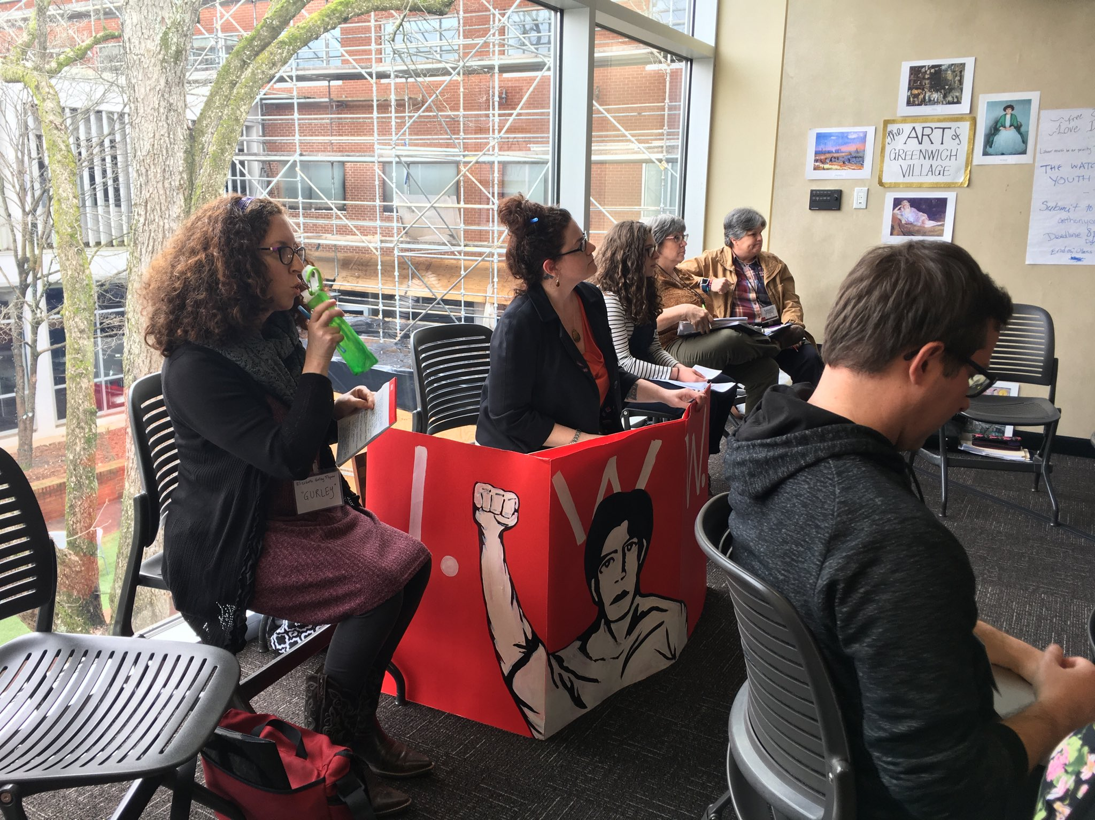
An Example of Openness, Sharing, and Vulnerability: Reacting Games and ALG
With OER, Reacting Games can
(legally) enable remixing and
customizing - making
teaching and historical
resources your own.
Photo from Dr. Peggy Elliott, Reacting Winter Conference 2019 at UGA:
https://twitter.com/ps_elliott/status/1086336782466199552

Slide 16

ALG is not a mandate.
Affordable Learning Georgia is encouraging the adoption, adaptation, and creation of OER by:
Building awareness (advocacy, events, visibility)
Providing support (time, infrastructure)
Using the power of a large system to build new OER, test / validate at a large scale, encourage team-based innovations

Slide 17
Textbook Transformation Grants: The Basics
Three different sizes (standard, large, mini)
Supporting faculty time, travel, materials, additional support, etc.
Proposals submitted, peer-reviewed, awarded
Contract is with institution, not individual
All USG institutions have been awarded grants

Slide 18
Apply for this grant if:
You have a small team of faculty ready to replace a commercial textbook with OER (Standard-Scale)
You have an entire department, or a team of faculty teaching more than 500 students, ready to replace a commercial textbook with OER (Large-Scale)
You are already using OER and you want to either revise the resources or create new ancillaries around them (Mini-Grant)

Slide 19
Getting Started
Join the ALG Newsletter list.
  http://affordablelearninggeorgia.org/newsletters
Form a team of transformers.
Do an initial OER / library / Web review.
Put together a plan.
Keep accessibility in mind (ADA compliance / S. 508).

Slide 20
When a New Round is Announced:
Read the RFP carefully.
Put the deadline and the Kickoff Meeting on your calendar.
Work with your team to apply.

Slide 21

We Have a Grant! Now What?
Project management is essential. Stick to the timeline, set measurable goals, and work together.
If possible, test out your OER in a pilot group.
If possible, test out any software in a ‘sandbox’ as both instructors and students.
Keep up-to-date on OER in your field. Do periodical searches with the bigger OER search tools.
Always keep accessibility in mind.

Slide 22
Our Grant is Finished! Now What?
Have a sustainability plan and stick to it.
If you are using links to materials on the Web, you will need to check these every semester.
Keep any timely materials up-to-date.
Work to improve the adaptability, accessibility, and usability of your resources.
Look toward expanding your resources and/or methods to more sections or more courses.

Slide 23
When in Doubt, Reach Out to your Champions and Coordinators!
http://affordablelearninggeorgia.org/about/
champions_coordinators/
Campus Champion: Megan Mittelstadt
Megan.Mittelstadt@uga.edu
Library Coordinators: Mariann Burright and Carla Buss
mariann@ung.edu
cbuss@ung.edu

Slide 24
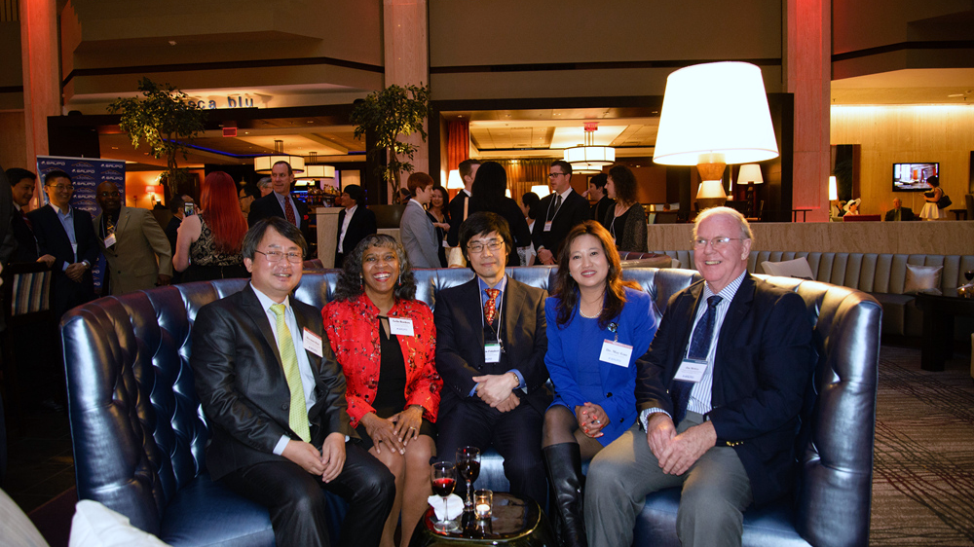
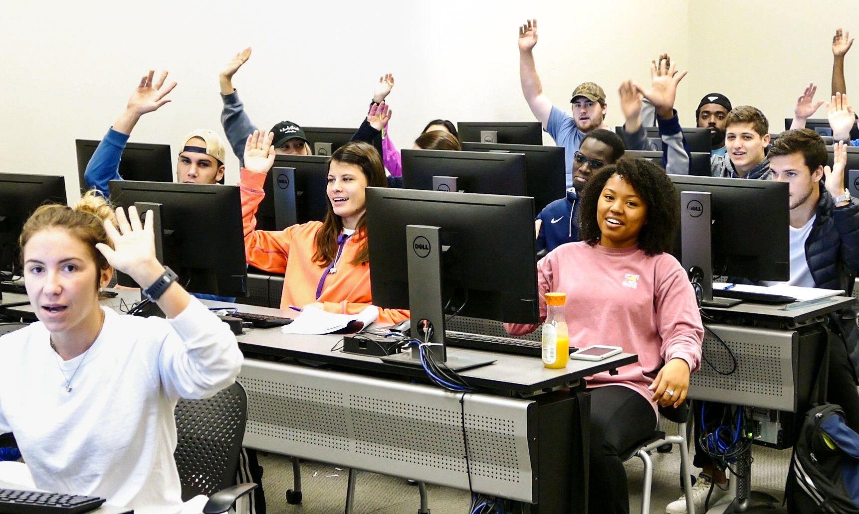
LET’S DISCUSS: PART II
Please tell us:
What do you plan to do with OER in the future?
If you could change something about the OER that exist right now, what would it be?
Any questions about all things Open?

Slide 25

Contact me:
jeff.gallant@usg.edu

